Slide 1
Sexual Misconduct Prevention Training
A New Program for International Scholars at the University of Delaware
Noemi Murphy
Assistant Director, Scholar Services
Office for International Students and Scholars
University of Delaware
www.udel.edu/oiss
Matthew McMahon
Sexual Violence Prevention Specialist
Student Wellness & Health Promotion
University of Delaware
www.udel.edu/studentwellness
Notice: This project was supported by Grant No. 2014-WA-AX-0011 awarded by the Office on Violence Against Women, U.S. Department of Justice. The opinions, findings, conclusions, and recommendations expressed in this publication/program/exhibition are those of the authors and do not necessarily reflect the views of the Department of Justice, Office on Violence Against Women.

Slide 2
Overview
UD International Community
Programs for International students
American culture
Campus Partnership
Project Design
Addressing cultural considerations
Implementation and Logistics
Assessment

Slide 3
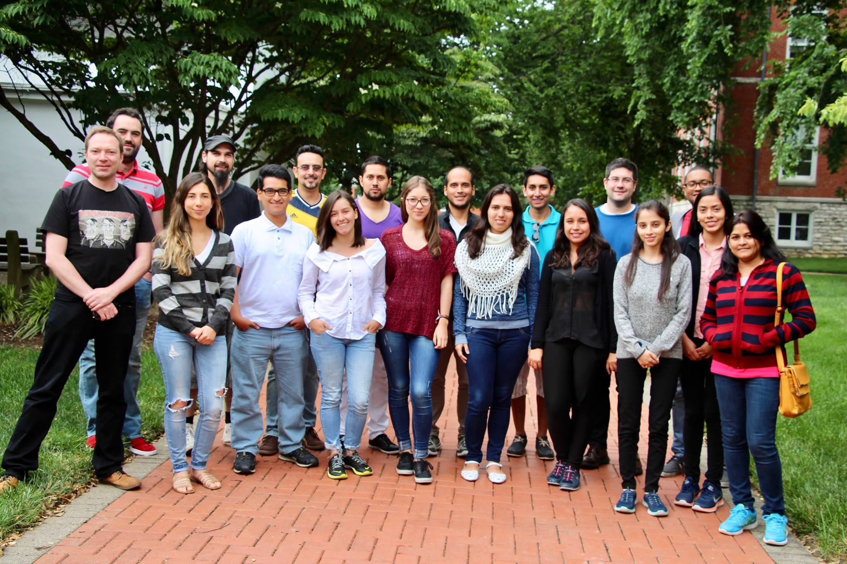
UD International Community
2015-2016 Academic Year
Total Number: 5,552
F-1 and J-1 Students: 4,486
J-1 Scholars: 412
H-1B employees: 67
F-2 and J-2 dependents: 587
98 different countries
China (60%)
Saudi Arabia (6.2%)
India (6%)
International Scholars
Fall 2016 → 3.6% increase from 2015
2016-2017: 558 J-1 Exchange Visitors
Notes:
OISS works with key campus and community stakeholders to provide opportunities for cross-cultural interactions and global engagement and contribute to the University’s campus internationalization efforts. With a long tradition of hosting international visitors, UD continues to attract a number of talented exchange visitors that help enrich the campus with increased cultural diversity and global awareness.
The Exchange Visitor Program at UD brings short-term scholars, researchers, professors, and international students to campus for, research, teaching, and study. One of the main responsibilities of OISS is to ensure that the university is operating in compliance with Department of State regulations.
OISS commits intentional resources and staffing to develop and maintain an annual schedule of programs and activities for international exchange visitors and their families at UD. In partnership with campus units and organizations in the Greater Newark Area, the international scholar population gets the opportunity to engage in programs that support the office’s internationalization efforts.

Slide 4
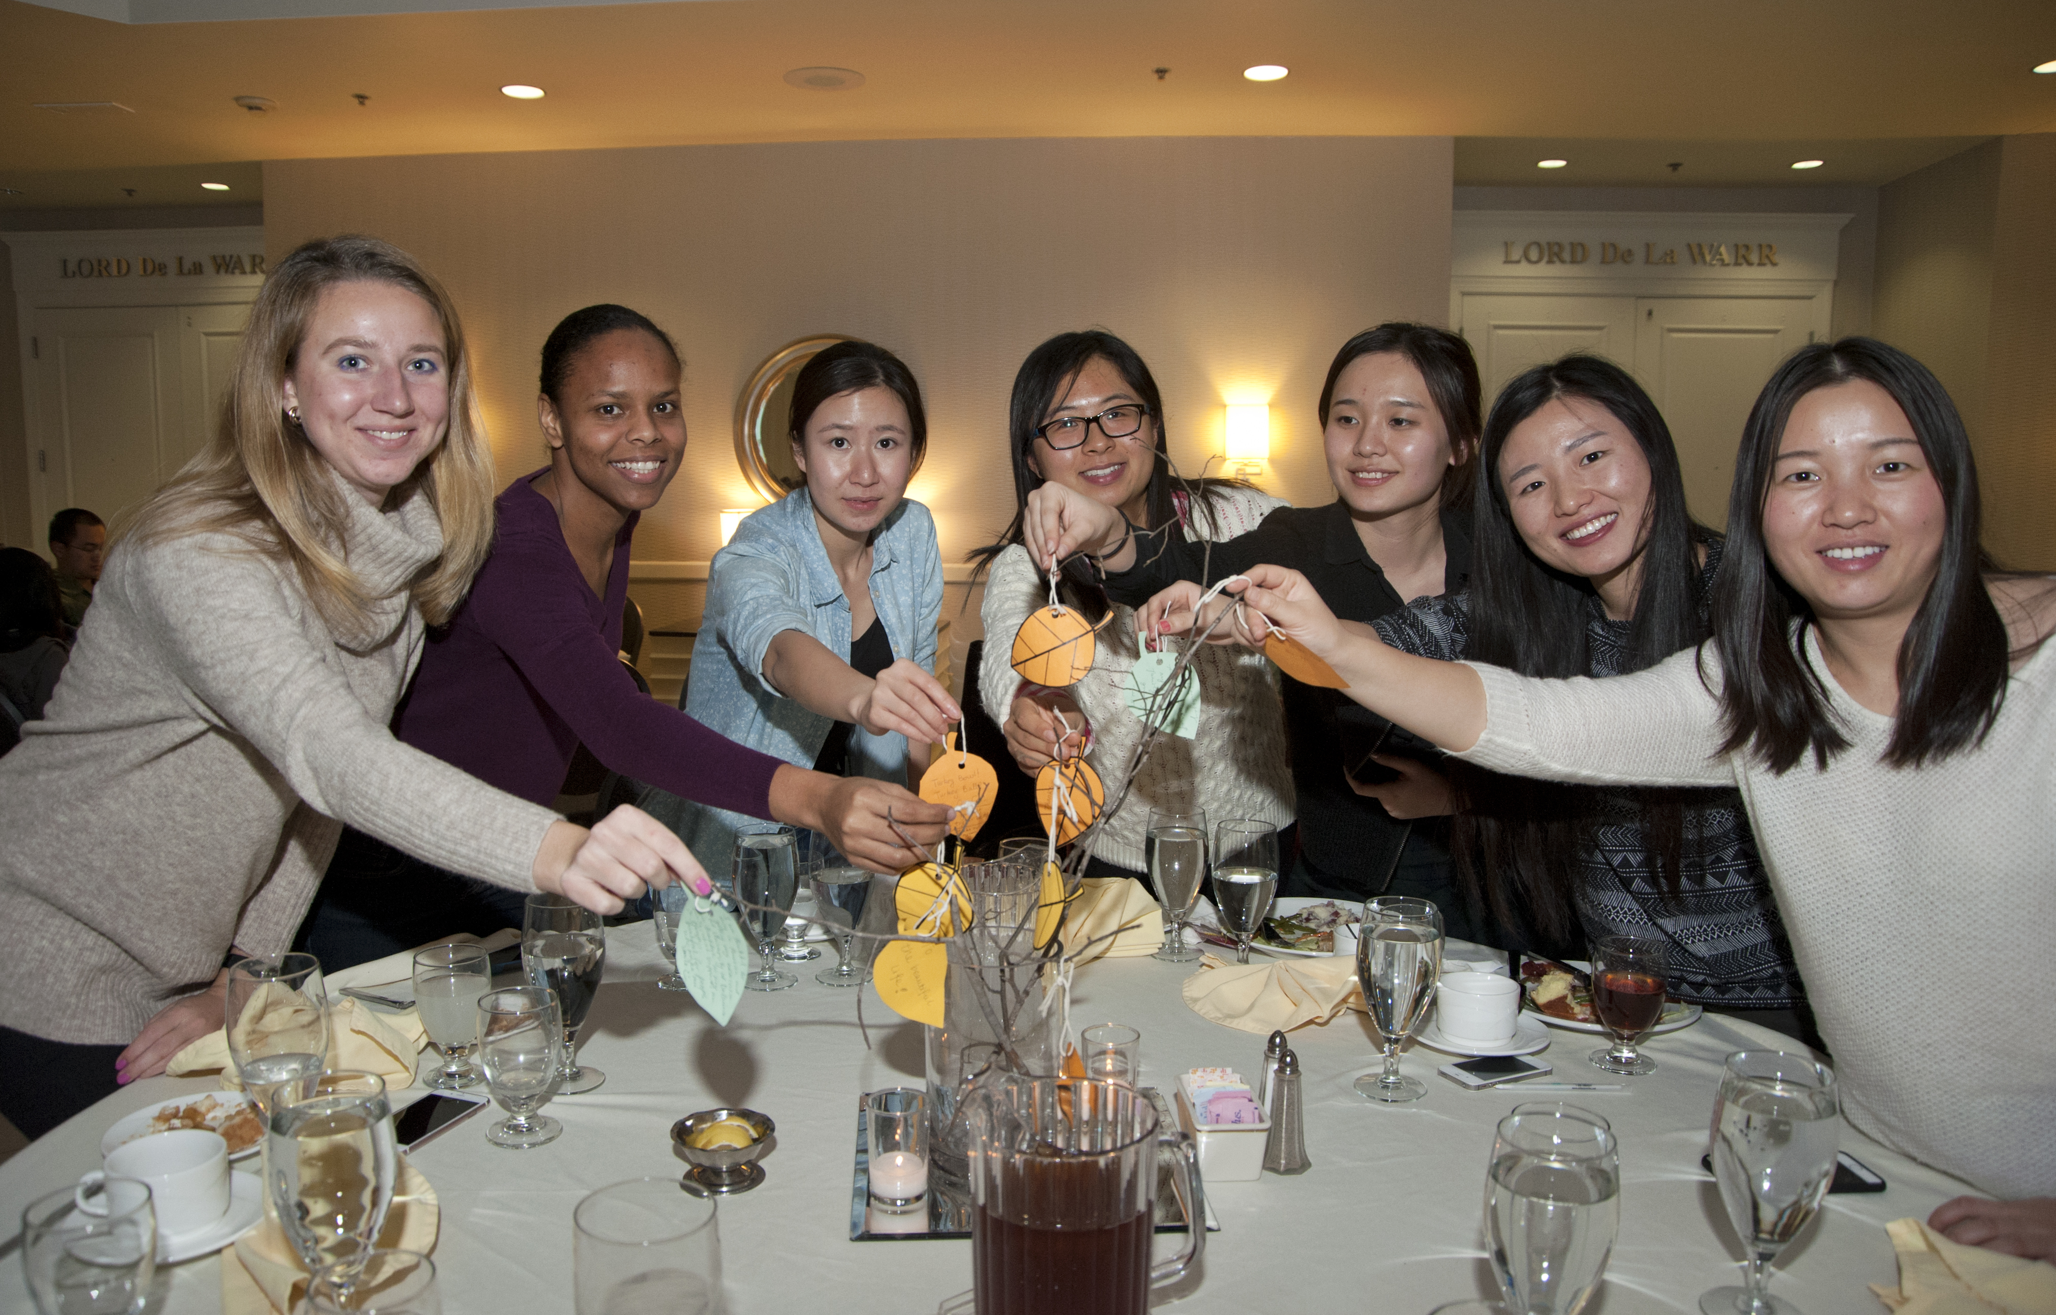
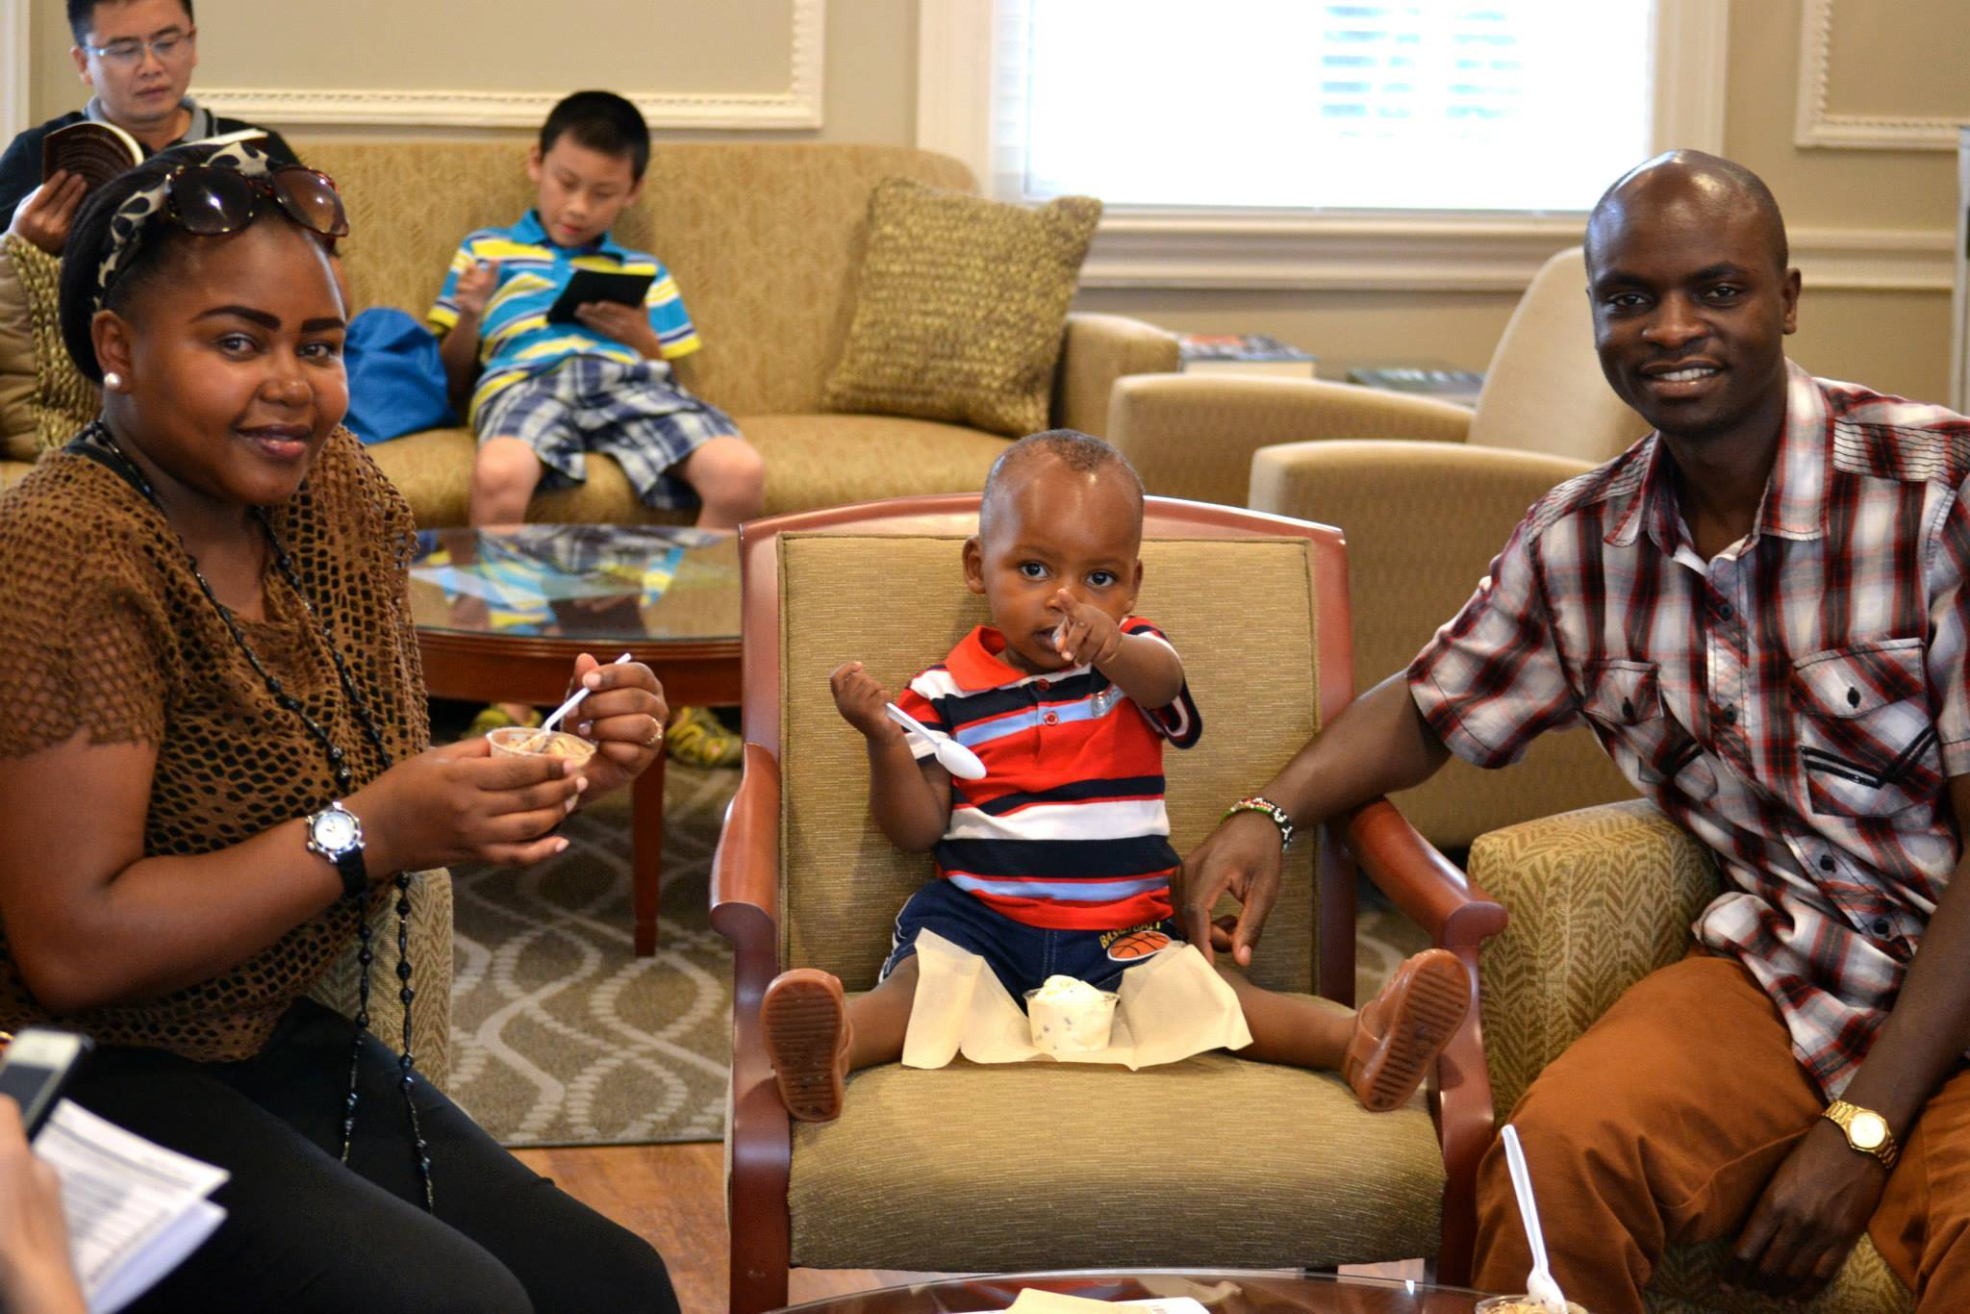
Our Programs during the year!
Immigration Compliance
International Understanding
Connect with the Community
Academic Success
International Caucus
Notes:
Why is it important that we do programming?
OISS welcomes opportunities to collaborate on programs to reach wider audiences. OISS strives to engage a wide variety of campus and community volunteers to participate in programs. With great access to international students and scholars as an international programming resource, OISS can play a helpful role for other offices around the university when they develop their own programs for internationalization.
Student experience, academic success, all the resources available to take advantage of so many things:
1. Programs to Support Academic Success
OISS recognizes the special needs of international students and scholars and should organize programs and activities to help students from abroad be academically successful.
2. Programs to Understand Government Regulations
All international students and scholars are in the U.S. temporarily for the purpose of study and research and have special responsibilities that accompany their non-immigrant status. OISS will conduct information programs regarding U.S. government regulations pertaining to immigration, visas and generally about working and living in the U.S.
3. Programs to Promote International Understanding
International students and scholars bring insights and perspectives that can contribute to learning about the ways of others. OISS will help to provide opportunities on campus and off for this learning to take place. This is one aspect of the internationalization of the university.
4. Programs to Connect to the Community
During the period of their studies at UD, international students and scholars are members of the Greater Newark community. As the primary contact office for international students at UD, OISS can play a leadership role in connecting our international visitors with resources in the community. These include cultural excursions, housing resources, connections to the community and the state
OISS programs and workshops for scholars
Monthly orientation
Weekly Coffee Hour
Thanksgiving Dinner with OISS
Ice Cream Socials
SSN trip
International Caucus
Field Trips
Annual Luncheon with City of Newark
What was missing?! → Culture Awareness and Title IX information.

Slide 5
Our goals
To educate about:
Individualism
Personal rights and responsibilities
Issues of inequality, gender-based violence, substance use and abuse, sexual wellness
Legal and immigration consequences
Provide resources
Notes:
Our goals:
To educate about individualism
To educate about personal rights and social responsibilities in American Culture most importantly, that everyone has a right to live the way they wish, but they have the responsibility to respect the way others’ live as well
To use the context of personal rights and social responsibilities to frame discussions about issues of inequality, gender-based violence, substance use and abuse, and sexual wellness
To explain that violating someone’s personal rights is not tolerated in the US could lead to legal and immigration consequences
To provide resources to students and scholars so they know where to go if they feel they have been victimized
INDIVIDUALISM: American’s are taught to “be yourself”
Being unique is embraced
Being independent is encouraged
Personal thoughts, ideas, and inventions are thought to be owned by an individual, not a group
Plagiarism – Using someone else’s thoughts, words or ideas as your own
Give credit to other individuals!
Noemi will talk more about how the cultures of our predominate sending countries (China, Saudi Arabia, South Korea, and India) either mirror or differ from American culture. She will set this up as a way for me to frame this conversation from an American perspective, emphasizing that there are many culture in the room and all cultures have varying thoughts/rules/beliefs around sex and relationships and that is OK, but this program is about what Americans value and expect around sexual behaviors.

Slide 6
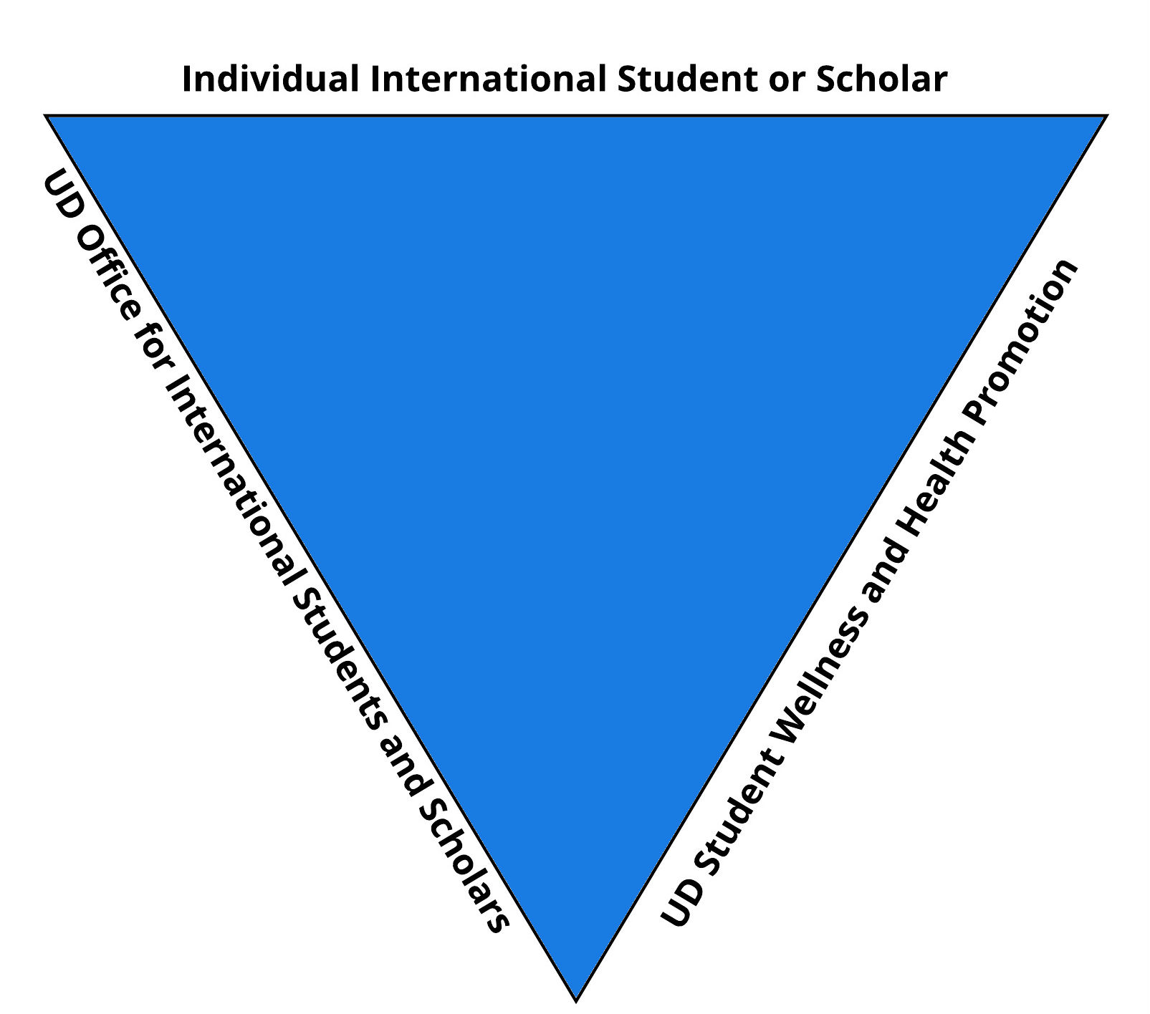
Campus Partnership
Notes:
Background and History of this project
Why was this program created?
Haven
Cultural differences surrounding expected romantic/sexual/social behavior
How did we get Admin Buy-In?
Partnership between OISS and SWHP
Partnership between SWHP and OEI
OEI charged with education of faculty and staff.
SWHP charged with education of students
Scholars fall outside those categories and the Title IX officer granted SWHP permission to develop and implement education for scholars
Why is this program co-presented by representatives of 2 different departments?

Slide 7
Implementation
What are the Logistics?
Who?
Facilitators:
Part I = Assistant Director, Scholar Services, UD Office for International Students and Scholars
Part II = Assistant Director, Scholar Services, UD Office for International Students and Scholars Sexual Violence Prevention Specialist, UD Student Wellness and Health Promotion
Audience:
Newly arrived International Scholars
N=300+ annually
When?
Schedule:
Part I = Once a month
Part II = Once a semester, once over winter session, and once over the summer (4 times per year)
How Long?
Part I = 60 minutes
Part II = 60 minutes: 15 minutes for OISS; 40 minutes for SWHP; 5 minutes for questions
Notes:
Here we will also talk about how we intend to get scholars to attend the workshops.

Slide 8
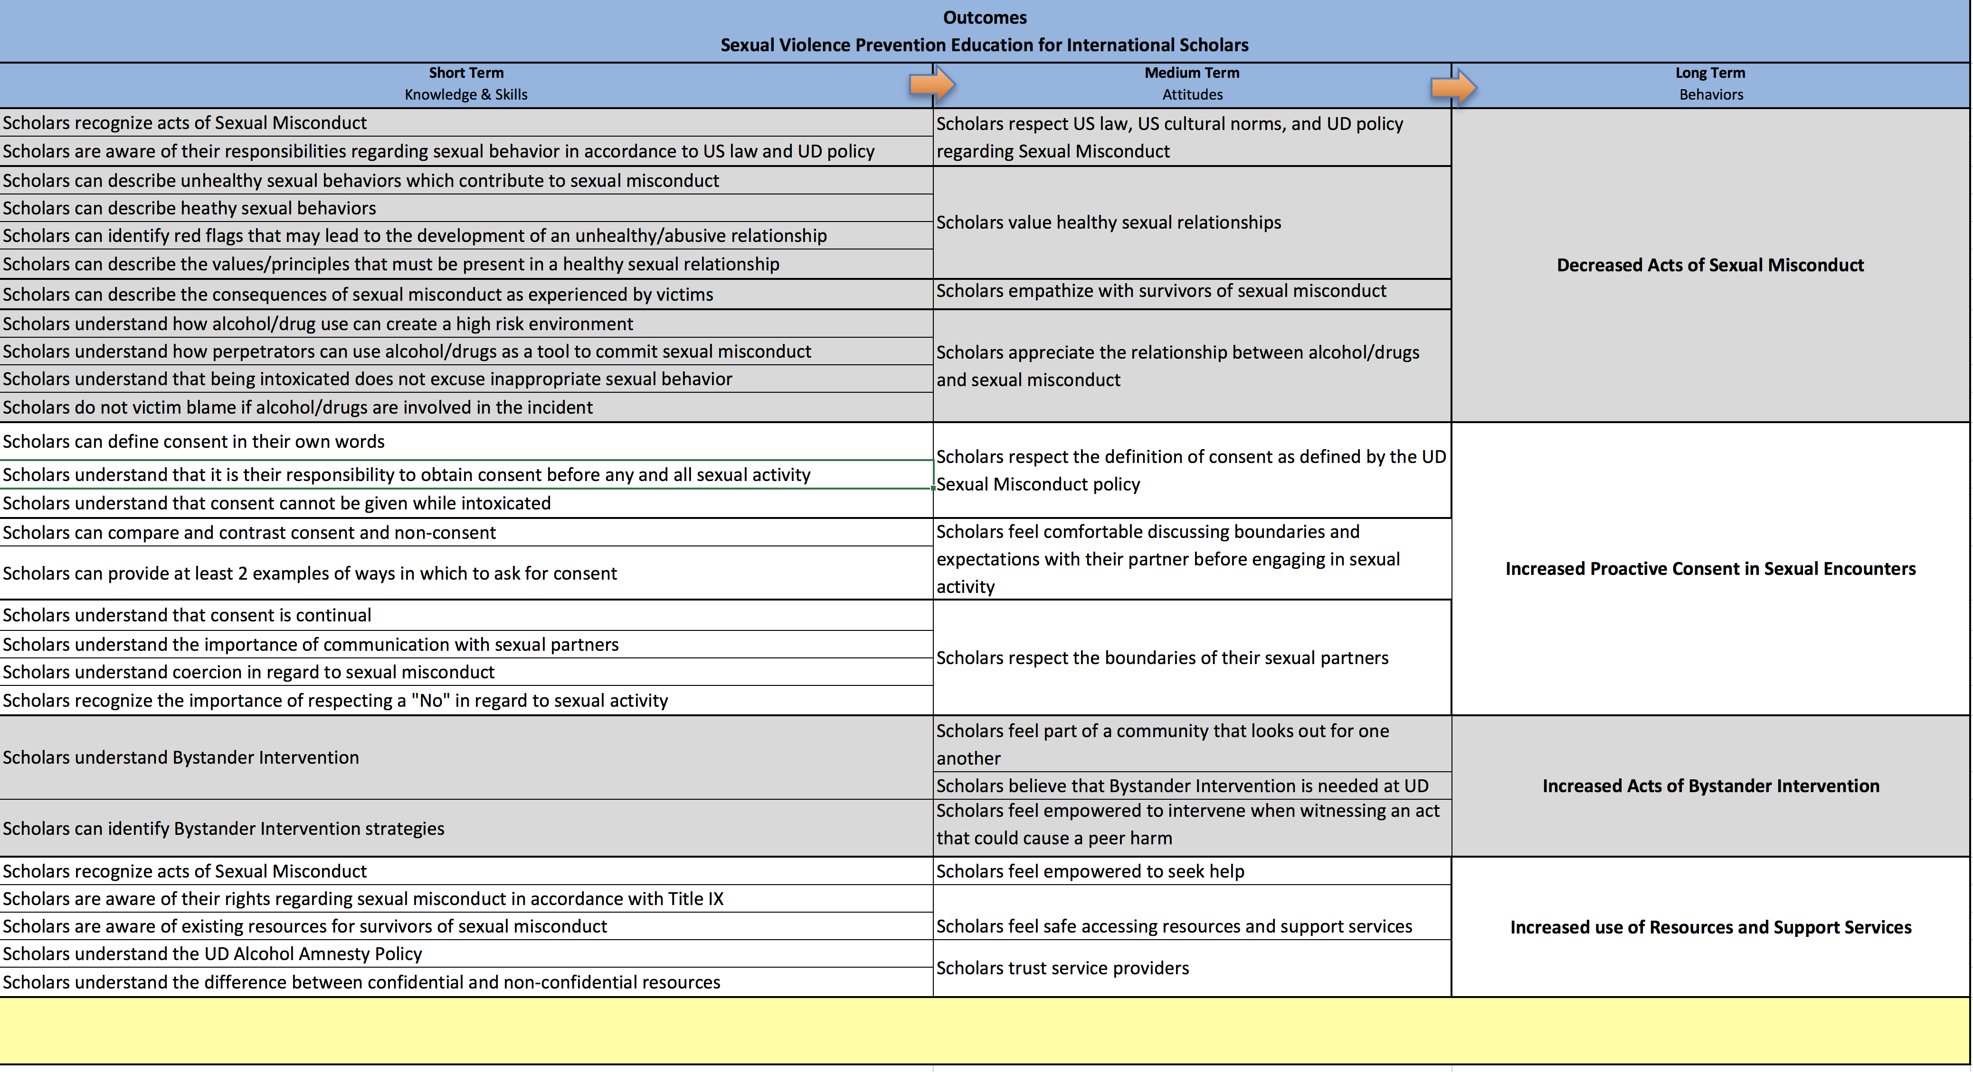
Logic Model
(In my perfect world)

Slide 9
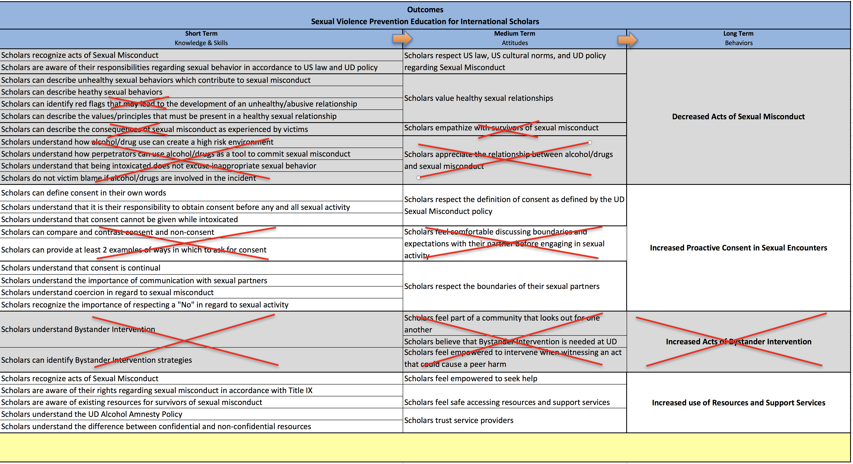
Logic Model
(Considering Constraints)

Slide 10
Outcomes
Decreased Acts of Sexual Misconduct
Scholars respect US law, US cultural norms, and UD policy regarding sexual misconduct
Scholars recognize acts of sexual misconduct
Scholars are aware of their responsibilities regarding sexual behavior in accordance to US law and UD policy
Scholars value healthy sexual relationships
Scholars understand how unhealthy sexual behaviors contribute to sexual misconduct
Notes:
Attitudes & Beliefs (long term) This program is not meant to reach this goal, but the start laying the foundation so that scholars can begin working towards this goal
Knowledge and Skills, these are more likely to be achieved with this program. These are the goals of the workshop.

Slide 11
Outcomes
Increased Proactive Consent in Sexual Encounters
Scholars respect the definition of consent as defined by the UD Sexual Misconduct Policy
Scholars understand consent as defined by the UD Sexual Misconduct Policy
Scholars understand that consent cannot be given while intoxicated
Scholars respect the boundaries of their sexual partners
Scholars understand their responsibility to obtain consent before any and all sexual activity

Slide 12
Outcomes
Increased use of Resources and Support Services
Scholars feel empowered to seek help
Scholars recognize acts of sexual misconduct
Scholars feel safe accessing resources and support services
Scholars are aware of their rights regarding sexual misconduct in accordance with Title IX
Scholars are aware of existing resources for survivors of sexual misconduct
Scholars trust service providers
Scholars understand the UD Alcohol Amnesty Policy
Scholars understand the difference between confidential and non-confidential resources

Slide 13
Learning Objectives
How will scholars demonstrate these behaviors?
What is the ultimate goal of this program?
Scholars can define acts identified as sexual misconduct (sexual assault, sexual harassment, dating and domestic violence, and stalking)
Scholars can define consent in their own words
Scholars can describe their responsibility to obtain consent
Scholars can explain why consent cannot be given by a person intoxicated by alcohol and/or drugs
Scholars can describe unhealthy sexual behaviors which contribute to sexual misconduct
Scholars can identify 2 of the 4 values / principles that must be present to achieve a healthy sexual relationship
Scholars can describe the UD Alcohol Amnesty Policy
Scholars know how to access policies and laws regarding sexual misconduct
Scholars can identify at least 2 confidential resources
Scholars can describe the difference between confidential and non-confidential resources
Notes:
How will scholars demonstrate this behavior?
Fix last column
Noemi, this is all for the second part; please feel free to add any for the first session.

Slide 14
Program Structure
Rights, Responsibilities, and Resources
Part I
Noemi’s Part (45 minutes)
Introduction to sexual misconduct (5 minutes)
Brief overview of sexual harassment, dating and domestic violence, stalking, and sexual assault
Brief introduction of rights and responsibilities. Introduction to Title IX
Brief introduction to consent
Notes:
Noemi will use this time as an orientation to UD, and to the United States. She will focus on immigration regulations, support services offered by OISS, various OISS programming, legal status and compliance with US law and UD policy. She will also focus on understanding American culture, specidically from the lends of individualism.
She will also deliver crucial content related to sexual violence. She will discuss Title IX, confidential and non-confidential resources; she will introduce the UD sexual misconduct policy and define all actions related to it; she will also define consent and expand on the UD policy as well as Delaware state laws.

Slide 15
Program Structure
Rights, Responsibilities, and Resources
Part II
Expected Behavior in the US (Personal Responsibilities)
Understanding acts of Sexual Misconduct (as a perpetrator)
Understanding consent
Understanding mandatory reporting (as a responsible employee)
US Cultural Norms around Relationships (Personal Rights)
Understanding acts of Sexual Misconduct (as a victim)
Understanding what American culture deems as healthy and unhealthy aspects of a relationship
Resources for victims of Sexual Misconduct (Resources)
Understanding the UD Alcohol Amnesty Policy
Understanding the difference between confidential and non-confidential resources

Slide 16
Program Outline
Introduction and explanation as to why this workshop is being given
Background on the relationship between OISS and SWHP
Definition of “personal responsibilities”
Introduction to the term “sexual misconduct”
Definition and explanation of sexual harassment
Definition and explanation explanation of stalking
Definition and explanation of relationship violence
Definition and explanation of sexual assault
Introduction to the concept of consent
Planned Parenthood “How do you know if someone wants to have sex with you” video
Definition and explanation of consent
Group activity: healthy and unhealthy behaviors in relationships
Discussion on personal rights
Explanation of mandatory reporting and confidential vs non-confidential resources
Discussion how to get help for you or a friend (available resources)
Group activity: recap of rights and responsibilities
Notes:
The question that I ask myself in the design process is: How will scholars demonstrate this behavior?
Once I can answer that question, I can begin to design a program with content that deliberately provides the education needs for the audience to acquire the desired skills.

Slide 17
Cultural Considerations
Many cultures in the same room
Gender issue
Taboo subject matter
Language barrier
Notes:
We will talk about how we deal with these considerations.

Slide 18
Design
Creative Solutions
Cartoon depictions
Visuals help overcome issues with language barrier
Emojis are universal and accessible. Brings an appropriate lightness to a somber subject matter.
Video
Visuals convey a more strong depiction of consent in an approachable manner
Closed Captioning provides another means to address the language barrier
Group Activity
Allows for conversation
Allows for in-the-moment assessment of learning

Slide 19
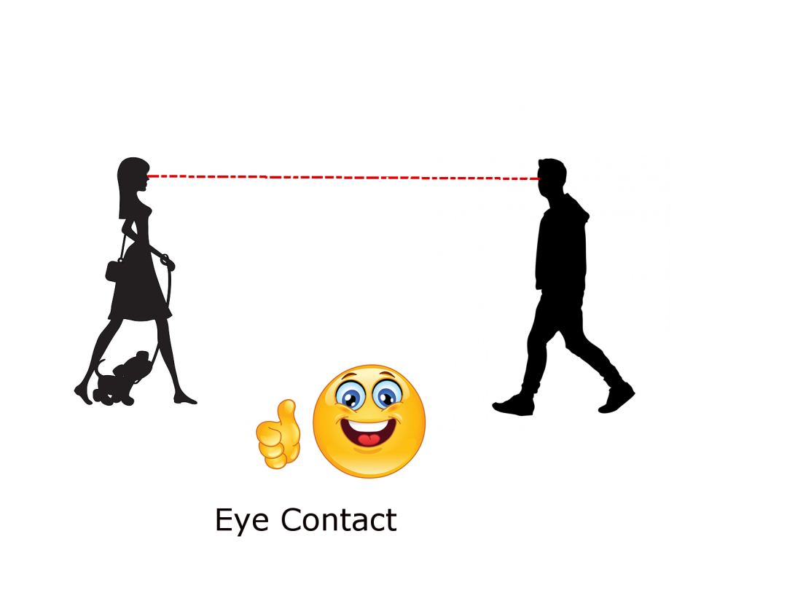
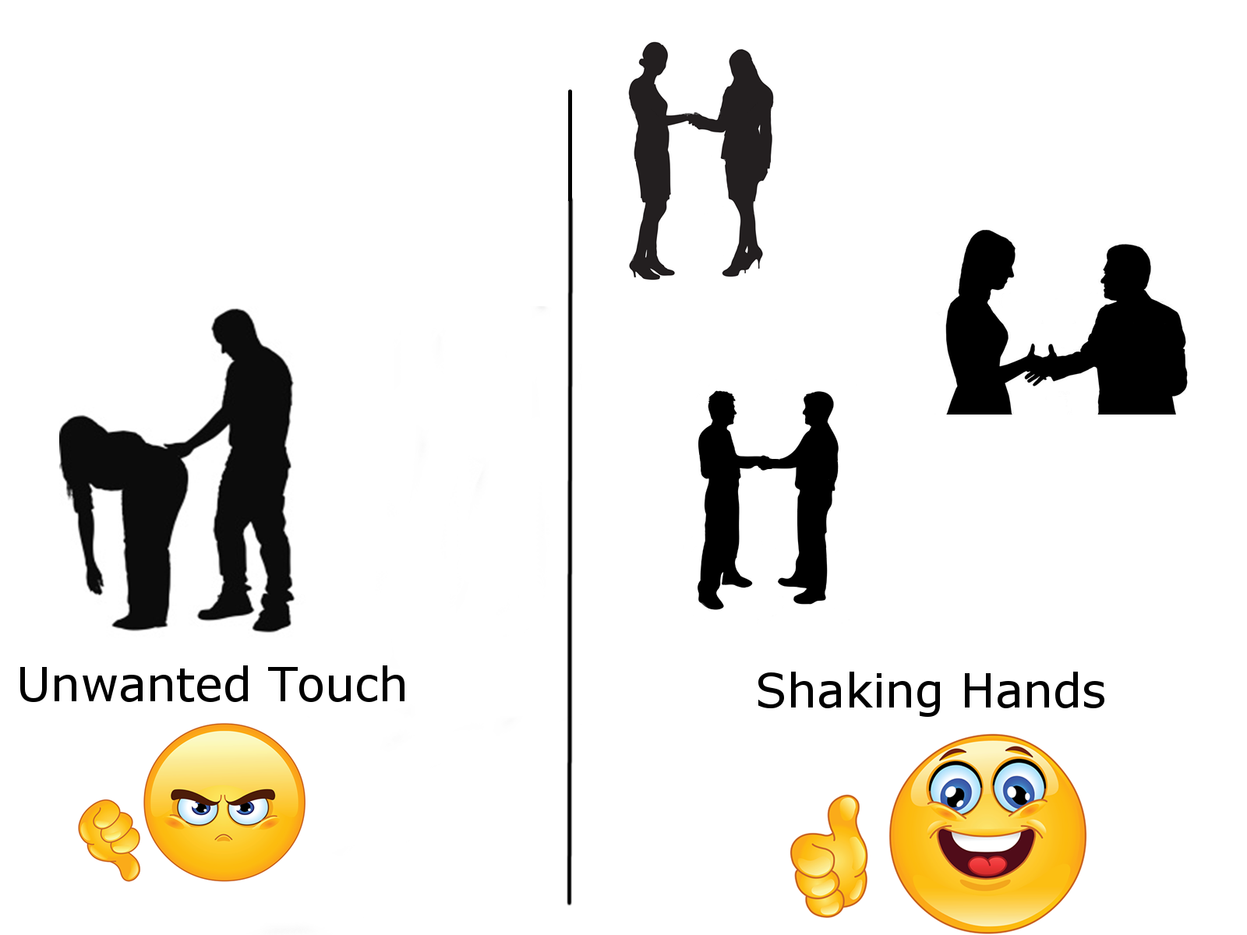
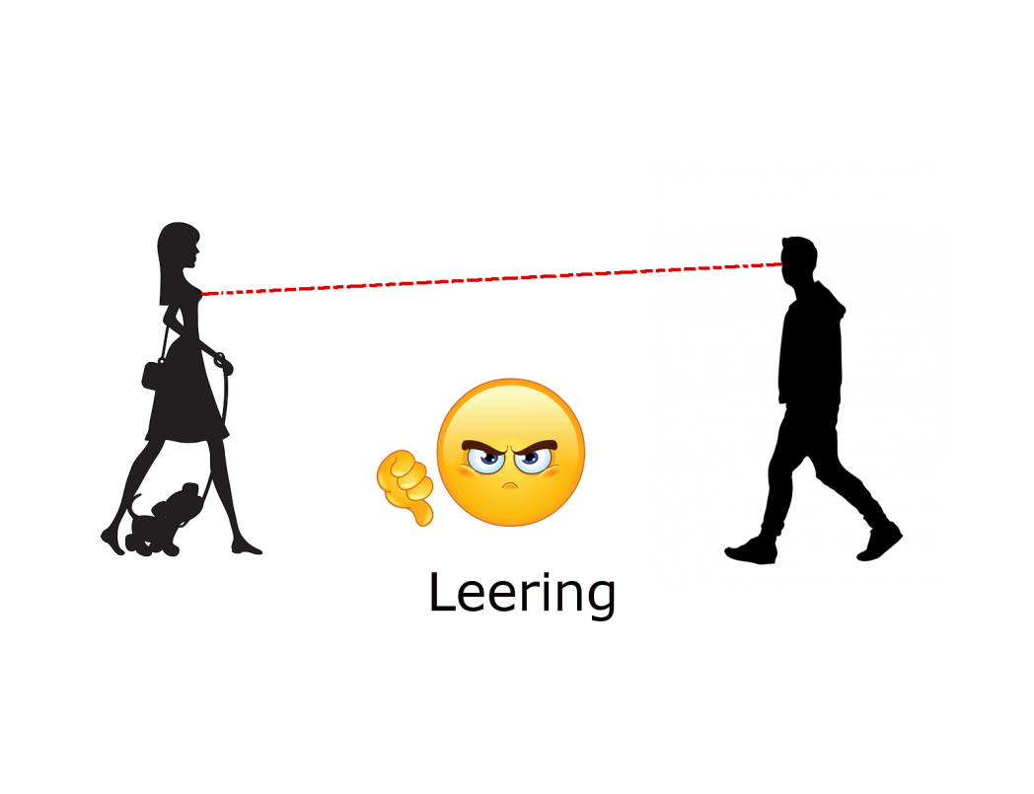
Sexual Harassment

Slide 20
Sexual Harassment

Slide 21
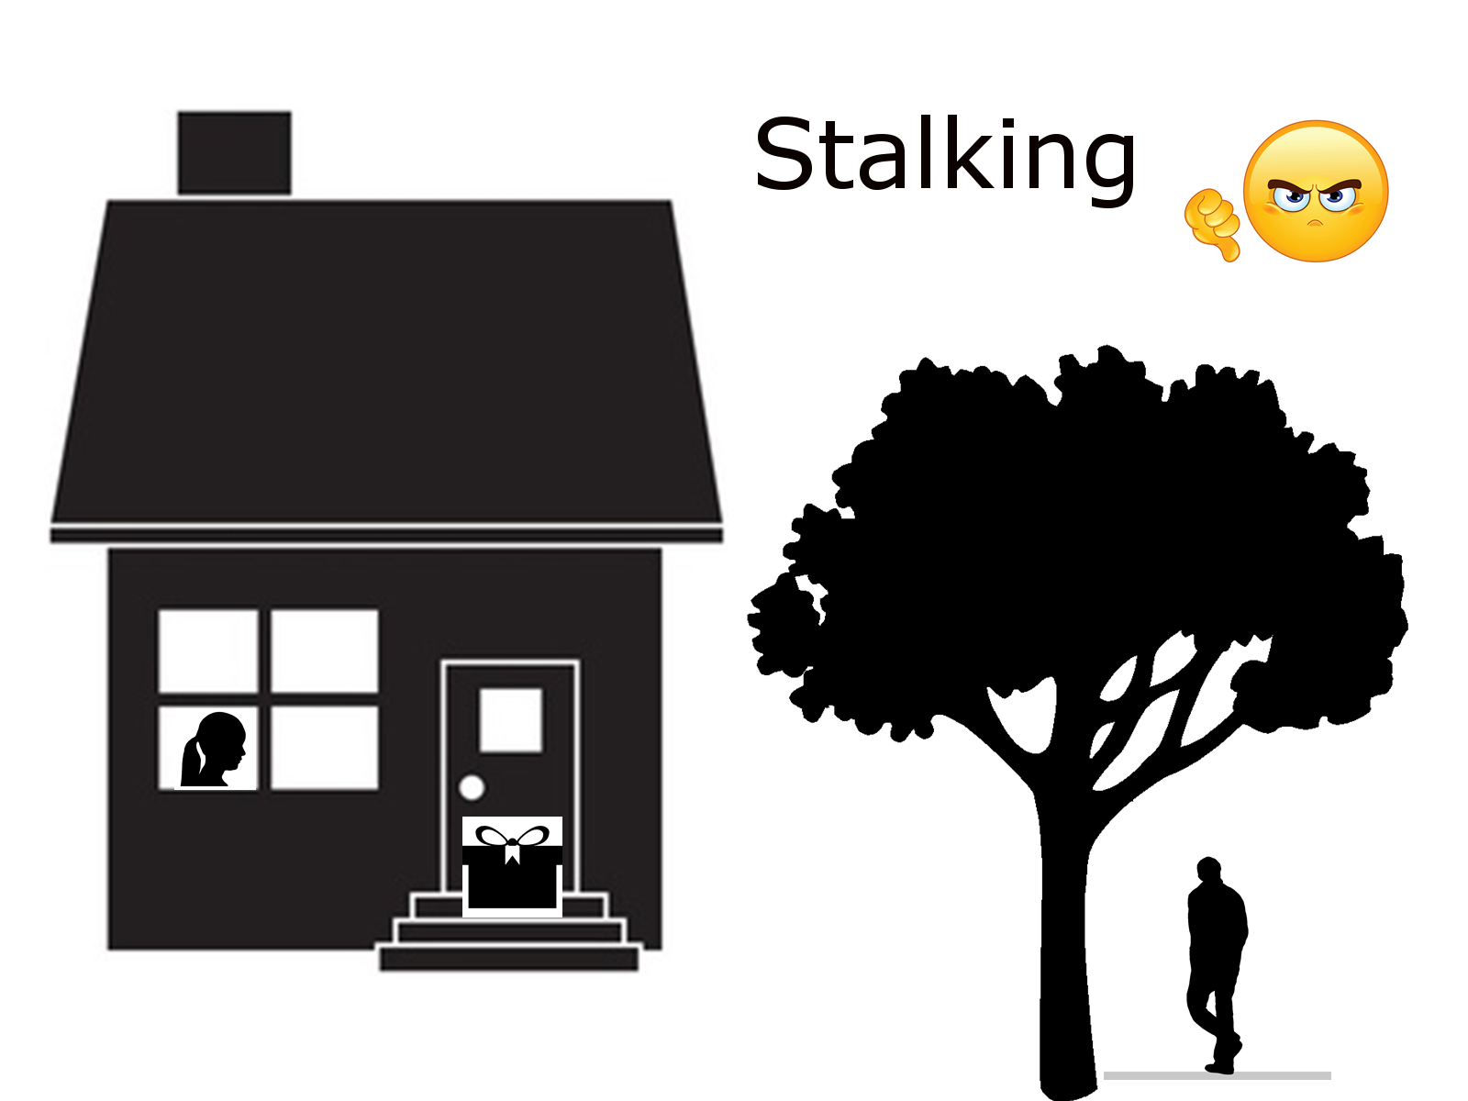
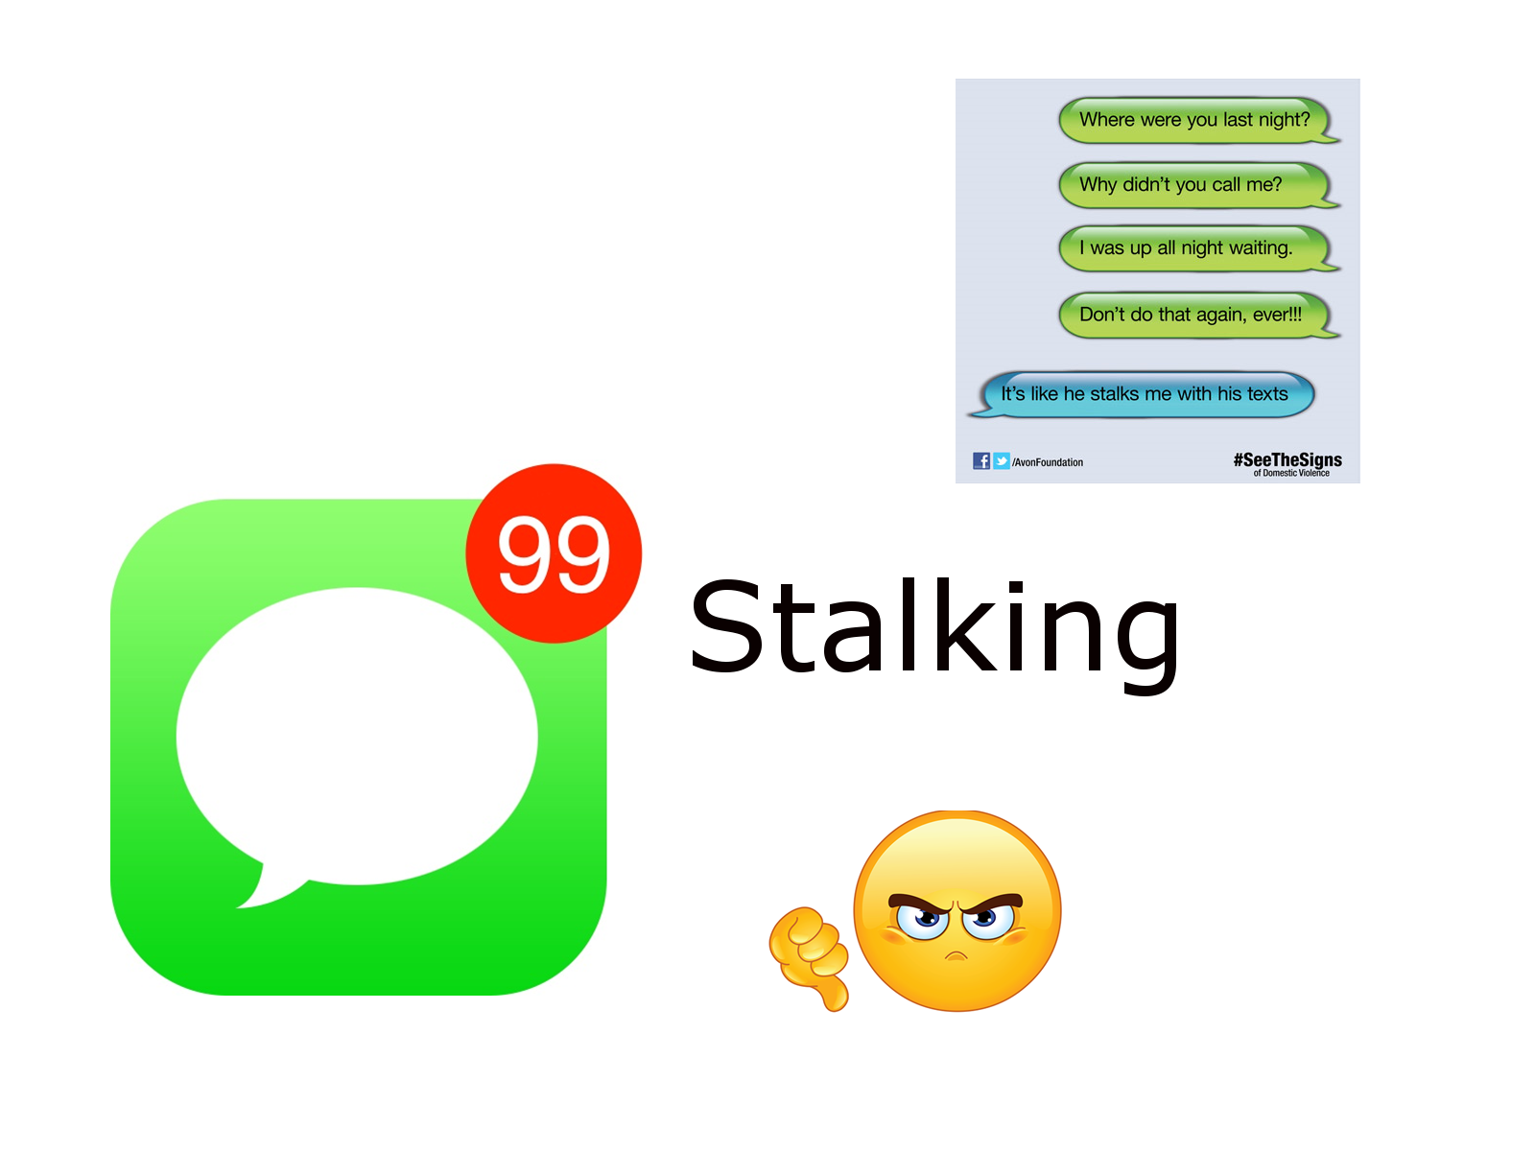

Slide 22
Activity
Healthy Behaviors
Unhealthy Behaviors
All partners are enthusiastic and enjoying the behaviors
Communication
Paying attention to body language
Asking for consent
Partner is free to say no
Sober
Being honest
Respectful
Partner is uncomfortable with what is happening
Silence
Not checking in with your partner
Not asking for consent
Coercion (Guilt or Pressure)
Intoxicated
Lying or manipulating
Disrespectful
Notes:
Have the participants name the behaviors and then once they have finished, click to bring up the correct responses on the screen.

Slide 23
Assessment
consent
85% of those attending the focus group responded when asked to define consent in their own words
100% of respondents accurately wrote in the definition of consent
62% of focus group members indicated “strongly agree” to understanding why consent cannot be given by a person incapacitated by alcohol and/or drugs. This coupled with the 38% who indicated “agree,” results in 100%.
92% of focus group members indicated “strongly agree” and 8% indicated “agree” to understanding their responsibility to ask for consent before engaging in sexual activity
Notes:
This assessment data comes from a focus group of 14 international scholars. Before we present this material to larger groups and make it mandatory, we wanted to get feedback from our scholar populations to see how this information resonates.

Slide 24
Assessment
Healthy Relationships
91% of respondents (100% of participants)accurately identified 2 of the 4 values/principles needed for a healthy relationship
100% of respondents (62% of participants) provided accurate answers to the question: “Please list 2 unhealthy relationship behaviors that contribute to sexual misconduct”
Notes:
This assessment data comes from a focus group of 14 international scholars. Before we present this material to larger groups and make it mandatory, we wanted to get feedback from our scholar populations to see how this information resonates.
The 4 values principles are: honest, responsible, equal, and respectful

Slide 25
Assessment
Confidential and Non-Confidential Resources
It is clear that we need to rethink the way that we teach this information.
Only 62% of focus group members responded to the question asking to differentiate between confidential and non-confidential.
Of those respondents, only 50% could answer the question accurately.
Notes:
This assessment data comes from a focus group of 14 international scholars. Before we present this material to larger groups and make it mandatory, we wanted to get feedback from our scholar populations to see how this information resonates.
In the future we will hand out resource cards that clearly define confidential and non-confidential resources along with what the reporting process looks like. The resource card will also provide the information on the “how to get help” slide.

Slide 26
Thank You!
Questions?

