Slide 1
FIN3000
Chapter 10
Some Lessons from Capital Market History

Slide 2
Overview: Chapter 10-12
Chapter 10
Chapter 11
Chapter 12
Some Lessons from Capital Markets History
Risk and Return
Cost of Capital

Slide 3
Chapter 10 Objectives
Learn how to calculate the return on an investment
Understand the historical returns on various types of investments
Introduction to the risk and return relationship
Overall concept
Understand the historical risks on various types of investments

Slide 4
Calculating Returns

Slide 5
Dollar Return
Total Dollar Return
The return on an investment measured in $
$ Return
Dividends
Capital Gains
=
+
Capital Gains
Price Received
Price Paid
=
-

Slide 6
Dollar Return: Example
You invest in a stock with a share price of $25
After one year, the stock price per share is $35
Each share paid a $2 dividend
What was your dollar return after one year?
$2
$10
$12
$35
$37
Notes:
Answer is C

Slide 7
Dollar Return: Example
You invest in a stock with a share price of $25
After one year, the stock price per share is $35
Each share paid a $2 dividend
What was your dollar return after one year?
$ Return
=
Dividends
+
Capital Gains
=
$2
+
($35-$25)
=
$2
+
$10
= $12

Slide 8
Percent Return
Total % Return
The return on an investment measured as a percentage of the original investment
% Return
$ Return
$ Invested
=

Slide 9
Percent Return: Example
You invest in a stock with a share price of $25
After one year, the stock price per share is $35
Each share paid a $2 dividend
What was your % return after one year?
8%
40%
48%
34.3%
5.7%
Notes:
Answer is C

Slide 10
Percent Return
Dividend Yield
D_{t+1}
P_{t}
D = Dividend
P = Price of Stock
t = time 0
Capital Gains Yield
P_{t+1} - P_{t}
P_{t}
% Return
=
Dividend Yield
+
Capital Gains Yield
D_{t+1} + P_{t+1} - P_{t}
P_{t}
=

Slide 11
Percent Return: Example
You invest in a stock with a share price of $25
After one year, the stock price per share is $35
Each share paid a $2 dividend
What was your % return after one year?
% Return
=
Dividend Yield
+
Capital Gains Yield
D_{t+1}
P_{t}
P_{t+1} - P_{t}
P_{t}
$2
$25
($35-$25)
$25
=
+
=
+
=
8% + 40%
= 48%

Slide 12
Historical Returns on Investments

Slide 13
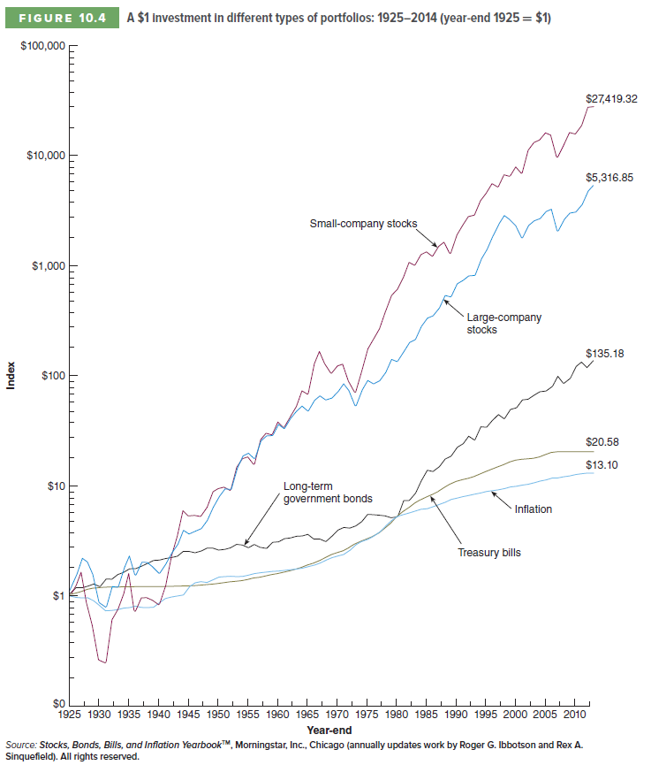
Historical Returns: 1926 to 2014
Small-company stocks
Large-company stocks
Index
Long-term government bonds
Inflation
Treasury bills

Slide 15
Computing Average Returns
Historical Average Return
Sum of Yearly Returns
# of Years
=
Historical Average Return
10.77
89 Years
Sum of the 89 years of returns per Table 10-1 (for Large Stocks)
=
= 12.1% per year

Slide 16
Average Returns: 1926-2014
Investment | Average Return
Large Stocks | 12.1%
Small Stocks | 16.7%
Long-Term Corporate Bonds | 6.4%
Long-Term Government Bonds | 6.1%
U.S. Treasury Bills | 3.5%
Inflation | 3.0%

Slide 17
Understanding Risk

Slide 18
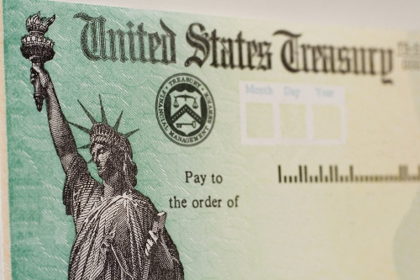
Understanding Risk
How would you classify the risk level (low, medium, high) of an investment in the following companies? Why?

Slide 19
Understanding Risk
Lowest Risk
Highest Risk

Slide 20
Understanding Risk
Why did you classify the investments in this manner from a risk standpoint?
Startup vs. established company
Dividend paying vs. not paying dividends
Volatility of returns
Historical track record
Level of certainty on the returns

Slide 21
Understanding Risk-Free Return
Is there an investment that has no risk?
Yes!
U.S. Treasury Bills
Note: While there is a remote possibility there could be risk with U.S. Treasury Bills, it is considered to be so small we consider it risk-free.

Slide 22
Understanding Risk-Free Return
Why are U.S. government Treasury bills considered risk-free?
Short time to maturity
Taxes can be raised to pay all of the government bills
Government can “print” money

Slide 23
Understanding Risk Premium
The excess return required from an investment in a risky asset over that required from a risk-free investment
Risk Premium
The risk premium can also be considered as the reward for bearing risk.

Slide 24
Question
If the US Treasury bills have an average return of 3.5% and large stocks have an average return of 12.1%, what is the risk premium for large stocks?
12.1%
15.6%
8.6%
Need more information
Notes:
Answer is C

Slide 25
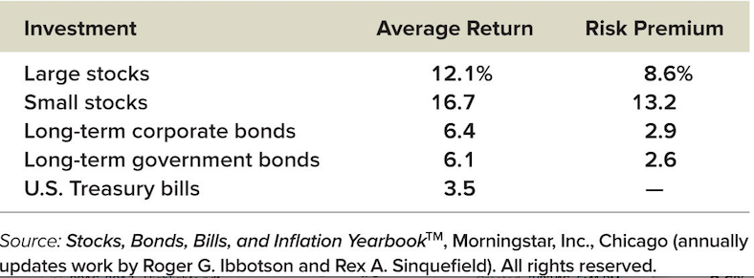
Historical Risk Premiums
All investments, other than a risk-free investment, will have a risk premium

Slide 26
Historical Risk Premiums
Lesson #1
Risky assets, on average, earn a risk premium
This is the reward for bearing risk

Slide 27
Historical Risk Premiums
What determines the relative sizes of the risk premium for the different assets?
This question is the heart of modern finance and the focus of next chapter
Part of the answer can be found by looking at the historical variability of the returns of different investments

Slide 28
Understanding Risk
Risk is measured by the dispersion, spread, or volatility of returns

Slide 29
Understanding Risk
Both Investment A and Investment B deliver an average of 5% return over 4 years. Which one is more risky? Why?
 | Investment A Annual Returns | Investment B Annual Returns
Year 1 | 6% | 15%
Year 2 | 4% | -10%
Year 3 | 3% | 20%
Year 4 | 7% | -5%
Average Annual Return | 5% | 5%

Slide 30
Understanding Risk
To understanding risk, it is critical to understand both of the following when it comes to returns on investments:
Average Returns
Volatility of Returns

Slide 31
Understanding Risk
Risk is measured by the dispersion, spread, or volatility of returns

Slide 32
Calculating Risk
Since volatility of returns is a key risk driver, we can better quantify risk by calculating volatility. There are statistical tools to do just this:
Variance
Standard Deviation
Common measure of return dispersion
Also called variability
VAR(R) or σ²
Square root of the variance
Sometimes called volatility
Same “units” as the average
SD(R) or σ

Slide 33
Return Variability
The statistical tools for historical returns:
Return variance: (“T" =number of returns)
Standard deviation
Copyright (c) 2017 McGraw-Hill Education. All rights reserved. No reproduction or distribution without the prior written consent of McGraw-Hill Education.

Slide 34
Calculating Historical Variance and Standard Deviation
Copyright (c) 2017 McGraw-Hill Education. All rights reserved. No reproduction or distribution without the prior written consent of McGraw-Hill Education.

Slide 35
Historical Data: 1926-2014

Slide 36
Historical Data: 1926-2014

Slide 37
Return Variability Review and Concepts
Normal distribution:
A symmetric frequency distribution
The “bell-shaped curve”
Completely described by the mean and variance
Historical returns on securities roughly approximate a normal distribution

Slide 38
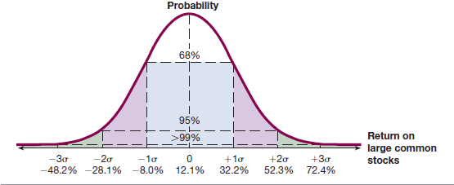
The Normal Distribution
An observation on a normally distributed random variable has a:
68% chance of being with +/- one standard deviation of the mean
95% chance of being within +/- two standard deviations of the mean
>99% chance of being within +/- three standard deviations of the mean
Illustrated returns are based on the historical return and standard deviation for a portfolio of large common stocks. Average return = 12.1%; Standard Deviation = 20.1%

Slide 39
Question
From 1926 to 2014, long-term corporate bonds had an average return of 6.4% with a standard deviation of 8.4%. What range of returns would you expect to see 68% of the time?
-14.8% to +14.8%
-10.4% to +23.2%
-2.0% to 14.8%
-8.4% to 8.4%
Notes:
Answer is C

Slide 40
Question - Answer
From 1926 to 2014, long-term corporate bonds had an average return of 6.4% with a standard deviation of 8.4%. What range of returns would you expect to see 68% of the time?
Range of returns = Mean +/- 1 Standard Deviation
= 6.4% +/- 8.4%
= -2.0% to 14.8%
Answer is C

Slide 41
Historical Risk Premiums
The greater the potential reward, the greater the risk
On average, bearing risk is rewarded
But, in a given year, there is a significant chance of a large change in value
Lesson #2

Slide 42
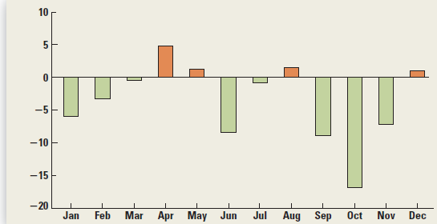
2008: S&P 500 Monthly Returns
Copyright (c) 2017 McGraw-Hill Education. All rights reserved. No reproduction or distribution without the prior written consent of McGraw-Hill Education.

Slide 43
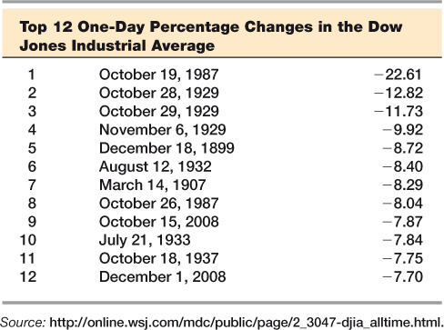
Record One-Day Losses
Copyright (c) 2017 McGraw-Hill Education. All rights reserved. No reproduction or distribution without the prior written consent of McGraw-Hill Education.

Slide 44
Question
Your 75 year-old grandparents ask you for advice on how they should invest their assets. What do you think is the best recommendation of the following choices?
100% Treasury bonds
100% corporate bonds
100% stocks
50% stocks and 50% corporate bonds
1/3 stocks; 1/3 corporate bonds; 1/3 Treasury bonds
Notes:
CML would pick E

Slide 45
Question
You are committed to contributing the maximum allowed to your 401(k) plan once you begin work upon graduation. What do you think is the best way to invest these funds of the following choices?
100% Treasury bonds
100% corporate bonds
100% stocks
50% stocks and 50% corporate bonds
1/3 stocks; 1/3 corporate bonds; 1/3 Treasury bonds
Notes:
CML would pick C

Slide 46
Question
You want to save for a down payment on a house purchase to be made in the next 3-5 years. What do you think is the best way to invest these funds of the following choices?
100% Treasury bonds
100% corporate bonds
100% stocks
50% stocks and 50% corporate bonds
1/3 stocks; 1/3 corporate bonds; 1/3 Treasury bonds
Notes:
CML would pick E

Slide 47
Geometric vs. Arithmetic Average
Returns

Slide 48
Question
What was the average annual return for this investment over 2 years?
75%
25%
0%
None of the above
Notes:
Both B and C are correct answers

Slide 49
Average Returns
$ Return
% Return
Average =
-50%+100%
2
Year 1
-$50
-50%
Year 2
+$50
+100%
= 25%
Cumulative
$0
0%
Arithmetic Average
Geometric Average

Slide 50
Arithmetic vs. Geometric Average
Arithmetic Average
Return earned in an average period over multiple periods
Answers the question, “What were your returns in an average year over a particular period?”
Geometric Average
Average compound return per period over multiple periods
Answers the question, “What has been your average compound return per year over a particular period?”
Geometric Average < Arithmetic Average
(unless all returns are equal)

Slide 51
Geometric Average Return: Formula
1/T
Where:
R_{i} = return in each period
T = number of periods
Copyright (c) 2017 McGraw-Hill Education. All rights reserved. No reproduction or distribution without the prior written consent of McGraw-Hill Education.

Slide 52
Calculating a Geometric Average Return
Arithmetic Average Return = 11.48%

Slide 53
Geometric vs. Arithmetic Average Returns: 1926-2014
Copyright (c) 2017 McGraw-Hill Education. All rights reserved. No reproduction or distribution without the prior written consent of McGraw-Hill Education.

Slide 54
Question
If you invested $1.00 (one dollar) 89 years ago and thought you were going to earn a return of 16.7%, but only earned a return of 12.2%, about how much less money did you earn compared to what you thought you would have earned?
$900
$9,000
$90,000
$900,000
$9,000,000
Notes:
$1 for 89 years at 16.7% is $931,765. (1.167)^89
$1 for 89 years at 12.2% is $28,142. (1.122)^89
Difference is $903,623
Answer is C

Slide 55
Review of Real vs. Nominal Returns

Slide 56
Inflation and Interest Rates
Real rate of interest
= Change in purchasing power
Nominal rate of interest
= Quoted rate of interest
= Change in purchasing power and inflation
The nominal rate of interest includes our desired real rate of return plus an adjustment for expected inflation
Copyright (c) 2017 McGraw-Hill Education. All rights reserved. No reproduction or distribution without the prior written consent of McGraw-Hill Education.

Slide 57
The Fisher Effect
The Fisher Effect defines the relationship between real rates, nominal rates and inflation
(1 + R) = (1 + r)(1 + h)
R = nominal rate (Quoted rate)
r = real rate
h = expected inflation rate
Approximation: R = r + h
Copyright (c) 2017 McGraw-Hill Education. All rights reserved. No reproduction or distribution without the prior written consent of McGraw-Hill Education.

Slide 58
Inflation Example
If we require a 10% real return and we expect inflation to be 8%, what is the nominal rate?
(1 + R) = (1 + r)(1 + h)
R = (1.1)(1.08) – 1 = .188 = 18.8%
Approximation: R = 10% + 8% = 18%

Slide 59
Question
On a particular risky investment, investors require an excess return of 7 percent in addition to the risk-free rate of 4 percent. What is this excess return called?
Inflation premium
Required return
Real return
Average return
Risk premium
Notes:
MC Q 1
Answer is E
Multiple ChoiceDifficulty: 1 Basic
MC Qu. 01 On a particular risky investment, investors...Learning Objective: 10-01 Calculate the return on an investment.

Slide 60
Question
One year ago, you purchased 600 shares of a stock. This morning you sold those shares and realized a total return of 3.1 percent. Given this information, you know for sure the:
Stock price increased by 3.1 percent over the last year.
Stock increased in value over the past year.
Stock paid a dividend.
Dividend yield is greater than zero.
Sum of the dividend yield and the capital gains yield is 3.1 percent.
Notes:
MC Q 13
Answer is E
Multiple ChoiceDifficulty: 1 Basic
MC Qu. 13 One year ago, you purchased 600...Learning Objective: 10-01 Calculate the return on an investment.

Slide 61
Questions to Answer
Assuming a normal distribution of a data set, what percentage of all data observations will be captured +/- one standard deviation from the mean?
Same question but +/- two standard deviations from the mean?
Same question but +/- three standard deviations from the mean?
What is the difference between the arithmetic and geometric average?

Slide 62
Chapter 11
Risk and Return

Slide 63
Expected Returns
In the previous chapter, we used actual historical data to calculate average returns and variances
We now want to look at the returns and variances expected in the future
Thus, we need to understand the probabilities of various potential outcomes

Slide 64
Question
If a stock has a 50% probability of having an expected return of 10% and a 50% probability of having an expected return of 20%, what is the overall expected return for this stock?
10%
20%
15%
30%
Impossible to calculate
Answer is C: 15% (.5*10% + .5*20%)
Notes:
CML Question
Answer is C

Slide 65
Expected Returns
Expected returns are based on the probabilities of possible outcomes
Where:
p_{i} = the probability of state “i” occurring
R_{i} = the expected return on an asset in state i
Copyright (c) 2017 McGraw-Hill Education. All rights reserved. No reproduction or distribution without the prior written consent of McGraw-Hill Education.

Slide 66
Example: Expected Returns
Copyright (c) 2017 McGraw-Hill Education. All rights reserved. No reproduction or distribution without the prior written consent of McGraw-Hill Education.

Slide 67
Portfolio Expected Returns
A portfolio is a collection of assets
The expected return of a portfolio is the weighted average of the expected returns for each asset in the portfolio
Weights (w_{j}) = % of portfolio invested in each asset
Copyright (c) 2017 McGraw-Hill Education. All rights reserved. No reproduction or distribution without the prior written consent of McGraw-Hill Education.

Slide 68
Example: Portfolio Weights
Copyright (c) 2017 McGraw-Hill Education. All rights reserved. No reproduction or distribution without the prior written consent of McGraw-Hill Education.

Slide 69
Variance & Standard Deviation
Variance and standard deviation measure the volatility of returns
Variance = Weighted average of squared deviations
Standard Deviation = Square root of variance
These can be computed for the expected return of individual stocks and a portfolio
Covered in FINC314

Slide 70
Question
A stock is expected to return 13 percent in an economic boom, 10 percent in a normal economy, and 3 percent in a recessionary economy. Which one of the following will lower the overall expected rate of return on this stock?
An increase in the rate of return in a recessionary economy
An increase in the probability of an economic boom
A decrease in the probability of a recession occurring
A decrease in the probability of an economic boom
An increase in the rate of return for a normal economy
Notes:
MC Q 3
Answer is D
Multiple ChoiceDifficulty: 1 Basic
MC Qu. 03 Stock A comprises 28 percent of...Learning Objective: 11-01 Calculate expected returns.

Slide 71
Systemic and Unsystemic Risk

Slide 72
Systemic and Unsystemic Risk
Systemic Risk
Unsystemic Risk
Factors that affect a large number of assets
Changes in GDP
Inflation
Interest rate changes
Et cetera
Also called “market risk”
Factors that unique to a specific company or limited number of assets
Labor strike
Shortage of parts
Risk of hurricane
Et cetera
Also called “asset-specific risk” or “unique risk”
Non-Diversifiable Risk
Diversifiable Risk

Slide 73
Portfolio
Diversification

Slide 74
The Principle of Diversification
Diversification can substantially reduce risk without an equivalent reduction in expected returns
Reduces the variability of returns
Caused by the offset of worse-than-expected returns from one asset by better-than-expected returns from another

Slide 75
Standard Deviations of Annual Portfolio Returns
Copyright (c) 2017 McGraw-Hill Education. All rights reserved. No reproduction or distribution without the prior written consent of McGraw-Hill Education.

Slide 76
Portfolio Diversification
As more stocks are added, each new stock has a smaller risk-reducing impact on the portfolio
The standard deviation falls very slowly after about 25 stocks
The lower limit for the portfolio standard deviation is ≈ 20%.
Forming well-diversified portfolios can eliminate about half the risk of owning a single stock.
Minimum level of risk that cannot be diversified away = systematic portion
Copyright (c) 2017 McGraw-Hill Education. All rights reserved. No reproduction or distribution without the prior written consent of McGraw-Hill Education.

Slide 77
Total Risk
Total Risk
Systemic Risk
Unsystemic Risk
=
+
The standard deviation of returns is a measure of total risk.
For well-diversified portfolios, unsystemic risk is very small.
Therefore, the total risk for a diversified portfolio is essentially the systemic risk.
Systemic Risk Principle
There is a reward for bearing risk
There is no reward for bearing risk unnecessarily
The expected return (market required return) on an asset depends only on that asset’s systematic or market risk.

Slide 78
Question
Which one of the following is the best example of unsystematic risk?
Inflation exceeding market expectations
A warehouse fire
Decrease in corporate tax rates
Decrease in the value of the dollar
Increase in consumer spending
Notes:
MC Q 20
Answer is B
Multiple ChoiceDifficulty: 1 Basic
MC Qu. 20 Which one of the following is...Learning Objective: 11-03 Define the systematic risk principle.

Slide 79
Question
Portfolio diversification eliminates:
All investment risk
The portfolio risk premium
Market risk
Unsystemic risk
The reward for bearing risk
Notes:
MC Q 30
Answer is D
Multiple ChoiceDifficulty: 1 Basic
MC Qu. 30 Portfolio diversification eliminates:Learning Objective: 11-04 Discuss the security market line and the risk-return trade-off.

Slide 80
Question
Mary owns a risky stock and anticipates earning 16.5 percent on her investment in that stock. Which one of the following best describes the 16.5 percent rate?
Expected return
Real return
Market rate
Systematic return
Risk premium
Notes:
MC Q 1
Answer is A
Multiple ChoiceDifficulty: 1 Basic
MC Qu. 01 Mary owns a risky stock and...Learning Objective: 11-01 Calculate expected returns.

Slide 81
Question
Stock A comprises 28 percent of Susan's portfolio. Which one of the following terms applies to the 28 percent?
Portfolio variance
Portfolio standard deviation
Portfolio weight
Portfolio expected return
Portfolio beta
Notes:
MC Q 3
Answer is C
Multiple ChoiceDifficulty: 1 Basic
MC Qu. 03 Stock A comprises 28 percent of...Learning Objective: 11-01 Calculate expected returns.

Slide 82
Questions to Answer
What is the difference between systemic and unsystemic risk?
What kind of risk can by avoided through a diversified portfolio?
About how many stocks do you need in a portfolio for it to be considered well-diversified?

Slide 83
Risk Summary
Total Risk
Systemic Risk
Unsystemic Risk
=
+
Risk factors that affect a large number of assets
Overall market risk
Examples: changes in GDP, inflation, interest rates, etc.
Risk factors that affect a limited number of assets
Asset-specific risk
Examples: labor strikes, parts shortages, etc.
Cannot be eliminated by diversification
Eliminated by diversification

Slide 84
Systemic Risk Principle
Systemic Risk Principle
The expected return on a risky asset depends only on that asset’s systemic risk
We ignore unsystemic risk because in a well-diversified portfolio, unsystemic risk is essentially eliminated.

Slide 85
Measuring Systemic Risk for Individual Stocks
We want to understand how much each individual stock in a portfolio contributes to the overall riskiness of the portfolio
This means we want to understand the level of systemic risk for each individual stock
Remember: Unsystemic risk is eliminated through portfolio diversification
Sample Portfolio
Notes:
39

Slide 86
Beta Coefficient

Slide 87
Introducing the Beta Coefficient
Amount of systemic risk present in a particular risky asset relative to that in an average risky asset
Beta measures the stock’s volatility relative to the market
Beta Coefficient
An “average risky asset” is defined to have a beta of 1.

Slide 88
Question - Flashback
What do you think is the beta of a U.S. Treasury bill?
1.0
-1.0
0
0.5
Beta doesn’t apply to T-bills
Notes:
CML question
Answer is C

Slide 89
Interpretation of Beta
Beta < 1.0 → stock is less risky than average
Beta > 1.0 → stock is riskier than average
0
1.0
Risk-free asset
Average risk
Most stocks have betas in the range of 0.5 to 1.5
Treasury bills
Beta of the overall market
Notes:
39

Slide 90
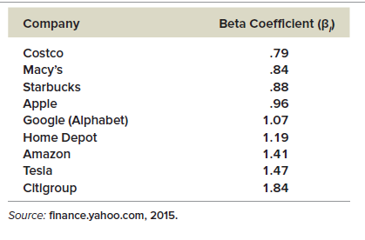
Beta Coefficients for Selected Companies
Copyright (c) 2017 McGraw-Hill Education. All rights reserved. No reproduction or distribution without the prior written consent of McGraw-Hill Education.

Slide 91
Portfolio Beta
β_{p} = Weighted average of the Betas of the assets in the portfolio
Weights (w_{j})= % of portfolio invested in asset j
Copyright (c) 2017 McGraw-Hill Education. All rights reserved. No reproduction or distribution without the prior written consent of McGraw-Hill Education.
Notes:
47

Slide 92
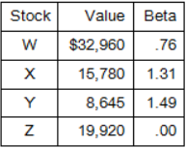
Question
What is the beta of the following portfolio?
.98
.76
1.18
1.21
1.13
Notes:
MC Q 74
Answer is B
Portfolio value = $32,960 + 15,780 + 8,645 + 19,920 = $77,305
β_{P} = ($32,960 /$77,305)(.76) + ($15,780/$77,305)(1.31) + ($8,645/$77,305)(1.49) + ($19,920 /$77,305)(0) = .76

Slide 93
Question
Standard deviation measures _____ risk while beta measures _____ risk.
systematic; unsystematic
unsystematic; systematic
total; unsystematic
total; systematic
asset-specific; market
Notes:
MC Q 23
Answer is D
Multiple ChoiceDifficulty: 1 Basic
MC Qu. 23 Standard deviation measures _____ risk while...Learning Objective: 11-03 Define the systematic risk principle.

Slide 94
Total Risk vs. Systematic Risk
Consider the following information:
Standard Deviation Beta
Security C 20% 1.25
Security K 30% 0.95
Which security has more total risk?
A. Security C
B. Security K
Notes:
Answer is B – Security K has more total risk because the standard deviation is higher

Slide 95
Total Risk vs. Systematic Risk
Consider the following information:
Standard Deviation Beta
Security C 20% 1.25
Security K 30% 0.95
Which security has more systemic risk?
A. Security C
B. Security K
Notes:
Answer is A – Security C has more systemic risk since the beta is higher – beta is the measure of systemic risk

Slide 96
Total Risk vs. Systematic Risk
Consider the following information:
Standard Deviation Beta
Security C 20% 1.25
Security K 30% 0.95
Which security should have the higher expected return?
A. Security C
B. Security K
Notes:
Answer is A – Security C should have a higher expected return since the beta is higher

Slide 97
Capital Asset Pricing Model
(CAPM)

Slide 98
Beta and the Risk Premium
From Chapter 10 we learned:
Risk Premium
The excess return required from an investment in a risky asset over that required from a risk-free investment
Algebraically, this is:
Risk Premium = Expected Return – Risk Free Return
We now know that the higher the beta for a company, the greater the risk, so the risk premium will be greater

Slide 99
Capital Asset Pricing Model
Defines the relationship between risk and return
Mathematical equation that shows the relationship between expected return and beta
Capital Asset Pricing Model (CAPM)
If the systemic risk of an asset is known (i.e., the beta), CAPM can be used to determine its expected return.

Slide 100
Capital Asset Pricing Model
Expected Return of an Asset
Risk-Free Rate of Return
Market Risk Premium
Asset Beta
=
+
x
E(R_{A}) = R_{f} + (E(R_{M}) – R_{f})β_{A}
Measures the pure time value of money
Amount of systemic risk of the specific asset
Reward for bearing an average amount of systemic risk

Slide 101
CAPM Example
What is the expected return for Stock A?
Risk-free rate = 4%
Market risk premium = 7%
Stock A beta = 1.3
Expected Return of an Asset
Risk-Free Rate of Return
Market Risk Premium
Asset Beta
=
+
x
=
4%
+
[ 7% x 1.3 ]
=
4%
+
9.1%
= 13.1%

Slide 102
Security Market Line
(SML)

Slide 103
Security Market Line
Positively sloped straight line displaying the relationship between expected return and beta
The slope of the SML is the market risk premium
The market risk premium is the difference between the expected return on a market portfolio and the risk-free rate
Security Market Line (SML)

Slide 104
Security Market Line (SML)
The SML represents market equilibrium
The slope of the SML is the market risk premium (also called the reward-to-risk ratio)
Copyright (c) 2017 McGraw-Hill Education. All rights reserved. No reproduction or distribution without the prior written consent of McGraw-Hill Education.

Slide 105
Question
According to the capital asset pricing model, the expected return on a security will be affected by all of the following except the:
Market risk premium
Risk-free rate
Market rate of return
Security’s standard deviation
Security’s beta
Notes:
MC Q 40
Answer is D
Multiple ChoiceDifficulty: 1 Basic
MC Qu. 40 According to the capital asset pricing...Learning Objective: 11-04 Discuss the security market line and the risk-return trade-off.

Slide 106
Questions to Answer
What is meant by beta?
What is the difference between the standard deviation of a stock and the beta of the stock?
What is the beta of Treasury bills?

Slide 107
Chapter 12
Cost of Capital

Slide 108
Chapter 12 Objectives
Learn how to determine a firm’s overall cost of capital
Cost of equity capital
Cost of debt
Weighted average cost of capital
Understand the pitfalls of overall cost of capital and how to manage them
E(R_{company})=Rf + [Rm – Rf] B_{company}

Slide 109
Introduction
We know from Capital Budgeting (Ch. 9) that the discount rate (or required return) is a critical input to making investment decisions
We will now discuss how firms determine their required return
This discussion brings together various topics we have discussed:
Stocks and bonds
Capital budgeting
Risk and return

Slide 110
Introduction
Where does a firm get the capital (i.e., cash) needed to start and run their business?
Debt
Equity
and/or
Who remembers how the CIMBA Winery funded their business?

Slide 111
Introduction
The manner in which a firm utilizes debt and equity to fund their business is known as its capital structure.
This is a variable within control of management
This managerial decision is discussed further in the Intermediate Finance course
For purposes of our discussion today, we will assume a firm has a set amount of debt and equity to run their business
Thus, to understand a firm’s cost of capital, we need to understand its cost of both debt and equity

Slide 112
Cost of Capital Basics
The cost to a firm for capital funding equals the return to the providers of those funds
Cost to a firm for capital
The return an investor requires to provide capital (debt or equity) to the firm
=

Slide 113
Cost of Capital Basics
Required Return
Cost of Capital
Appropriate Discount Rate
=
=
Investor’s point of view
Firm’s point of view
What’s used for NPV calculations

Slide 114
Importance of Cost of Capital
Understanding a firm’s cost of capital is of critical practical importance
Capital Budgeting Decisions
Financing Decisions
Operating Decisions
Both the NPV and IRR rule require knowledge of the appropriate discount rate
The optimal capital structure minimizes the cost of capital
The cost of capital is used by regulatory agencies to determine the “fair” return in some regulated industries

Slide 115
Cost of Capital Overview
Sources of Capital
1/3
1/3
1/3
Cost of Equity
Cost of Debt
Cost of Preferred Stock
9%
3%
6%
Weighted Average Cost of Capital
0.33(9%) + 0.33(3%) + 0.33(6%) = 6%

Slide 116
Cost of Equity

Slide 117
Cost of Equity
The cost of equity is the return required by equity investors given the risk of the cash flows from the firm
Two major methods for determining the cost of equity
Focus of Discussion
Dividend Growth Model
CAPM and the Security Market Line (SML)
Copyright (c) 2017 McGraw-Hill Education. All rights reserved. No reproduction or distribution without the prior written consent of McGraw-Hill Education.

Slide 118
CAPM (or SML) Approach
From what we learned in Chapter 11, we can use the following information to compute the cost of equity
Risk-Free Rate
Market Risk Premium
Systemic Risk of Asset
Rate for Treasury bills
Expected return for the market overall less the risk-free rate
Beta
Expected market risk premium

Slide 119
Question - CAPM Example
What is the cost of equity capital for XYZ company?
XYZ Company equity beta = 1.2
Current risk-free rate = 7%
Expected market risk premium = 6%
13%
14.4%
14.2%
8.4%
7.2%
Notes:
CML Question
Answer is C

Slide 120
CAPM Example
What is the cost of equity capital for XYZ company?
XYZ Company equity beta = 1.2
Current risk-free rate = 7%
Expected market risk premium = 6%
Expected market risk premium
R_{E} = 7% + 1.2 (6%) = 14.2%

Slide 121
CAPM Advantages & Disadvantages
Advantages
Explicitly adjusts for systematic risk
Applicable to all companies, as long as beta is available
Disadvantages
Must estimate the expected market risk premium, which does vary over time
Must estimate beta, which also varies over time
Relies on the past to predict the future, which is not always reliable
Copyright (c) 2017 McGraw-Hill Education. All rights reserved. No reproduction or distribution without the prior written consent of McGraw-Hill Education.

Slide 122
Cost of Debt

Slide 123
Question - Cost of Debt
How would we determine the cost of debt?
Use the coupon rate of existing debt
Use the Fisher Effect formula to calculate the cost of debt
Use the YTM (yield-to-maturity) of the current debt
Use the CAPM formula
Use the beta multiplied by the risk-free rate
Notes:
CML question
Answer is C

Slide 124
Cost of Debt
How would we determine the cost of debt?
Cost of Debt
Required Return on a Firm’s Debt
Current YTM on Existing Debt
=
=
Note: The cost of debt is NOT the coupon rate

Slide 125
Cost of Debt – Tax Impact
Since interest paid on debt is tax-deductible, the after-tax cost of debt is:
After-Tax Cost of Debt
YTM of Debt
(1-Tax Rate)
=
x

Slide 126
Cost of Debt – Example
The debt of XYZ Company has a current yield-to-maturity of 8.9%. Their tax rate is 40%. What is the after-tax cost of debt?
8.9%
3.56%
5.34%
Not enough information provided
Notes:
CML question
Answer is C

Slide 127
Cost of Debt – Example
The debt of XYZ Company has a current yield-to-maturity of 8.9%. Their tax rate is 40%. What is the after-tax cost of debt?
After-Tax Cost of Debt
YTM of Debt
(1-Tax Rate)
=
x
=
8.9%
x
(1-.40)
= 5.34%

Slide 128
Cost of Preferred Stock

Slide 129
Cost of Preferred Stock
Preferred stock pays a constant dividend every period
Dividends expected to be paid forever
Preferred stock is a perpetuity
Example:
Preferred annual dividend = $10
Current stock price = $111.10
R_{P} = 10 / 111.10 = 9%
Copyright (c) 2017 McGraw-Hill Education. All rights reserved. No reproduction or distribution without the prior written consent of McGraw-Hill Education.

Slide 130
Weighted Average Cost of Capital
(WACC)

Slide 131
Weighted Average Cost of Capital
Sources of Capital
Target Weights*
Individual Cost of Capital
Calculation
Common Stock
x%
a%
=
ax%
Preferred Stock
y%
b%
=
by%
Debt **
z%
c%
=
cz%
100%
WACC%
* If target weights aren’t available, use market values ** Need to compute net of taxes
Notes:
Build by column

Slide 132
WACC – Estimating Weights
What are the weights of common stock, preferred stock, and debt for XYZ Company?
XYZ Company
Capital
Component Value
$
%
Stock price
= $50
Common stock*
$150 million
60%
Common stock shares outstanding
= 3 million
Preferred stock
$25 million
10%
Preferred stock outstanding
= $25 million
Debt
$75 million
30%
Debt outstanding
= $75 million
Total Capital
$250 million
100%
* Total market value of common stock is $50 per share multiple by 3 million shares outstanding
Notes:
Bullet, assumptions, headings

Slide 133
WACC – Final Calculation
What is the WACC for XYZ Company if the cost of capital for common stock, preferred stock, and debt is 14%, 9%, and 10%, respectively? (Assume a 40% tax rate)
Weight %
Before-tax
Return
After-tax
Return
Calculation
Common stock
60%
14%
14%
8.4%
Preferred stock
10%
9%
9%
.9%
Debt
30%
10%
6%
1.8%
100%
This is the calculated WACC!
11.1%

Slide 134
Weighted Average Cost of Capital or WACC
The Company
50% (10%) + 25% (6%) + 25% (4%) = 7.4%

Slide 135
Weighted Average Cost of Capital or WACC
(W in common stock) (cost of common)
+ (W in preferred stock) (cost of preferred stock)
+ (W in bonds) (after-tax cost of bonds)
The Company

Slide 136
Summary of Capital Cost Calculations

Slide 137
Factors That Influence a Company’s WACC
There are numerous factors that influence a company’s WACC
Market Conditions
Capital Structure
Investment Policy
Interest rates
Tax rates
Market risk premium
Amount financed by debt vs. equity
Dividend policy
Firms with riskier projects generally have a higher WACC

Slide 138
Question
Which one of the following is used as the pretax cost of debt?
Average coupon rate on the firm’s outstanding bonds
Coupon rate on the firm’s latest bond issue
Weighted average yield to maturity on the firm’s outstanding debt
Average current yield on the firm’s outstanding debt
Annual interest divided by the market price per bond for the latest bond issue
Notes:
MC Q 16
Answer is C
Multiple ChoiceDifficulty: 1 Basic
MC Qu. 16 Which one of the following is...Learning Objective: 12-02 Determine a firms cost of debt.

Slide 139
Question
Which one of the following is the primary determinant of an investment's cost of capital?
Life of the investment
Amount of the initial cash outlay
The investment level of risk
The source of funds used for the investment
The investment’s net present value
Notes:
MC Q 33
Answer is C
Multiple ChoiceDifficulty: 1 Basic
MC Qu. 33 Which one of the following is...Learning Objective: 12-04 Identify some of the pitfalls associated with a firms overall cost of capital and what to do about them.

Slide 140
Divisional and Project Costs of Capital

Slide 141
Risk-Adjusted WACC
A firm’s WACC reflects the risk of an average project undertaken by the firm
“Average” risk = the firm’s current operations
Different divisions/projects may have different risks
The division’s or project’s WACC should be adjusted to reflect the appropriate risk and capital structure
Copyright (c) 2017 McGraw-Hill Education. All rights reserved. No reproduction or distribution without the prior written consent of McGraw-Hill Education.

Slide 142
Using WACC for All Projects
What would happen if we use the WACC for all projects regardless of risk?
Assume the WACC = 15%
Copyright (c) 2017 McGraw-Hill Education. All rights reserved. No reproduction or distribution without the prior written consent of McGraw-Hill Education.
Notes:
Ask students which projects would be accepted if they used the WACC for the discount rate? Compare 15% to IRR and accept projects A and B.
Now ask students which projects should be accepted if you use the required return based on the risk of the project? Accept B and C.
So, what happened when we used the WACC? We accepted a risky project that we shouldn’t have and rejected a less risky project that we should have accepted. What will happen to the overall risk of the firm if the company does this on a consistent basis? Most students will see that the firm will become riskier.

Slide 143
Using WACC for All Projects
Assume the WACC = 15%
A project’s required return is calculated using the SML and the project’s Beta
Adjusting for risk changes the decisions
Copyright (c) 2017 McGraw-Hill Education. All rights reserved. No reproduction or distribution without the prior written consent of McGraw-Hill Education.
Notes:
Ask students which projects would be accepted if they used the WACC for the discount rate? Compare 15% to IRR and accept projects A and B.
Now ask students which projects should be accepted if you use the required return based on the risk of the project? Accept B and C.
So, what happened when we used the WACC? We accepted a risky project that we shouldn’t have and rejected a less risky project that we should have accepted. What will happen to the overall risk of the firm if the company does this on a consistent basis? Most students will see that the firm will become riskier.

Slide 144
Finding Beta for a Project/Division
How do you determine the beta (or risk level) for a project or division within a company?
Pure Play Approach
Subjective Approach

Slide 145
Pure Play Approach
Find one or more companies that specialize in the product or service being considered
Compute the beta for each company
Take an average
Use that beta along with the CAPM to find the appropriate return for a project of that risk
Pure play companies can be difficult to find
Copyright (c) 2017 McGraw-Hill Education. All rights reserved. No reproduction or distribution without the prior written consent of McGraw-Hill Education.

Slide 146
Subjective Approach
Consider the project’s risk relative to the firm overall
If the project is riskier than the firm, use a discount rate greater than the WACC
If the project is less risky than the firm, use a discount rate less than the WACC
Copyright (c) 2017 McGraw-Hill Education. All rights reserved. No reproduction or distribution without the prior written consent of McGraw-Hill Education.

Slide 147
Subjective Approach - Example
Risk Level | Discount Rate
Very Low Risk | WACC – 8% 6%
Low Risk | WACC – 4% 10%
Same Risk as Firm | WACC 14%
High Risk | WACC + 6% 20%
Very High Risk | WACC + 10% 24%
Copyright (c) 2017 McGraw-Hill Education. All rights reserved. No reproduction or distribution without the prior written consent of McGraw-Hill Education.

Slide 148
Question
Which one of the following is the primary determinant of an investment's cost of capital?
Life of the investment
Amount of the initial cash outlay
The investment level of risk
The source of funds used for the investment
The investment’s net present value
Notes:
MC Q 33
Answer is C
Multiple ChoiceDifficulty: 1 Basic
MC Qu. 33 Which one of the following is...Learning Objective: 12-04 Identify some of the pitfalls associated with a firms overall cost of capital and what to do about them.

