Slide 1
Taxes
Rich Jakotowicz CFP®
richj@udel.edu
302.831.7226

Slide 2


Taxes on Purchases (Sales Tax)
  Sales tax is added to the price of goods sold.
  Delaware is one of the few states that do not charge sales tax on most items. However, there is sales tax included in gasoline, alcohol, tobacco products and other specific goods.
  State sales taxes range from 0% - 9.5% (Delaware & Tennessee) and are paid when you make a purchase.
Taxes on Property
  The most common tax is real estate tax. The amount of tax is established by the county in which the property is located. This tax varies largely from county to county and is based upon the size and value of the property. As states and localities increase this tax, it is an unwelcome surprise to those living on low and/or fixed income.
  Property taxes may also be levied on vehicles, boats, and certain machinery.

Slide 3
“Estate Tax” - Taxes on Wealth at Death
  Estate tax may be due when an individual dies and passes their wealth to someone other than their spouse. The US Government and local governments have specific levels of wealth that trigger the tax.
  Low net worth individuals are not subject to this tax. The size of the estate that is taxable changes each year with inflation and legislation. Current legislation allows approximately $11M to pass at death without paying an estate tax.
“Income Tax” - Taxes on Earnings – TAX FORM1040
  Anyone who has ever been employed in the USA is aware of income tax. This tax occurs on a number of levels including federal income tax, state income tax, local income tax, 6.2% for Social Security(+6.2% Employer), and 1.45% for Medicare
“Capital Gains Tax”
  Typically a 15% tax on long-term (>1yr) gains from investments. If you buy a stock at $10 and sell at $30, you gained $20 of which you owe $3 in tax. Short-term gains get tax as if they are Income.
  Note: low income earners pay 0% and high income earners pay 20%

Slide 4
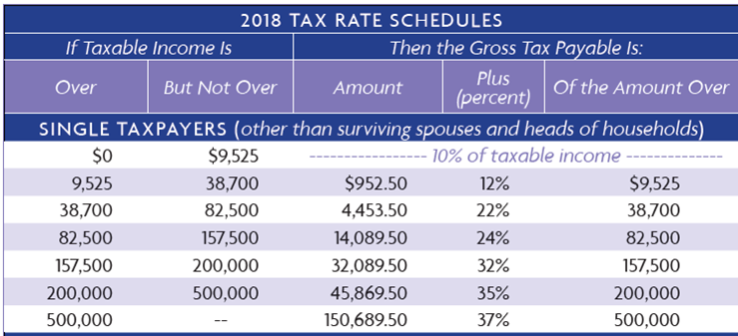
2018 Income Tax Rates IF Single Taxpayer
How much tax would you owe if you are Single
and your Taxable Income was $100,000 in 2018?
$14,089.50
+ .24 x ($100,000-$82,500)
= $18,289.50 Tax Payable

Slide 5
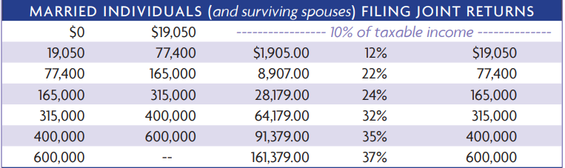
2018 Income Tax Rates IF Married
How much tax would you owe if you are Married
and your Taxable Income was $100,000 in 2018?
$8,907
+ .22 x ($100,000-$77,400)
= $14,331 Tax Payable

Slide 6
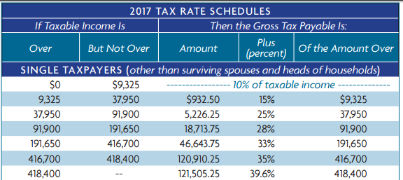
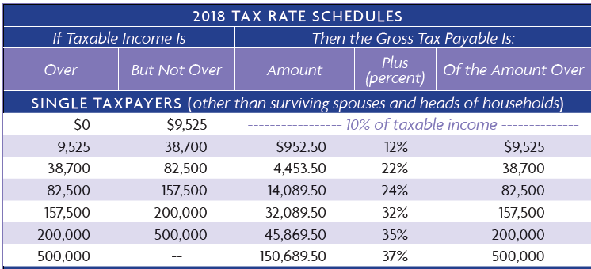
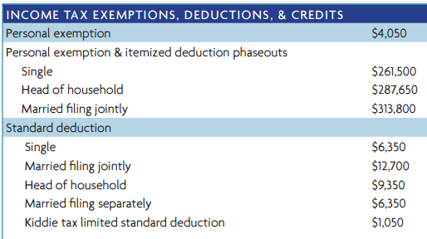
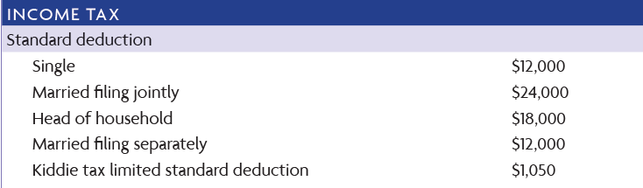
Reverts back after 2025

Slide 7
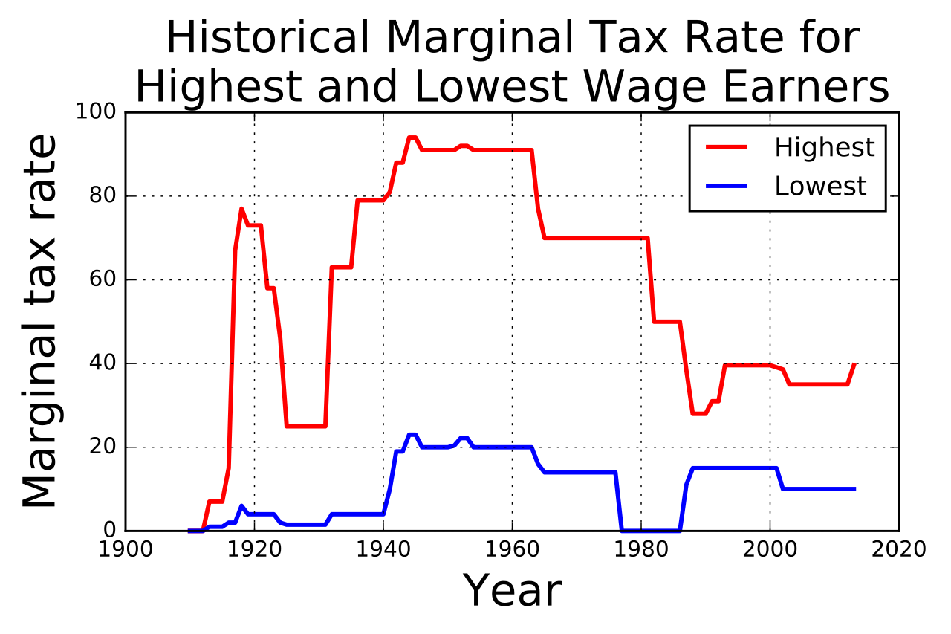

Slide 8
General Structure of the 1040 Tax Return
    Income
    - Deductions
    = Taxable Income
    Use “Tax Rate Schedule” to calculate Total Taxes for the Year
    - Tax credits
    - Taxes already paid during the year (ex. withholding from paycheck)
    = Tax that needs to be paid and submitted when filing*
* If negative, taxpayer will receive a refund.

Slide 9
General Structure of the 1040 Tax Return
  Income
    Employment W2 or unemployment compensation received
    Interest and Dividends received
    Retirement plan (IRA, 401K) or pension plan distributions
    Social security benefits (possibly taxable if combined income exceeds specific levels)
    Anything else the IRS says is income!
    “Gross income is all income from whatever source derived (unless excluded by law)”.

Slide 10
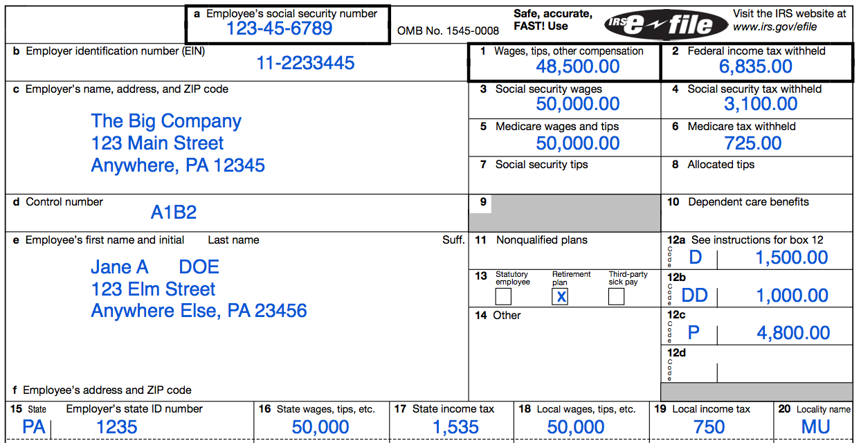
Form W2 reports compensation - issued by your employer
Form 1099 Investment Income
for your bank accounts and any investment accounts.
you will not receive statements for your retirement accounts unless you have taken a distribution during the year.

Slide 11
General Structure of the 1040 Tax Return
    Income
    - Deductions
    = Taxable Income
    Use “Tax Rate Schedule” to calculate Total Taxes for the Year
    - Tax credits
    - Taxes already paid during the year (ex. withholding from paycheck)
    = Tax that needs to be paid and submitted when filing*
* If negative, taxpayer will receive a refund.

Slide 12
General Structure of the 1040 Tax Return
  Deductions
  Show up in two places on the 1040:
    Before AGI – Adjusted Gross Income
      (also known as “above the line” deductions)
    After AGI – Adjusted Gross Income
      (also known as “below the line” deductions)
  Both types reduce your taxable income
  Above the line deductions reduce your AGI, and since many tax benefits are based on your AGI, the lower the better.
    This makes an above the line deductions more powerful than below the line deductions

Slide 13
General Structure of the1040 Tax Return
  Deductions (before AGI a.k.a. Above the Line)
    $5500 Deductible IRA contribution (for those who qualify)
    Health Savings Account contributions
    Student loan interest (for those who qualify)
    Capital losses (up to the amount of your capital gains plus $3,000)
  There are others - these are popular deductions.

Slide 14

General Structure of the 1040 Tax Return
  Deductions (after AGI)
You Need To Pick One – Pick whichever is largest
Standard deduction OR Itemized deduction
                Create Your Own List

Slide 15

General Structure of the1040 Tax Return
Standard deduction OR Itemize your deductions.
  This makes sense if your actual deductible expenses are greater than the standard deduction.
    Hmmm….so what’s deductible?????

Slide 16
Itemized Deductions
Mortgage Interest paid on a Maximum loan of $750,000
Medical expenses in excess of 7.5% in 2018 & 2019
State and local income tax + Property Tax
  (limited to $10,000 maximum)
Charitable contributions (limits apply)
There are others, but these are the largest and most popular.
Many of these deductions are limited for high income taxpayers (due to AGI phase outs) and/or may have subtle adjustments

Slide 17
General Structure of the 1040 Tax Return
    Income
    - Deductions
    = Taxable Income
    Use “Tax Rate Schedule” to calculate Total Taxes for the Year
    - Tax credits
    - Taxes already paid during the year (ex. withholding from paycheck)
    = Tax that needs to be paid and submitted when filing*
* If negative, taxpayer will receive a refund.

Slide 18
2018 Income Tax Rates IF Single Taxpayer
How much tax would you owe if you are Single
and your Taxable Income was $100,000 in 2018?
$14,089.50
+ .24 x ($100,000-$82,500)
= $18,289.50 Tax Payable

Slide 19
General Structure of the 1040 Tax Return
    Income
    - Deductions
    = Taxable Income
    Use “Tax Rate Schedule” to calculate Total Taxes for the Year
    - Tax credits
    - Taxes already paid during the year (ex. withholding from paycheck)
    = Tax that needs to be paid and submitted when filing*
* If negative, taxpayer will receive a refund.

Slide 20
Subtract Tax Credits
“Dollar for dollar” reduction in taxes owed. Change each year.
Better than deductions!
  Child tax credit = $2000 per child (16 and under)
  Child care tax credit (12 and under)
  Earned income tax credit
  First time homebuyers
  Tuition
  MANY rules determine eligibility.
  Most tax credits phase out at various income levels and may or may not be refundable

Slide 21
General Structure of the 1040 Tax Return
    Income
    - Deductions
    = Taxable Income
    Use “Tax Rate Schedule” to calculate Total Taxes for the Year
    - Tax credits
    - Taxes already paid during the year (ex. withholding from paycheck)
    = Tax that needs to be paid and submitted when filing*
* If negative, taxpayer will receive a refund.

Slide 22
Form W2 - issued by your employer
Throughout the year your Employer withheld part of your paycheck for taxes and sent it to the IRS.
The amount withheld is estimated so you may owe more or get a refund

Slide 23
Gross Income
All income you received from every source. Examples are: Salary/Wages, Interest from CD’s/Bonds, Pension Income, Prizes/Awards, etc.
Subtract “Adjustments to Income”
Examples include Contributions to IRA’s, and early withdrawal penalties from savings
The result is Adjusted Gross Income or AGI
Subtract “the Standard Deduction”
OR
Subtract “Itemized Deductions”
The result is Taxable Income
Next, determine the total tax owed based on Taxable Income. Use the IRS tax bracket for the current year.
Subtract the taxes that were withheld and/or paid over the course of the year
Subtract any tax credits that are available. Tax credits, and your eligibility, change from year to year.
The result is either (1) additional taxes are due (positive number) or (2) a tax refund from the government (negative number)

Slide 24
Putting it all together
Ann Taxpayer is single and has no dependents. Her taxable events in 2018 are:
Salary is $55,000, of which $4,000 in taxes were withheld from her paychecks
She deposited $2,000 into an IRA
She earned $600 in interest from CD’s and a savings account
Itemized deductions of $7,000 (includes $2,000 in Real Estate Taxes, $2,000 in State and Local Taxes, and $3,000 in mortgage interest)
She is not eligible for any tax credits

Slide 25
The basic calculation:
$55,600 = Gross Income (Salary + Interest from CD’s)
$2,000 = Adjustments (IRA Contribution)
$53,600 = AGI (Adjusted Gross Income)
$12,000 = Standard Deduction (Itemized deductions were only $7,000)
$41,600 = Taxable Income
NEXT, use the 2018 tax brackets for single filers to determine the tax due based on taxable income of $41,600

Slide 26
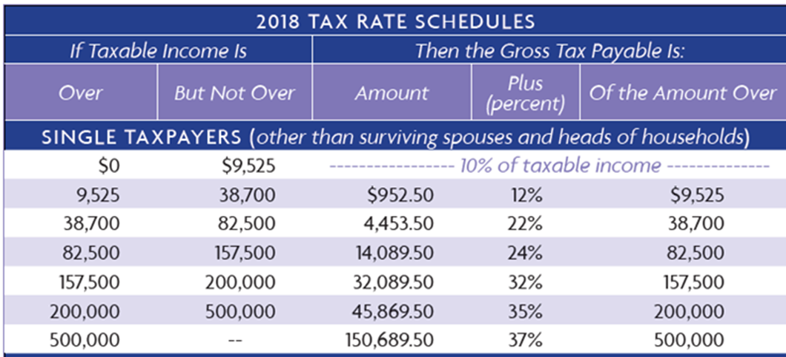
The basic calculation:
NEXT, use the 2018 tax brackets for single filers to determine the tax due based on taxable income of $41,600
$4,453.50 + 22% of (41,600-38,700)
= $5091.50 in total taxes due

Slide 27
The basic calculation:
$5091.50 in total taxes due
Since her employer already withheld $4,000 for taxes, she must pay an additional $1091.50 in taxes.
If she were eligible for a tax credit, it would be applied here to reduce her tax bill or create a tax refund (if the credit is refundable).
  For example, if Ann had a $1000 refundable credit she would only owe $91.50.
    This is much better than a $1000 deduction.
    Deductions are not as valuable as credits!

Slide 28
“The hardest thing in the world to understand is the income tax” – Albert. Einstein
Ann has a Marginal Tax Rate of 22%
(just looking at the brackets)
However, Ann has an Effective Tax Rate of 15%.
Total Tax Due $5,091
Taxable Income $41,600
= 12%

Slide 29
Your turn…..
Ann and Rich Taxpayer are married and have 2 children. Their taxable events in 2018 are:
Ann’s Salary is $55,000, of which $4,000 in taxes were withheld from her paychecks. Rich’s Salary is $100,000, of which $7,000 in taxes were withheld from his paychecks.
She deposited $2,000 and he deposited $3,000 into IRA accounts
They earned $1000 in interest from investments
They paid $6,000 in Property Tax, $15,000 in State and Local Tax, and $8,000 in interest payments on the mortgage
They are eligible for the child tax credit
Calculate total taxes, the remaining tax due or owed, and effective rate.

Slide 31
The Alternative Minimum Tax - AMT
Consider 2 people who each earned $350,000 last year. Person A took the standard deduction. Person B itemized because they had MANY deductions.
The government takes notice of Person B and realizes they did not collect enough in taxes

Slide 32
The Alternative Minimum Tax - AMT
AMT is a separate but parallel tax system that attempts to limit total deductions. It is referred to as a “flat” tax.
26% and 28%
If the AMT calculated for each person is $94,500, You must pay the higher of either the regular tax or the AMT
X
$94,500

Slide 33
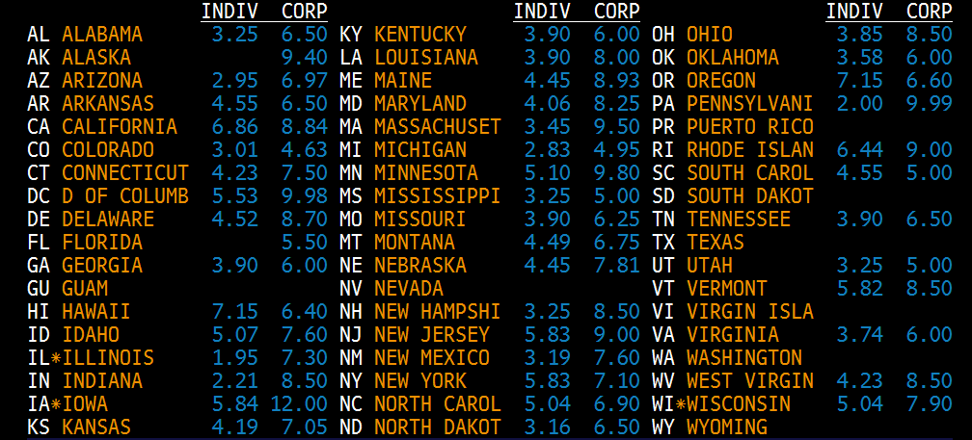
Using The Tax Rates Below,
Which States Are most Likely To Trigger AMT For Their Residents?

Slide 34
Employee Incentive Stock Options
Imagine you work for General Electric and the stock is currently worth $25 per share.
At the end of the year you are paid a bonus which includes stock options. The options allow you to purchase 1000 shares of GE Stock from the company at $20 per share.
You could instantly make $5 per share ($5000 total) if you buy at $20 and sell at $25. The $5000 would be a capital gain.
Alternatively you could buy at $20 and hold the stock in your account. You did not yet realize the gain BUT IT GETS included in the AMT calculation!!!

