Slide 1
Demystifying the F31
Julie M. Schneider, M.S.

Slide 2
What even is an F31?
Also known as the Ruth L. Kirschstein Predoctoral Individual National Research Service Award
The purpose of this Kirschstein-NRSA program is to enable promising predoctoral students with potential to develop into a productive, independent research scientists, to obtain mentored research training while conducting dissertation research. The F31 is also used to enhance workforce diversity though a separate program.

Slide 3
What even is an F31?
Also known as the Ruth L. Kirschstein Predoctoral Individual National Research Service Award
The purpose of this Kirschstein-NRSA program is to enable promising predoctoral students with potential to develop into a productive, independent research scientists, to obtain mentored research training while conducting dissertation research. The F31 is also used to enhance workforce diversity though a separate program.

Slide 4
What you commonly associate with Grant Writing
Specific Aims (1 Page)
State the goals of the proposed research and summarize the expected outcome, including the impact the results of the proposed research will exert on the research field involved.
Should have 2-3 feasible aims
The best aims add to the field, regardless of the result

Slide 5
What you commonly associate with Grant Writing
Research Strategy (6 pages)
Significance
Why does this matter?
Innovation
How does this add to the field?
Approach
How can it be executed?
Notes:
Now if you want more information on writing these seven pages (aims and research strategy) I highly recommend the Grant Writing course offered in the summer or most upper level doctoral courses which require you write a grant (although these are not always in line with your dissertation

Slide 6
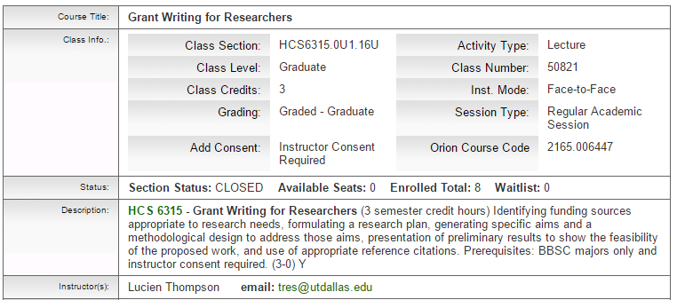
So then, what is this talk about?
The other 25+ documents you may not know as much about, but that are equally, if not more important to your ability to secure funding

Slide 7
Overview of Application Attachments
SF 424 (R&R Form)
Cover Letter
R&R Other Project Information Form
Human Subjects
Inclusion of Minorities/Children
Inclusion of Vertebrate Animals
Project Summary
Project Narrative
Bibliography & References Cited
Facilities & Other Resources
Equipment
R&R Senior/Key Person Profile
Biosketch(es)
PHS Fellowship Supplemental Form
Introduction (if Resubmission)
Fellowship Applicant Section
Doctoral Dissertation and Research Experience
Training Goals and Objectives
Activities Planned Under this Award
Research Training Plan Section
Specific Aims
Research Strategy
Respective Contributions
Selection of Sponsor and Institution
Training in Responsible Conduct of Research
Sponsors, Collaborators, and Consultants
Sponsor and Co-Sponsor Statements
Letters of Support
Description of Institutional Environment and Commitment to Training
Budget Section

Slide 8
Where do you even begin?
http://grants.nih.gov/grants/how-to-apply-application-guide.html
https://research.utdallas.edu/osp
Determine who you need to contact
Program Officer
Grant Specialist at UTD
Co-Sponsors
Referees

Slide 9
Internal breakdown of NIH
President of the USA
Secretary of Health and Human Services
NIH Director
Institute Director

Slide 10
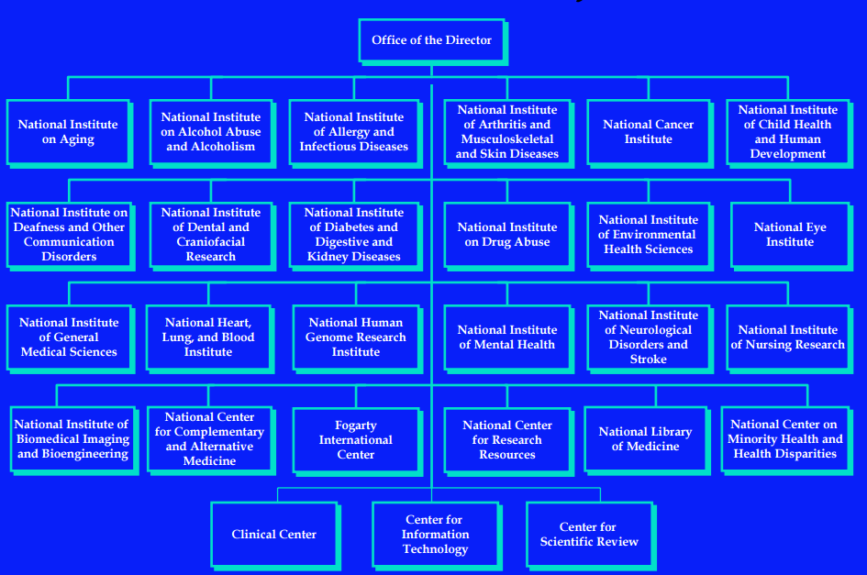
http://www.jst.go.jp/po_seminar/h16semi/pdf/semi2/pre/no_10.pdf

Slide 11
Internal breakdown of NIH
Institute Director
Division Director
Branch Chief
Program Officer

Slide 12
The role of a Program Officer
A program officer’s primary job is to support extramural grants, contracts, and training with goal of improving national health.
Advise grant applications
Attend the scientific review
Make funding recommendations
Monitor awarded grants
Foster specific science through initiatives and meetings
Talk to public
Maintain his/her own scientific expertise
http://www.jst.go.jp/po_seminar/h16semi/pdf/semi2/pre/no_10.pdf

Slide 13
Contacting your Program Officer
Go to the NIH website for F31 Awards
https://grants.nih.gov/grants/guide/contacts/parent_F31.html
Select the institute you are submitting to
https://www.nichd.nih.gov/Pages/index.aspx
Find the ‘Contacts for NICHD [or your institute] funding’ under Grants & Funding ***
Identify which division and branch applies to you and contact that Program Officer
https://www.nichd.nih.gov/grants-funding/grants-process/Documents/NICHD_Categories_Officers.pdf
***This varies across all Institutes, but each institute has a search engine built in that you can search Program Officer

Slide 14
Contacting your Program Officer
Include your Specific Aims page (and Research Strategy if possible)
Request a time to have a phone conversation
Send them an overview of the questions you have
Be prepared with specific questions when call occurs

Slide 15
Some General Rules
Your advisor, and henceforth, your sponsor, must have secured NIH (preferable) or NSF funding that will last the entire span of your “training”
You will need to assemble a team. Therefore, I recommend having your grant completely written about 6 months prior so your “team” can review it.
Everything you have done, are doing, and will do, matters! Every detail of your application needs to be well defined and thought out.
Notes:
After final point: everything you have done, are doing, and will do is for some goal. And to NIH that goal is that you become an independent researcher in the United States that will continue a lifetime of significant/innovative work.

Slide 16
Overview of the current presentation
Documents primarily completed by the PI
Documents primarily completed by sponsors/other academics
Documents that require changes to be unique to your project, but for the most part follow a very specific format

Slide 17
Overview of Application Attachments
SF 424 (R&R Form)
Cover Letter
R&R Other Project Information Form
Human Subjects
Inclusion of Minorities/Children
Inclusion of Vertebrate Animals
Project Summary
Project Narrative
Bibliography & References Cited
Facilities & Other Resources
Equipment
R&R Senior/Key Person Profile
Biosketch(es)
PHS Fellowship Supplemental Form
Introduction (if Resubmission)
Fellowship Applicant Section
Doctoral Dissertation and Research Experience
Training Goals and Objectives
Activities Planned Under this Award
Research Training Plan Section
Specific Aims
Research Strategy
Respective Contributions
Selection of Sponsor and Institution
Training in Responsible Conduct of Research
Sponsors, Collaborators, and Consultants
Sponsor and Co-Sponsor Statements
Letters of Support
Description of Institutional Environment and Commitment to Training
Budget Section

Slide 18
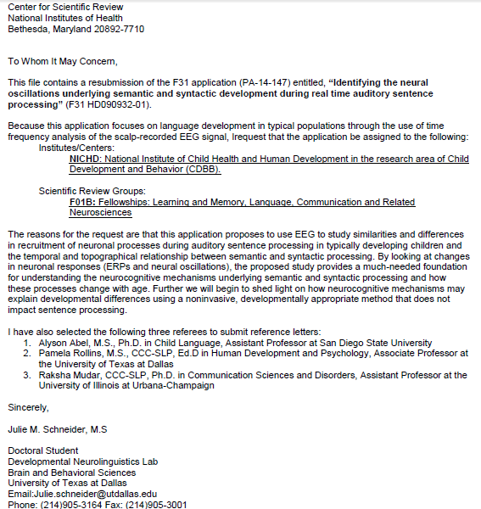
SF 424 (R&R Form): The Cover Letter
Application Title
Funding Announcement
Request assignment of awarding component
Request SRG assignment
List of anyone who should NOT review your application
Disciplines involved
List of referees

Slide 19
List of Referees
At least three, but no more than five, reference letters are required.
The letters should be from individuals not directly involved in the application, but who are familiar with the applicant’s qualifications, training, and interests.
The sponsor/co-sponsor(s) of the application cannot be counted toward the three required references.
Make sure you include a list of referees (including name, departmental affiliation, and institution) in the cover letter of the application so that the NIH staff will be aware of planned reference letter submissions.

Slide 20
List of Referees
Referees must submit a letter of reference through the ERA Commons website by the due date
There are no extensions
http://grants.nih.gov/grants/how-to-apply-application-guide/submission-process/reference-letter.htm

Slide 21
Additional Application Information to be completed
Descriptive title of applicant’s project
Proposed project start and end date
PI contact information
All other information is completed by UTD Grants Specialist

Slide 22
Overview of Application Attachments
SF 424 (R&R Form)
Cover Letter
R&R Other Project Information Form
Human Subjects
Inclusion of Minorities/Children
Inclusion of Vertebrate Animals
Project Summary
Project Narrative
Bibliography & References Cited
Facilities & Other Resources
Equipment
R&R Senior/Key Person Profile
Biosketch(es)
PHS Fellowship Supplemental Form
Introduction (if Resubmission)
Fellowship Applicant Section
Doctoral Dissertation and Research Experience
Training Goals and Objectives
Activities Planned Under this Award
Research Training Plan Section
Specific Aims
Research Strategy
Respective Contributions
Selection of Sponsor and Institution
Training in Responsible Conduct of Research
Sponsors, Collaborators, and Consultants
Sponsor and Co-Sponsor Statements
Letters of Support
Description of Institutional Environment and Commitment to Training
Budget Section

Slide 23
R&R Other Project Information Form: Human Subjects Section
If you do any research involving human subjects, a document outlining the following is required:
Risk to human subjects
Human subjects involvement, characteristics of your population, and design (inclusion/exclusion criteria)
Source of materials
Potential risks to subject
Adequacy of Protection Against Risks
Recruitment and Informed Consent
Other protections (i.e. confidentiality, anonymity, etc.)
Potential benefits/Knowledge Gained
Data and Safety Monitoring
Additional paperwork for clinical trials

Slide 24
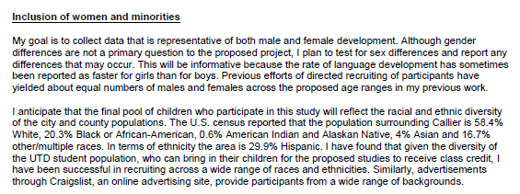
Participant Inclusion Forms
Inclusion of Women and Minorities
Inclusion of Children
Inclusion of Vertebrate Animals

Slide 25
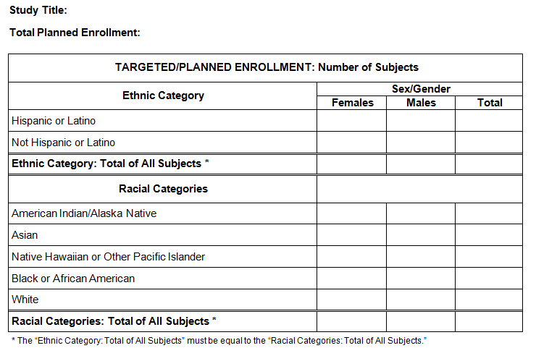
Planned Enrollment Report

Slide 26
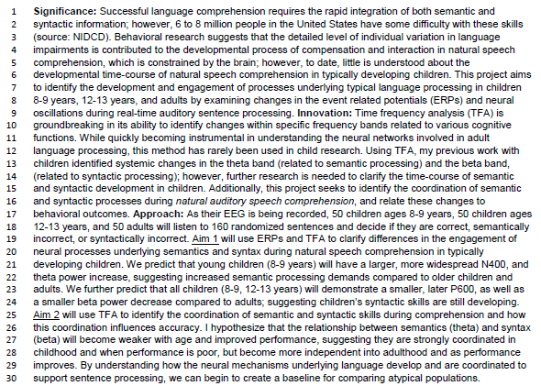
Project Summary
No more than 30 lines of text
Function is similar to an abstract
Highlights the significance, innovation, and approach

Slide 27
Project Narrative
No more than 2-3 sentences
Describes the relevance of the project to public health
Allows you to really demonstrate why this study should be funded

Slide 28
Bibliography & References Cited

Slide 29
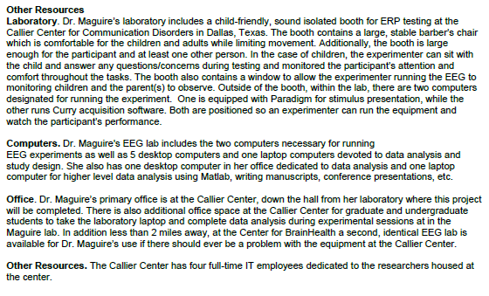
Facilities & Other Resources
No page limit
Used to give a clear mental image of what your surroundings offer
Allows you to emphasize the feasibility of your proposal

Slide 30
Equipment
No page limit
Differs from the previous file in that its’ primary focus is the detail of equipment specific to your study

Slide 31
Overview of Application Attachments
SF 424 (R&R Form)
Cover Letter
R&R Other Project Information Form
Human Subjects
Inclusion of Minorities/Children
Inclusion of Vertebrate Animals
Project Summary
Project Narrative
Bibliography & References Cited
Facilities & Other Resources
Equipment
R&R Senior/Key Person Profile
Biosketch(es)
PHS Fellowship Supplemental Form
Introduction (if Resubmission)
Fellowship Applicant Section
Doctoral Dissertation and Research Experience
Training Goals and Objectives
Activities Planned Under this Award
Research Training Plan Section
Specific Aims
Research Strategy
Respective Contributions
Selection of Sponsor and Institution
Training in Responsible Conduct of Research
Sponsors, Collaborators, and Consultants
Sponsor and Co-Sponsor Statements
Letters of Support
Description of Institutional Environment and Commitment to Training
Budget Section

Slide 32
Biographical Sketch(es)
Similar to resume and CV, but requires the following additional information:
Personal Statement
Positions and Honors
Contributions to Science
Two main research lines (undergraduate and graduate work)
Select 3 publications/presentations that highlight work in that area
Research Support
Scholastic Performance (F31/F32 Applicants Only)
Requires ERA Commons ID (https://public.era.nih.gov/commons)
Contact Grants Office to get setup
Will use this code for remainder of academic career
Examples: http://grants.nih.gov/grants/forms/biosketch.htm
Notes:
Give you an example at grants.nih.gov

Slide 33
Overview of Application Attachments
SF 424 (R&R Form)
Cover Letter
R&R Other Project Information Form
Human Subjects
Inclusion of Minorities/Children
Inclusion of Vertebrate Animals
Project Summary
Project Narrative
Bibliography & References Cited
Facilities & Other Resources
Equipment
R&R Senior/Key Person Profile
Biosketch(es)
PHS Fellowship Supplemental Form
Introduction (if Resubmission)
Fellowship Applicant Section
Doctoral Dissertation and Research Experience
Training Goals and Objectives
Activities Planned Under this Award
Research Training Plan Section
Specific Aims
Research Strategy
Respective Contributions
Selection of Sponsor and Institution
Training in Responsible Conduct of Research
Sponsors, Collaborators, and Consultants
Sponsor and Co-Sponsor Statements
Letters of Support
Description of Institutional Environment and Commitment to Training
Budget Section

Slide 34
Section of Application | Page Limits
Introduction to Resubmission (when applicable) | 1
Applicant’s Background and Goals for Fellowship Training | 6
Specific Aims | 1
Research Strategy | 6
Respective Contributions | 1
Selection of Sponsor Institution | 1
Training in Responsible Conduct of Research | 1
Sponsor and Co-Sponsor Statements | 6
Letters of Support from Collaborators, Contributors, and Consultants | 6
Description of Institutional Environment and Commitment to Training | 2

Slide 35
Section of Application | Page Limits
Introduction to Resubmission (when applicable) | 1
Applicant’s Background and Goals for Fellowship Training | 6
Specific Aims | 1
Research Strategy | 6
Respective Contributions | 1
Selection of Sponsor Institution | 1
Training in Responsible Conduct of Research | 1
Sponsor and Co-Sponsor Statements | 6
Letters of Support from Collaborators, Contributors, and Consultants | 6
Description of Institutional Environment and Commitment to Training | 2

Slide 36
Doctoral Dissertation and Research Experience
Summarize your research experience in chronological order.
If possible, include the areas studied and conclusions drawn
Include a narrative of doctoral dissertation (may be preliminary).
If you have no research experience, list other scientific experience. Do not list academic courses.

Slide 37
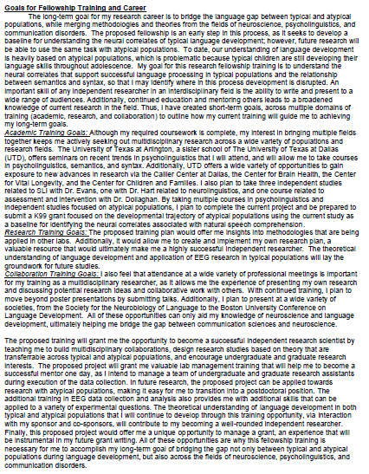
Training Goals and Objectives
Describe your overall training goals for the duration of the fellowship
Explain how the proposed fellowship will enable the attainment of these goals.
Identify the skills, theories, conceptual approaches, etc. to be learned or enhanced during the award.
Discuss how the proposed research will facilitate your transition to the next career stage.

Slide 38
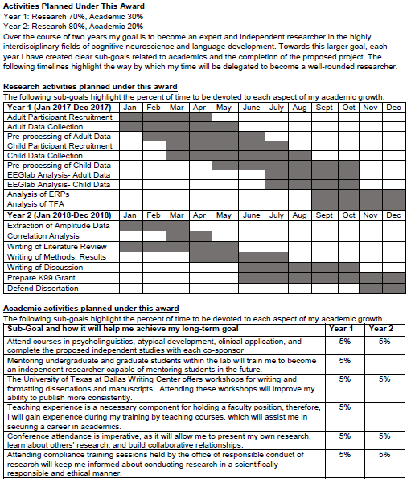
Activities Planned Under this Award
Describe, by year, the activities (research, coursework, etc.) you will be involved in during the proposed award and estimate the percentage of time to be devoted to each activity
The activities planned under this award should be individually tailored and well integrated with your research project.
Describe the skills and techniques that you intend to learn
Provide a timeline detailing the proposed research training and related activities for the entire duration of the program
Non-research based goals

Slide 39
Section of Application | Page Limits
Introduction to Resubmission (when applicable) | 1
Applicant’s Background and Goals for Fellowship Training | 6
Specific Aims | 1
Research Strategy | 6
Respective Contributions | 1
Selection of Sponsor Institution | 1
Training in Responsible Conduct of Research | 1
Sponsor and Co-Sponsor Statements | 6
Letters of Support from Collaborators, Contributors, and Consultants | 6
Description of Institutional Environment and Commitment to Training | 2

Slide 40
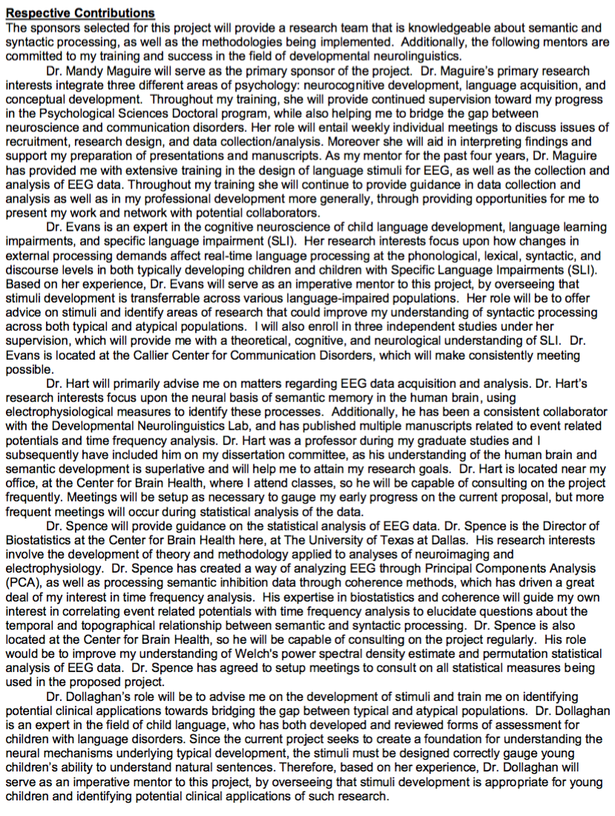
Respective Contributions
Describe the collaborative process between you and your sponsor/co-sponsor(s)
Discuss respective roles in the proposed research

Slide 41
Selection of Sponsor Institution
Rationale/justification for the selection of your sponsor and institution
Explain why sponsor/co-sponsors were selected
What training do they each bring to you?
Explain why further training at this institution would be valuable

Slide 42
Responsible Conduct of Research
Ensure the practice of scientific investigation with integrity
Five main instructional components
Format
Subject Matter
Faculty Participation
Durations of Instruction
Frequency of Instruction
https://research.utdallas.edu/orc/rcr/training
https://grants.nih.gov/grants/guide/notice-files/NOT-OD-10-019.html
Notes:
Remind of the training aspect; that you need funding to be trained on responsible conduct of research

Slide 43
Section of Application | Page Limits
Introduction to Resubmission (when applicable) | 1
Applicant’s Background and Goals for Fellowship Training | 6
Specific Aims | 1
Research Strategy | 6
Respective Contributions | 1
Selection of Sponsor Institution | 1
Training in Responsible Conduct of Research | 1
Sponsor and Co-Sponsor Statements | 6
Letters of Support from Collaborators, Contributors, and Consultants | 6
Description of Institutional Environment and Commitment to Training | 2

Slide 44
Sponsor and Co-Sponsors Statements
Research Support Available
In a table, list all current and pending research
Include funding source, complete identifying number, title of the research or training program, PI, dates, and amount
If sponsor’s research support will end prior to proposal end date, sponsor should provide a contingency plan

Slide 45
Sponsor and Co-Sponsors Statements
Previous Fellows/Trainees
Total number of predoctoral and postdoctoral individuals sponsored
Up to five, provide information about present position
Training Plan, Environment, Research Facilities
Personalized training plan (keep in mind gaps in skills)
Include coursework, seminars, trainings session, etc.
Include any pertinent environment or research facility information (consider various UTD center locations)

Slide 46
Sponsor and Co-Sponsors Statements
Number of Fellows/Trainees to be supervised during fellowship
Applicant’s Qualifications and Potential for a research career
Describe how the applicant is well-suited for research training
Production of an independent researcher

Slide 47
Section of Application | Page Limits
Introduction to Resubmission (when applicable) | 1
Applicant’s Background and Goals for Fellowship Training | 6
Specific Aims | 1
Research Strategy | 6
Respective Contributions | 1
Selection of Sponsor Institution | 1
Training in Responsible Conduct of Research | 1
Sponsor and Co-Sponsor Statements | 6
Letters of Support from Collaborators, Contributors, and Consultants | 6
Description of Institutional Environment and Commitment to Training | 2

Slide 48
Section of Application | Page Limits
Introduction to Resubmission (when applicable) | 1
Applicant’s Background and Goals for Fellowship Training | 6
Specific Aims | 1
Research Strategy | 6
Respective Contributions | 1
Selection of Sponsor Institution | 1
Training in Responsible Conduct of Research | 1
Sponsor and Co-Sponsor Statements | 6
Letters of Support from Collaborators, Contributors, and Consultants | 6
Description of Institutional Environment and Commitment to Training | 2

Slide 49
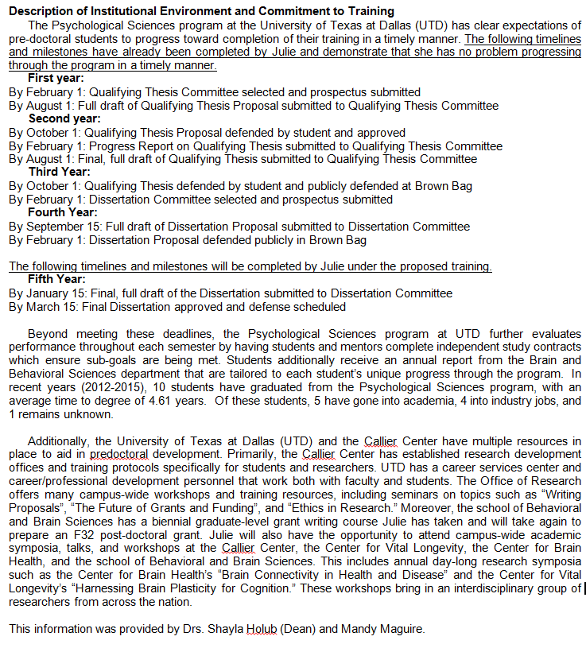
Description of Institutional Environment and Commitment to Training
Sponsoring institution must document a strong, well-established research program related to area of interest
Include names of key faculty members relevant to the candidate’s proposed developmental plan
Facilities and resources that will enhance career
Describe interactions with other investigators
Additional Educational Information
Describe the degree program in which applicant is enrolled
Include name of individual providing this information

Slide 50
Overview of Application Attachments
SF 424 (R&R Form)
Cover Letter
R&R Other Project Information Form
Human Subjects
Inclusion of Minorities/Children
Inclusion of Vertebrate Animals
Project Summary
Project Narrative
Bibliography & References Cited
Facilities & Other Resources
Equipment
R&R Senior/Key Person Profile
Biosketch(es)
PHS Fellowship Supplemental Form
Introduction (if Resubmission)
Fellowship Applicant Section
Doctoral Dissertation and Research Experience
Training Goals and Objectives
Activities Planned Under this Award
Research Training Plan Section
Specific Aims
Research Strategy
Respective Contributions
Selection of Sponsor and Institution
Training in Responsible Conduct of Research
Sponsors, Collaborators, and Consultants
Sponsor and Co-Sponsor Statements
Letters of Support
Description of Institutional Environment and Commitment to Training
Budget Section

Slide 51
Budget Section
Export Review Control Checklist
Allows Office of Research to determine if any aspects of the proposal will require UTD to get control access
Certification Form
Includes budget (as completed by OSP)
Requires signature by PI, Dean, and Program Head

Slide 52
Submission and Review
Peer Review Roles and Meeting Overview
Scientific Review Officer
Analyze the content of each application, and check for completeness.
Document and manage conflicts of interest.
Recruit and assign qualified reviewers
Attend and oversee administrative and regulatory aspects of peer review meetings.
Prepare summary statements for all applications reviewed

Slide 53
Submission and Review
Peer Review Roles and Meeting Overview
Chair
Serves as moderator of the discussion
Also serves as a peer reviewer

Slide 54
Submission and Review
Peer Review Roles and Meeting Overview
Reviewers
Prepare written critique for each assigned application
Assign a numerical score based on review criterion
Make recommendations

Slide 55
Submission and Review
Scoring Criteria
Overall Impact
Scored Review Criteria
Significance
Investigator(s)
Innovation
Approach
Environment
Additionally review aspects of budget, protections, resubmission, etc.

Slide 56
Submission and Review
Scoring
Nine point scale (1=exceptional; 9=poor)
Prior to the meeting, each reviewer gives a separate score for each of the five criteria
Each reviewer gives an overall impact score
These are used in the meeting to determine if they are discussed
If discussed, you are assigned a final impact score (between 10 and 90; high to low impact, respectively) & moves through the recommendation process
Given a summary statement to identify why it was ND (not discussed) & receive scored review criteria from reviewers

Slide 57
Questions?

