Slide 1
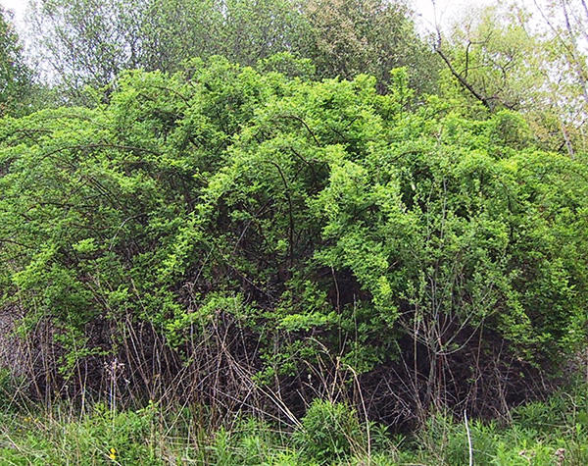
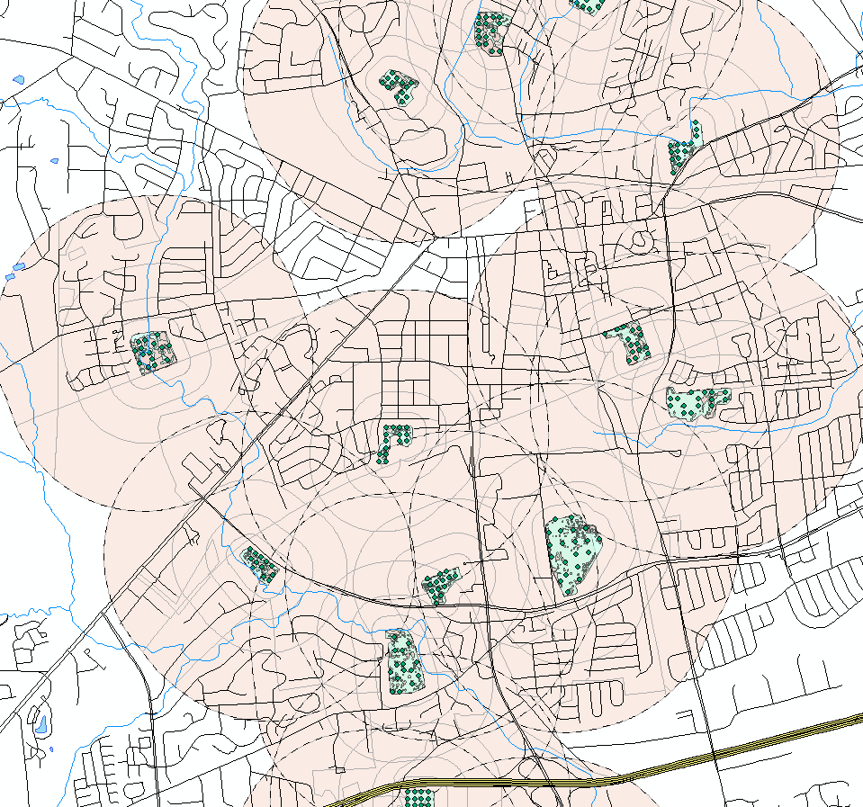
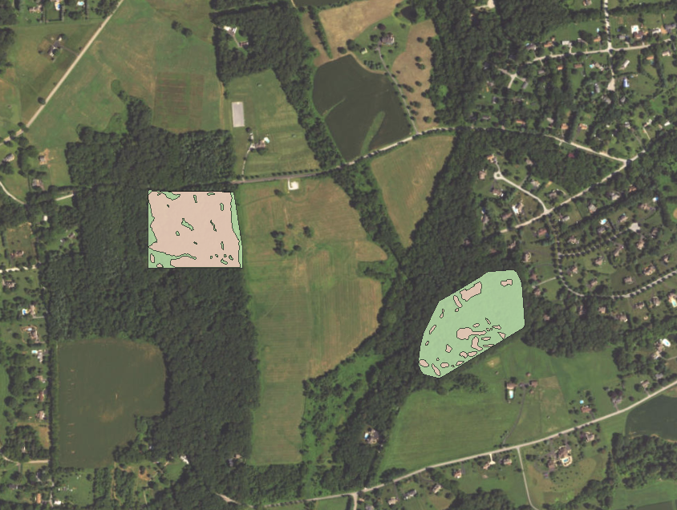
Assessing Urbanization and Plant Invasion Pressures on Forest Fragments
Eric Moore

Slide 2
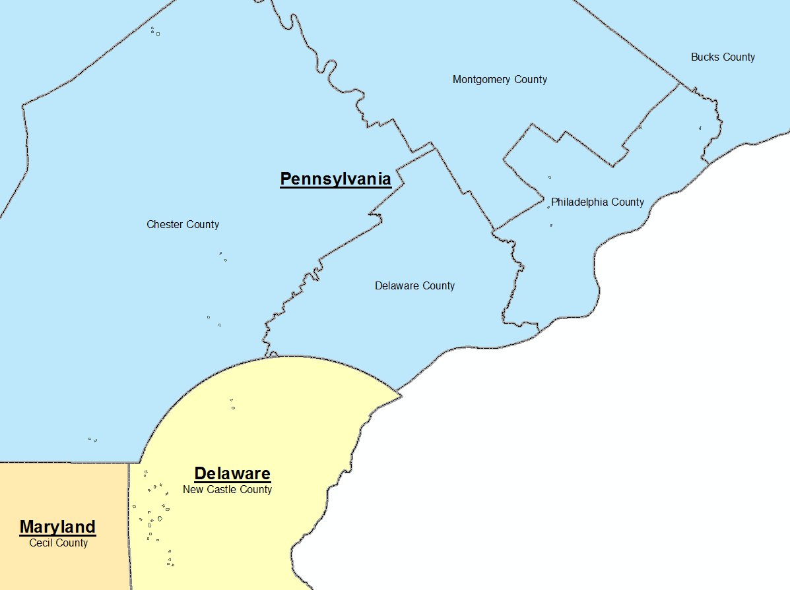
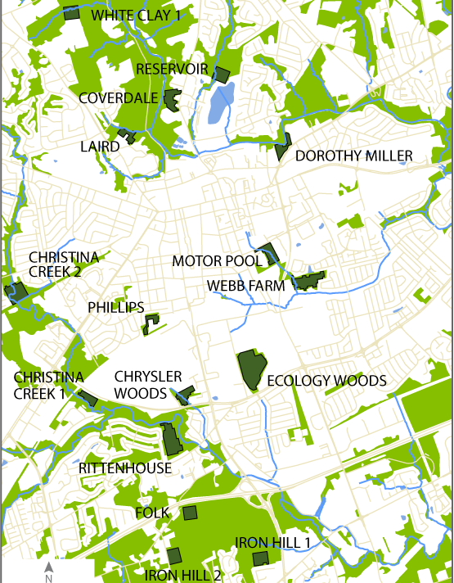
FRAME: Forest Fragments in Managed Ecosystems

Slide 3
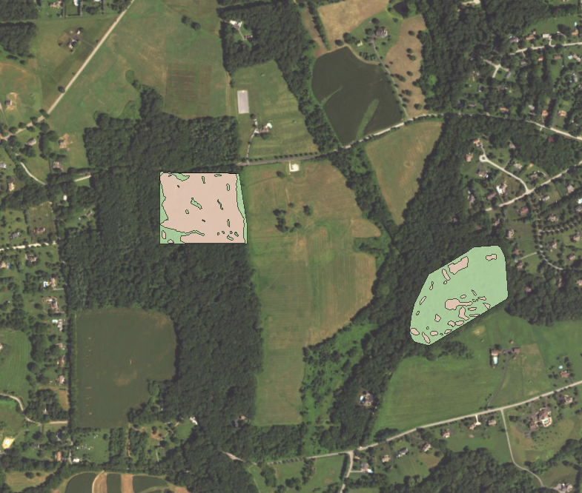
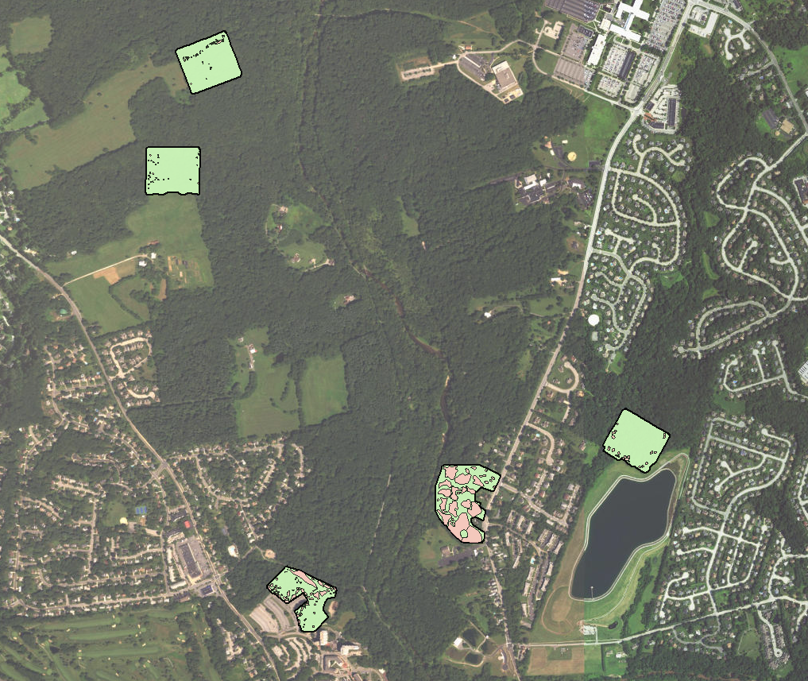
Invasive Plant Cover

Slide 4
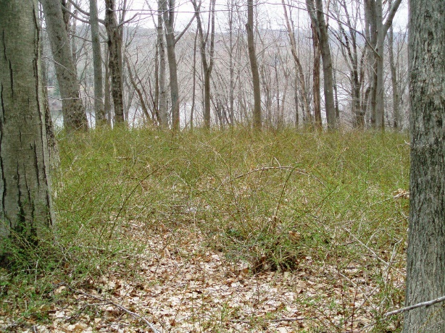
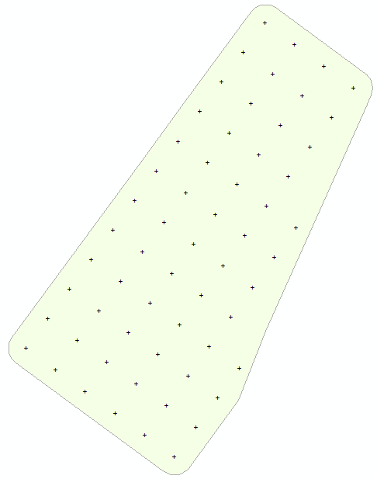

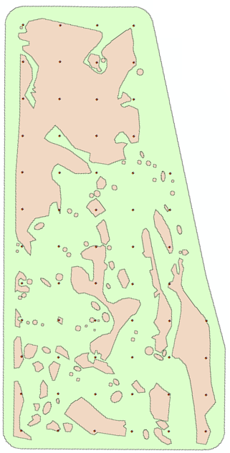
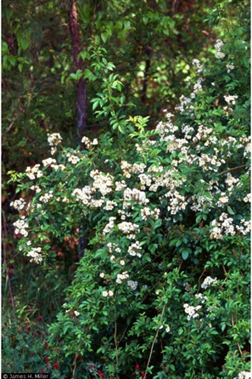
Invasion Gradient

Slide 5

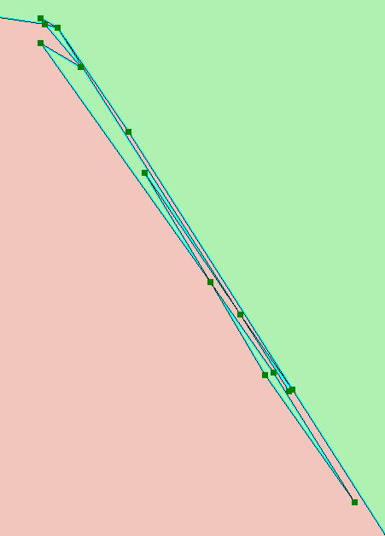
Caution! Problems with Digitizing
Notes:
Topology rules help locate erros

Slide 6
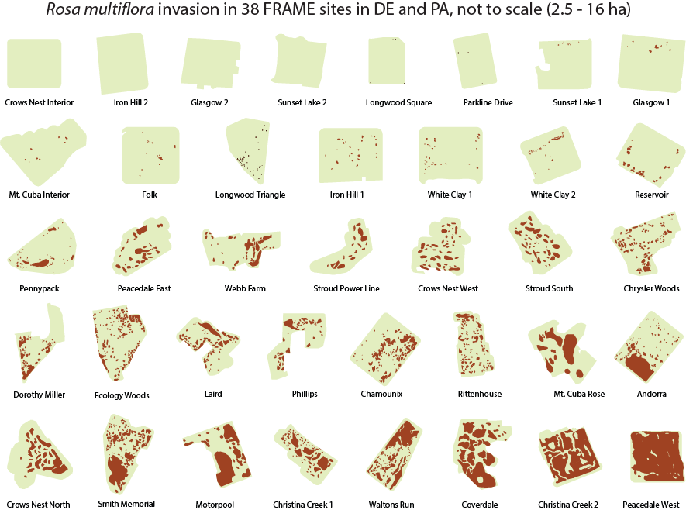

Rosa multiflora invasion in 38 FRAME sites in DE and PA (not to scale; 2.5 – 16 ha)
Notes:
cover of multiflora rose across all of our sites shows there is a gradient of invasion of this dominant invasive shrub

Slide 7
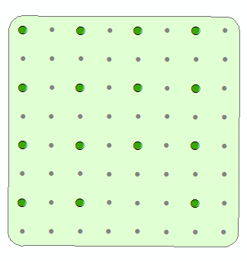
Invasion Gradient
% Rose Cover
Rosa multiflora
75%
Nonnative stems per site
Notes:
Forests may be invaded with other species; total nonnative stem density, which positively correlates with the rose invasion, is used to describe the invasion gradient

Slide 8
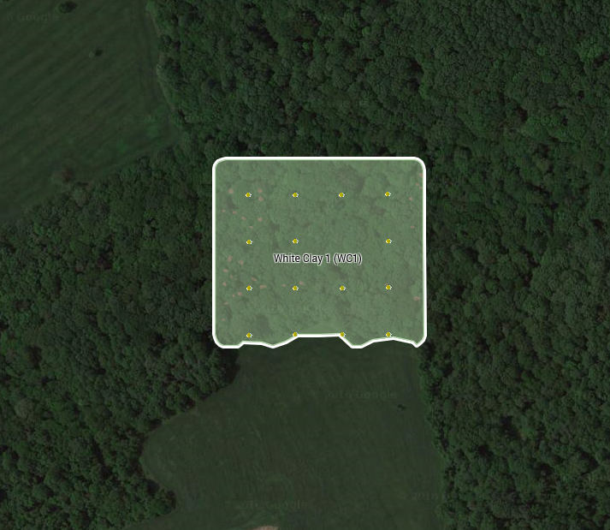
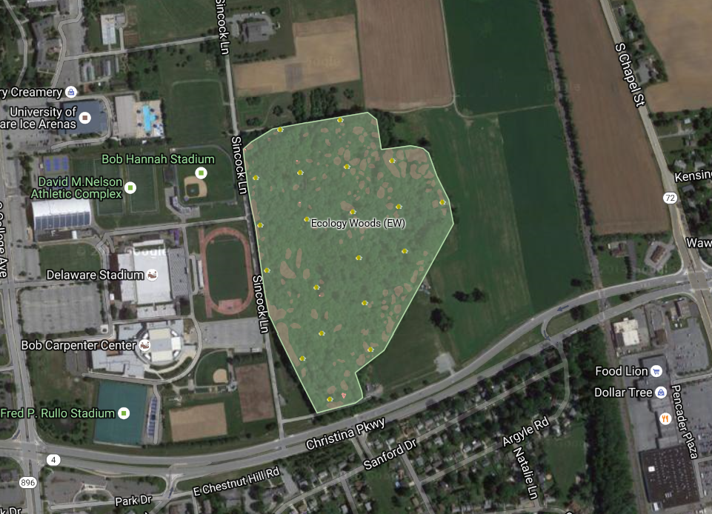
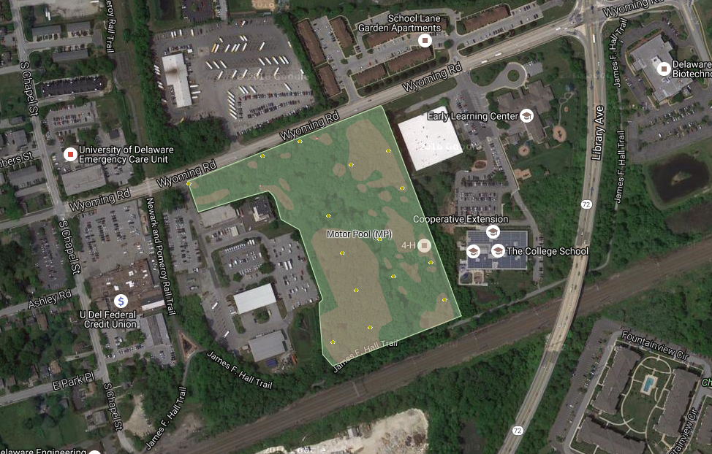
Urban - Rural Context

Slide 9
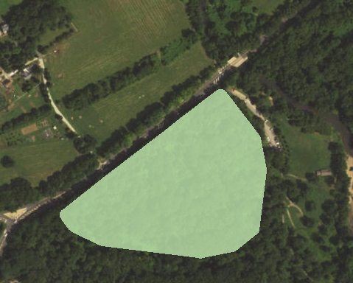
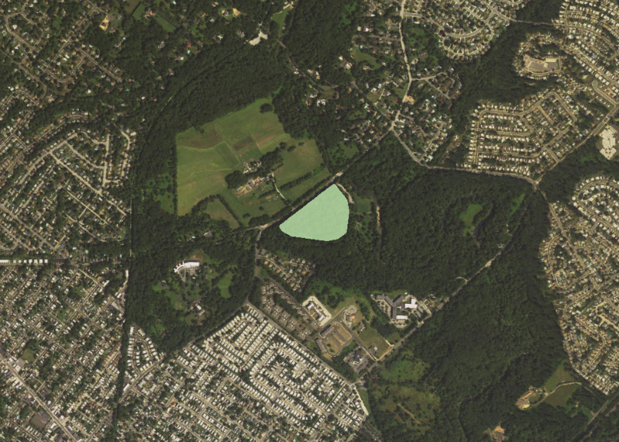
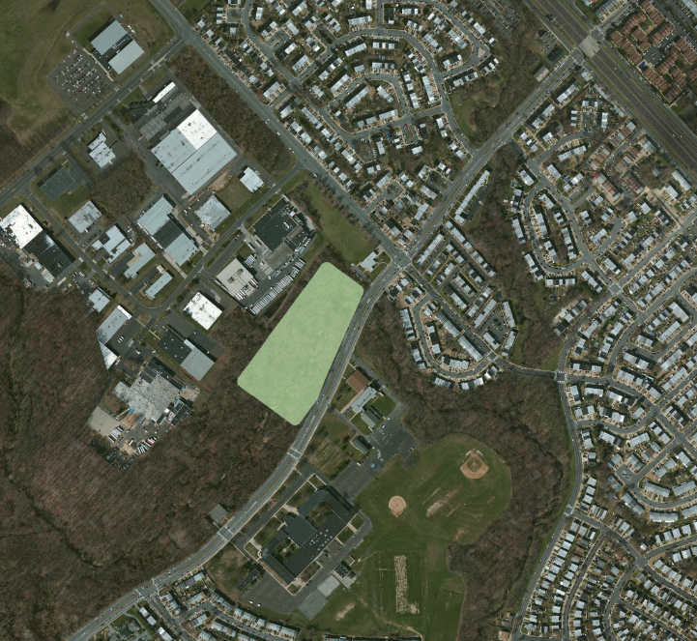
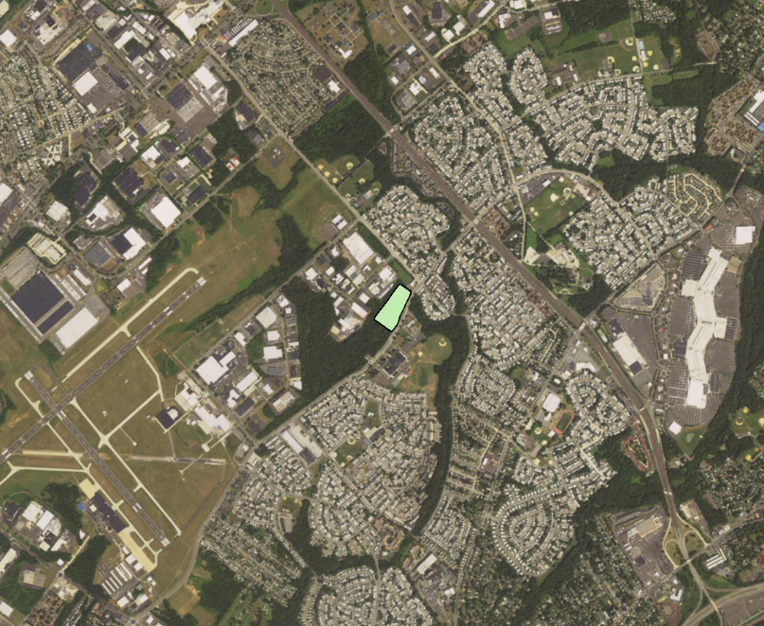
Scale of Urbanization
Small area? Fine scale?
Larger area?

Slide 10

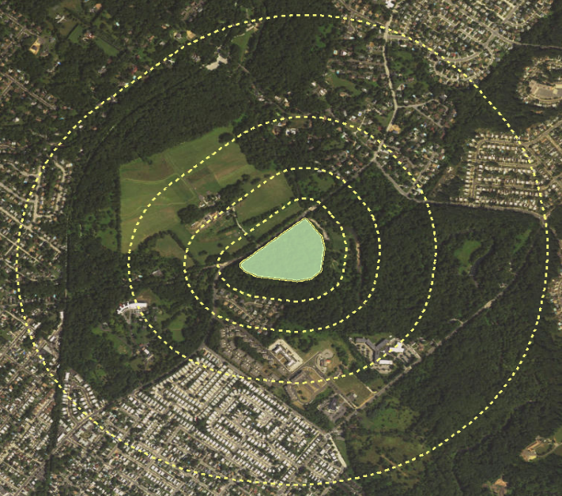

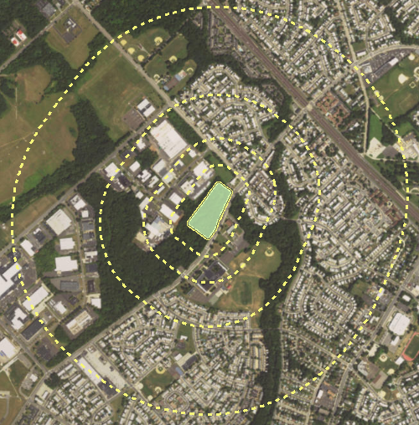
Assessing Urbanization at Multiple Distances

Slide 11
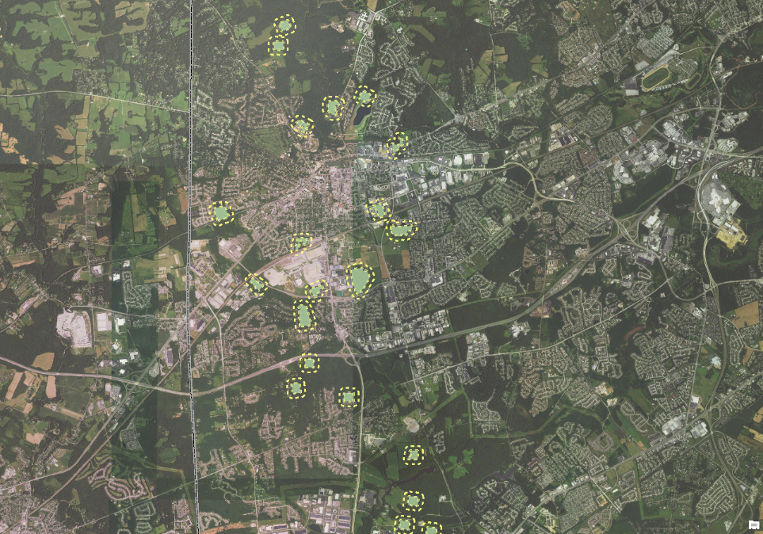
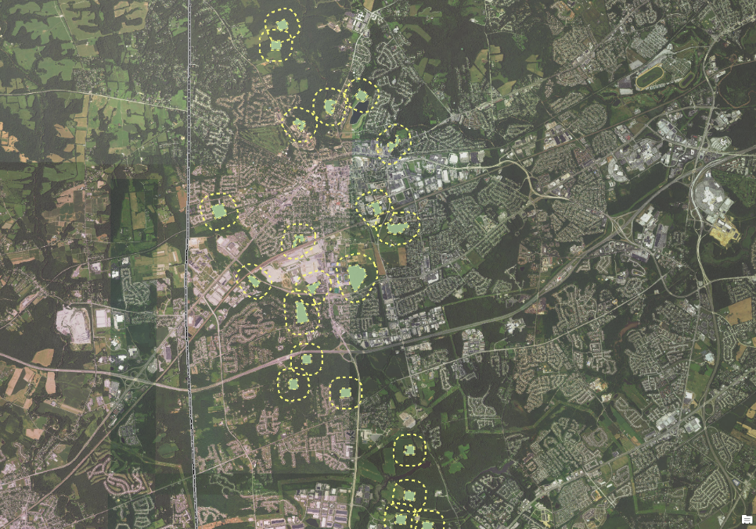
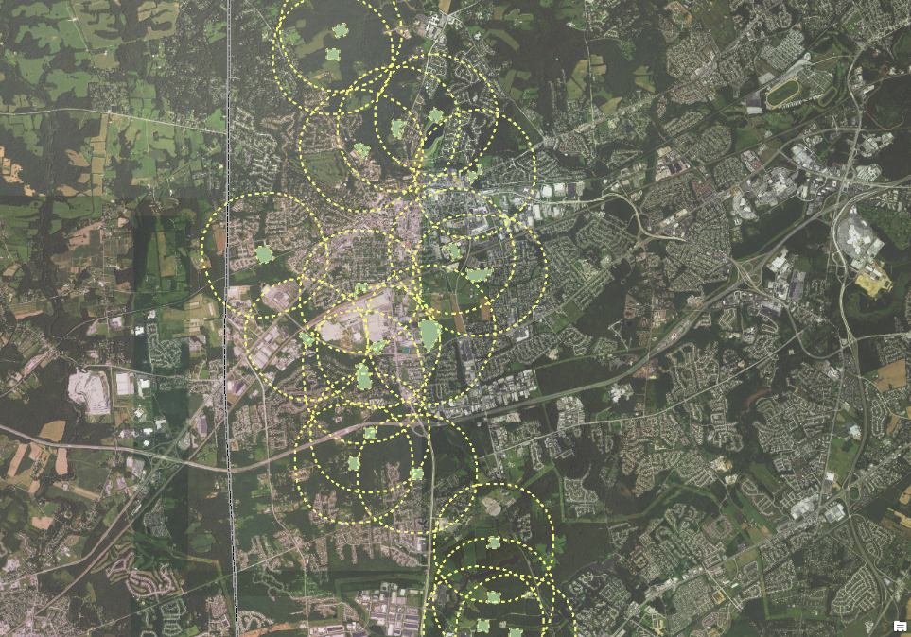
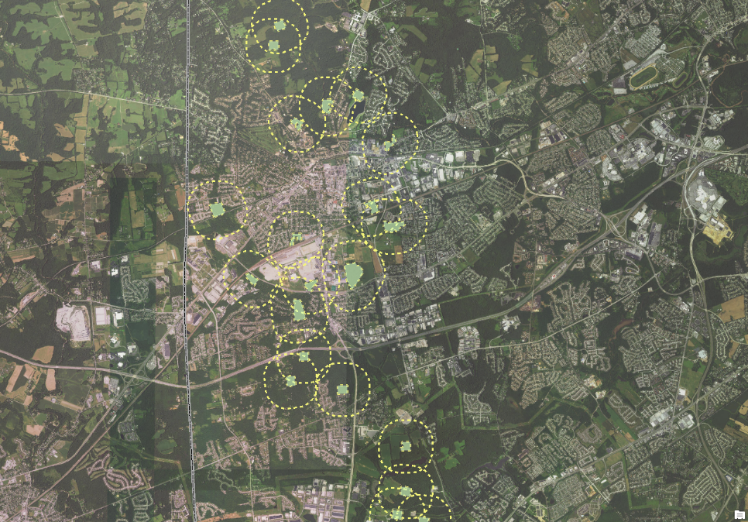
Buffers
100 m
250 m
1000 m
500 m

Slide 12
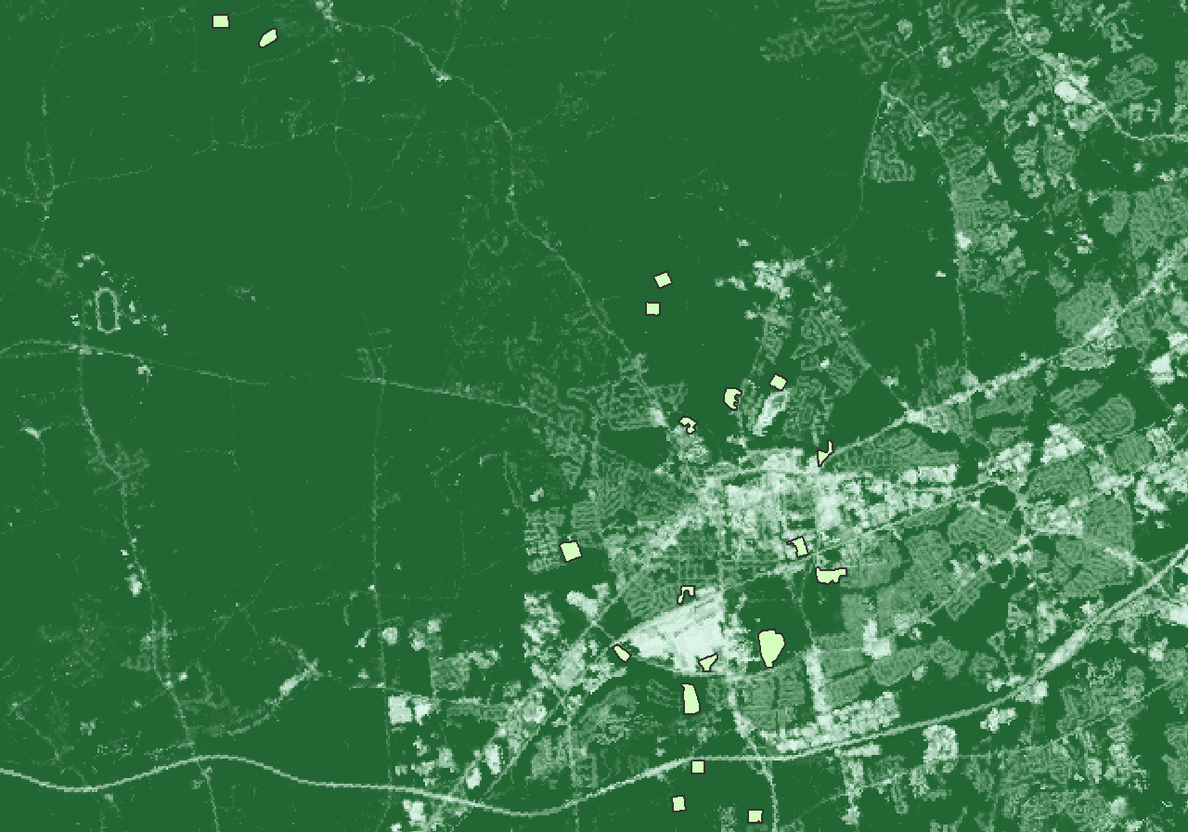
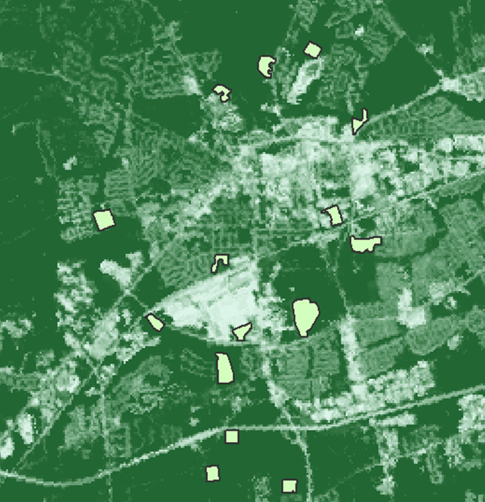
Impervious Surface

Slide 13
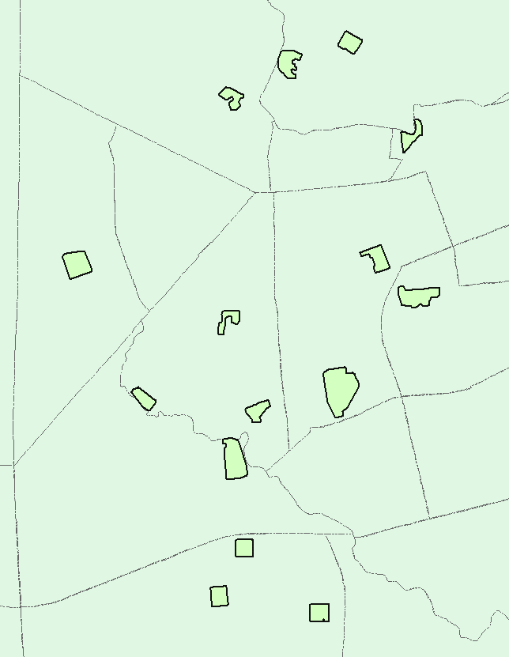
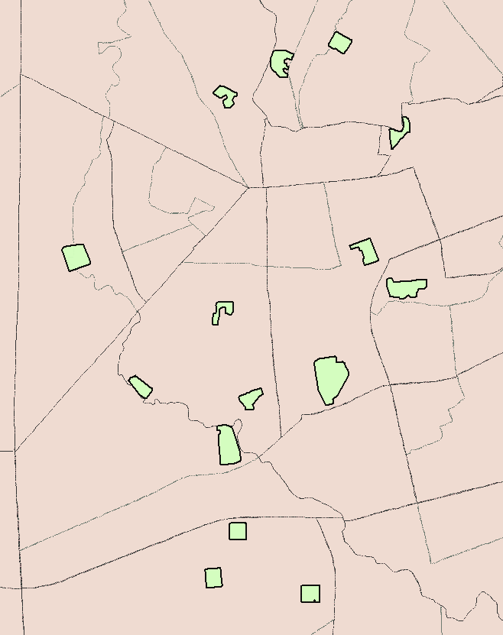
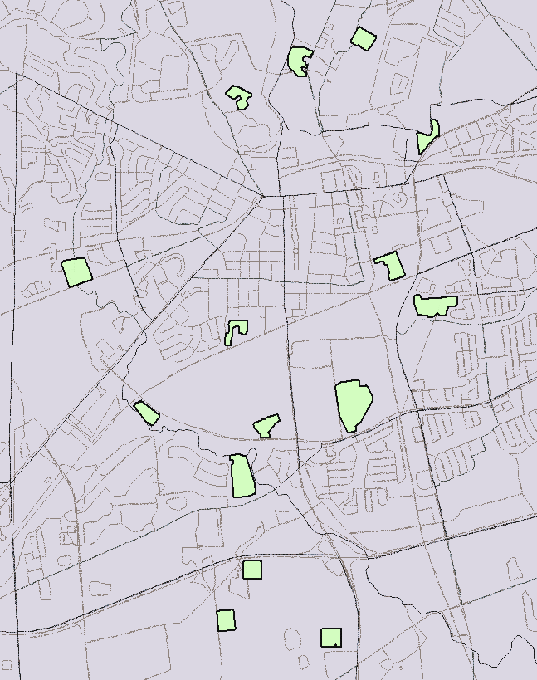
Census Data: Population and Housing
Tract
Block Group
Block

Slide 14
Urbanization Gradient
4
2
0
-2
-4
PCA 1 axis scores
-5.0 to -3.0
-2.9 to 0
0 to +2.9
+3.0 to +7.5
PCA 2: Ag (-), Forest (+)
-4 -2 0 2 4 6 8
PCA 1: Developed LULC (+), Impervious Surface (+),
# Houses (+), Population (+)
Notes:
Urbanization variables (developed land, impervious surface, house, population) are explained by one variable, PCA axis 1. One variable that describes urbanization intensity. PCA analysis which is a multivariate stat data reduction method that converts correlated variables into separate principle components
PCA1 – 55% of the variation; PCA2 – 15% of variation = 70% total

Slide 15
Invasion and Urbanization Gradient
Invasion Gradient
(Nonnative Shrub Stems site⁻¹)
Urban
- +
Invasion
<300
>300
Urbanization Gradient
Developed Land (+), Impervious Surface (+), Houses (+), Population (+)
(PCA 1 Axis Scores)
Notes:
We see sites in red with high U and I or sites in orange with high U but low I
Next step: understand how 2 factors influence system

Slide 16
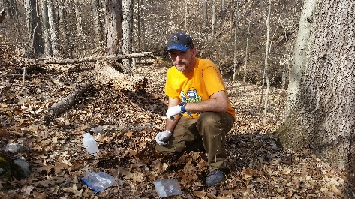


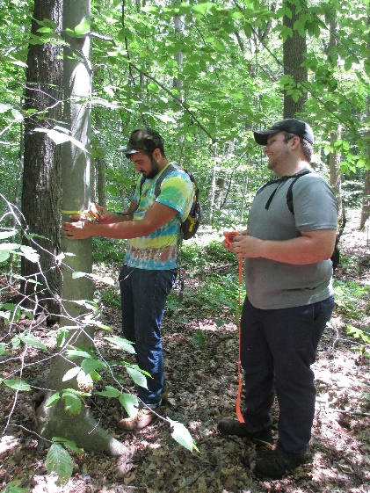
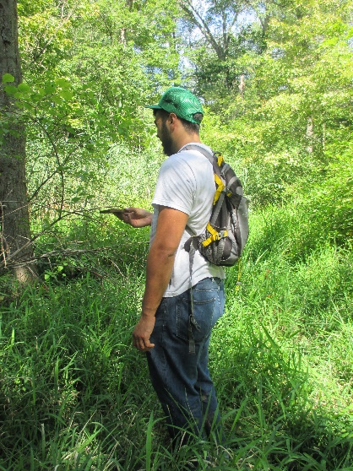
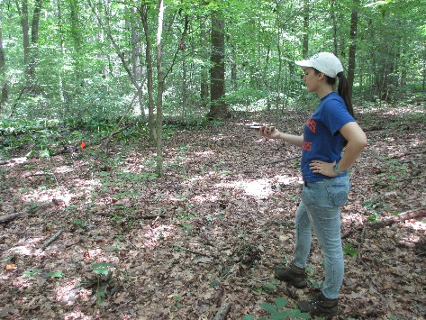

Acknowledgements
FRAME Collaborators:
Vince D’Amico
Greg Shriver
Lab Members:
Carl Rosier, Post-doc
Covel McDermot, PhD student
Eric Moore, PhD student
Field Crew:
Andrew Adams
Matt McDermitt
Nathaly Rodriguez
Philadelphia U.S. Forest Service Field Station:
Sarah Low, Lara Roman, and Jason Henning
Funding:
University of Delaware Research Foundation

Slide 17
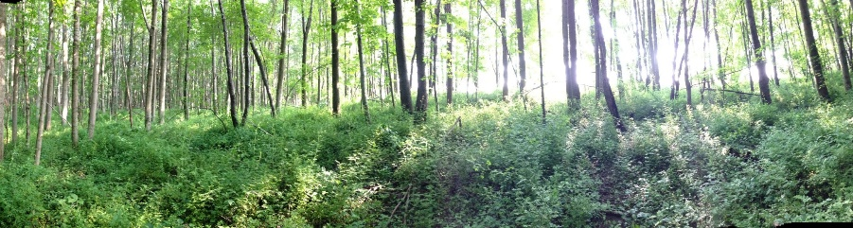
Questions?

