Slide 1



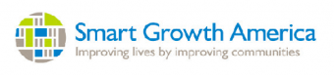
Citilabs’ Sugar Analyst – Measuring Accessibility
Dr. Rusty Lee, Assistant Professor, Civil and Environmental Engineering; Core faculty, Disaster Research center
UD
Citilabs

Slide 2
Accessibility
“the quality of being able to be reached or entered”
But as a quality, can it be measured?

Slide 3
Yes it can be measured…
Sugar Access is an ArcGIS add-in used to score and understand a community’s accessibility to employment opportunities, daily errands, public services, and other points of interest.
Sugar Access should be used to not only measure today’s accessibility, but also for scenario planning, to quickly test and compare proposed changes to your city’s transportation and land-use.

Slide 4
Data Overview
Delaware +15 mile buffer
  74,556 Census Blocks (could also do work at the tax parcel level)
  1,823 Block Groups
  All Census demographic data plus all employment data
    LEHD Origin-Destination Employment Statistics (LODES)
  Complete Highway Network (442,573 segments)
    Functional Classification – Interstates, Other Freeways and Expressways, Arterials, Collectors, Local.
    Data including speed, directional characteristics, etc.
    Travel time for AM peak, Midday, PM Peak and Evening

Slide 5
Complete Delaware transit system
  Routes, stops and schedules
Points of Interest – 21,191
  For gas stations – is diesel sold?
  For restaurants – cuisine served?
  Services available at rest areas
  Etc.
Travel time and POI data obtained by Citilabs’ from Here (formerly NAVTEQ)

Slide 6
POI data includes business names (gas stations, Wawa, etc.) as well as categorical groupings
Custom classes can also be built

Slide 7
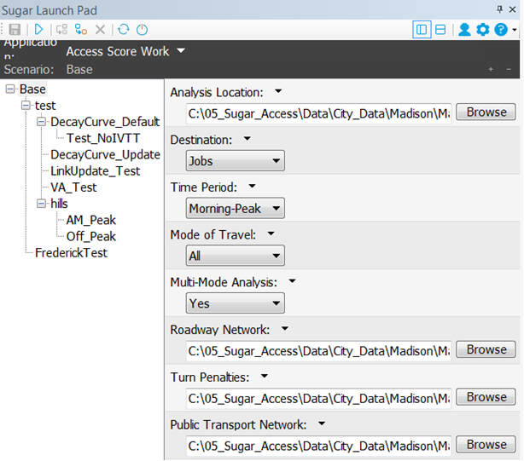
The Sugar Launch Pad
Once you decide on the region to look at and the time of day, building a scenario takes less than 5 minutes.
One limit – 30,000 geographic zones
  ~New Castle County – 10,100 census blocks
  But over 74,000 are in data set
Scenario is launched, runs in the cloud, typical result in about 60 minutes.

Slide 8
Main functions
Access Score - Work
Access Score – Non-work
Open Access Score
POI Summary
Scenario Analyzer

Slide 9
Access Score Work
How many jobs are available from a set of locations at a particular time of day using a particular mode?
All Access scores apply a decay function – Closer POI’s or jobs have more value than those further away
  Decay curve is customizable

Slide 10
For auto jobs, 15 min travel time has a decay factor of 55%; at 30 minutes, its 21%,

Slide 11
Displayed by quartiles

Slide 12
Travel Time Analysis Access to Grocery Stores – by mode
For any location (census block) in New Castle County, what is the minimum travel time to a grocery store by mode
  Auto
  Transit
  Bike
  Ped
Can include in scenario a maximum travel time..

Slide 13
By auto

Slide 14
By Transit

Slide 15
By bike

Slide 16
Walking

Slide 17
Wait a second…what’s wrong with these pictures…
The bike and pedestrian analyses showed New Castle County is quite bike and ped accessible
The road network assumes everything not classified as an interstate, freeway or expressway is bike and pedestrian accessible
  Doesn’t matter if there are bike facilities, sidewalks, speed of adjacent traffic, etc.
Bikes
Pedestrians

Slide 18
Obtained a limited data set and 90 day license to decide if it was worth investment
Decision made to purchase 1 year license and the associate data and continue evaluation
Issue of Bike and pedestrian accessibility raised with Citilabs and SSTI (State Smart Transportation Initiative at UWM).
Applied for grant from Smart Growth America and the Governor’s Institute On Community Design
“We in Delaware want to ensure that our streets are walkable and accessible for people of all abilities…”

Slide 19
Grant awarded in August 2017
Forming a Technical Advisory Committee to guide the work
Grant to fund beta version using best measures of bike and pedestrian accessibility.
  Allow a state or local agency to decide the measures they like best
    Example – Bike stress levels, Peter Furth, Northeastern University
  Easy connection to Sugar Access and its Network Editor to look at current accessibility and impact of future projects..
DelDOT funding additional work to include ADA accessibility

Slide 20
When a realistic pedestrian network is completed, new studies will ensure that bus stops are accessible.
Can also look at walkability for schools
When a realistic bike network is completed, new studies will show increases in access from new or proposed projects
Can use the Network editor to look at changes to the current bus routes

Slide 21
Questions? elee@udel.edu

