Slide 1
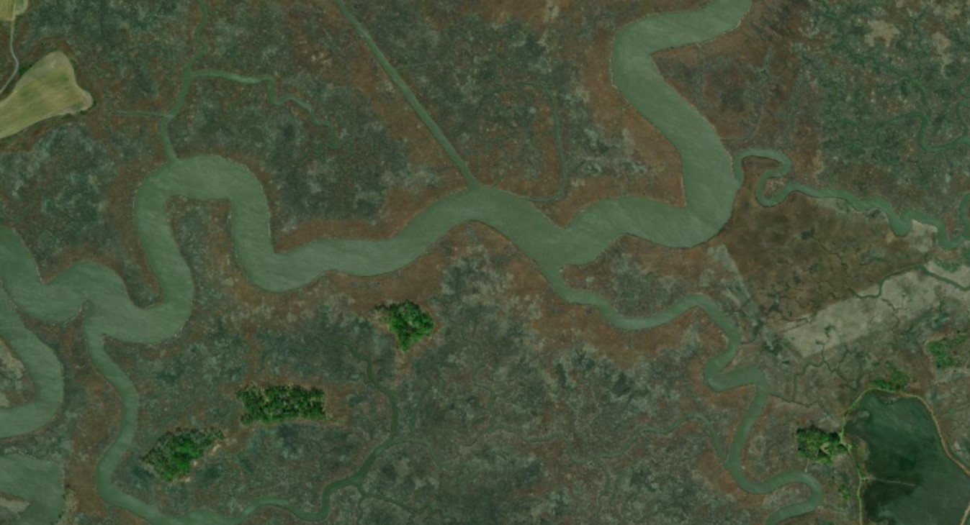
Spatial patterns of carbon storage in Delaware coastal wetlands
Daniel L Warner, Ph.D. Co-PIs: John Callahan, Ph.D., Tom McKenna, Ph.D.

Slide 2
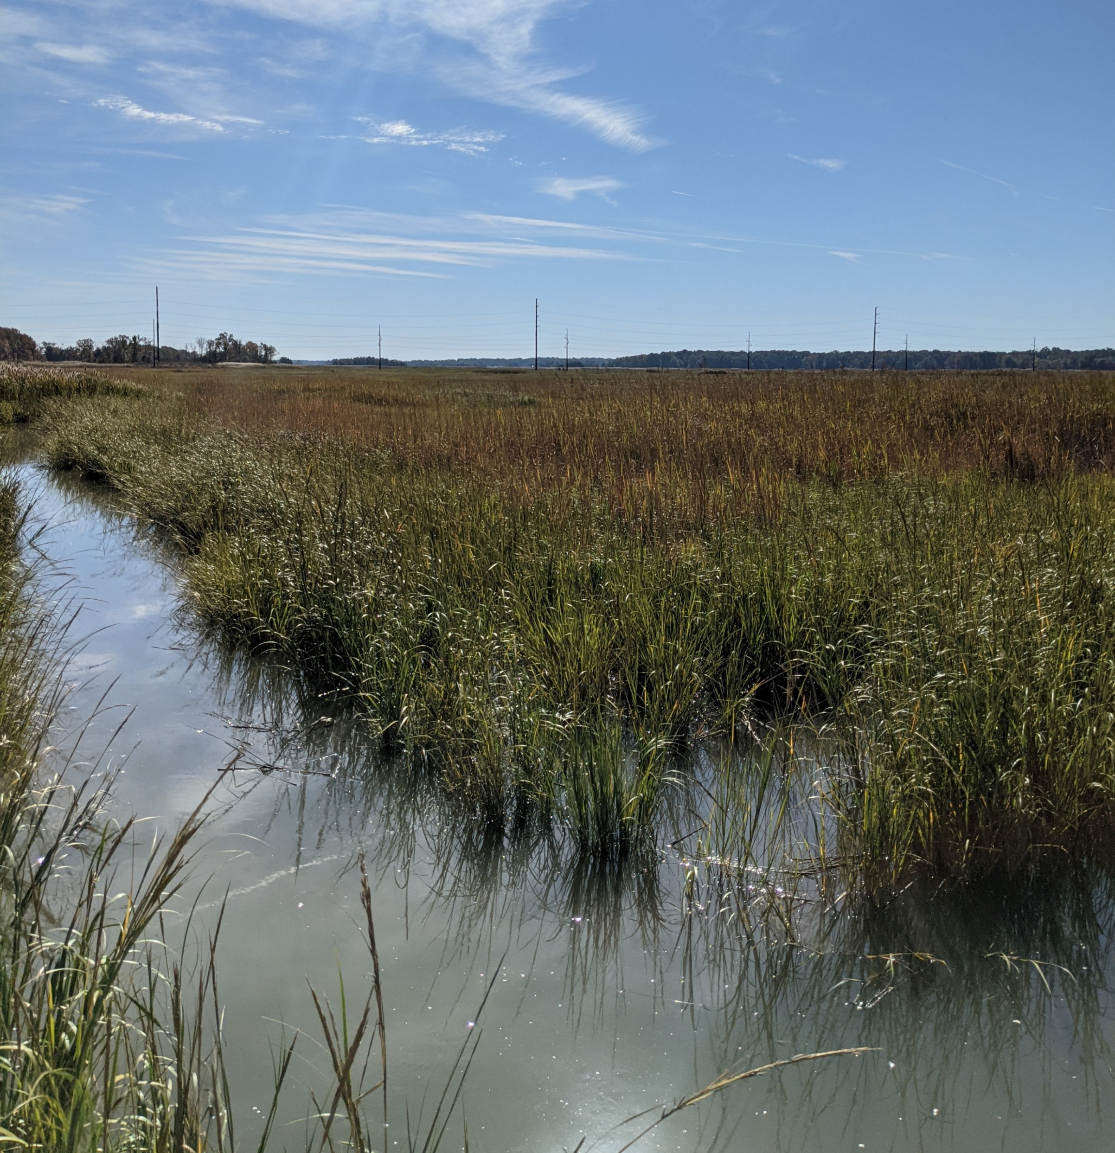
Blue Carbon
Coastal wetlands accumulate and store carbon at much higher levels than other ecosystems
High plant productivity + slow decomposition
Storage is difficult to estimate
Variable sediment thickness
Storage varies in space and vertically

Slide 3
Spatial variability in marshes
Hydrology: variable flow paths and flooding patterns
Vegetation: different species and growth forms
Chemical/Sediment inputs: what is coming from upstream and what is coming from the tides?

Slide 4
Questions
Can we map carbon storage across marsh ecosystems using GIS?
What variables/data sources are useful?
How much carbon is stored in Blackbird and St. Jones marshes?

Slide 5
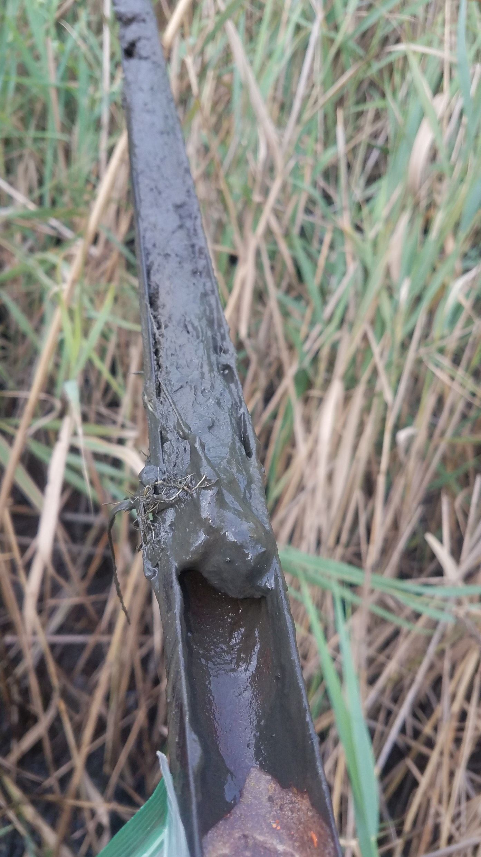
Carbon data
Sediment cores collected with hand augers
DNERR set – mostly near major channels
DGS set – mostly interior and marsh fringe
Organic matter content measured via loss-on-ignition (LOI)
Carbon content via CNS elemental analysis
Bulk density based on core volume and dry weight

Slide 6
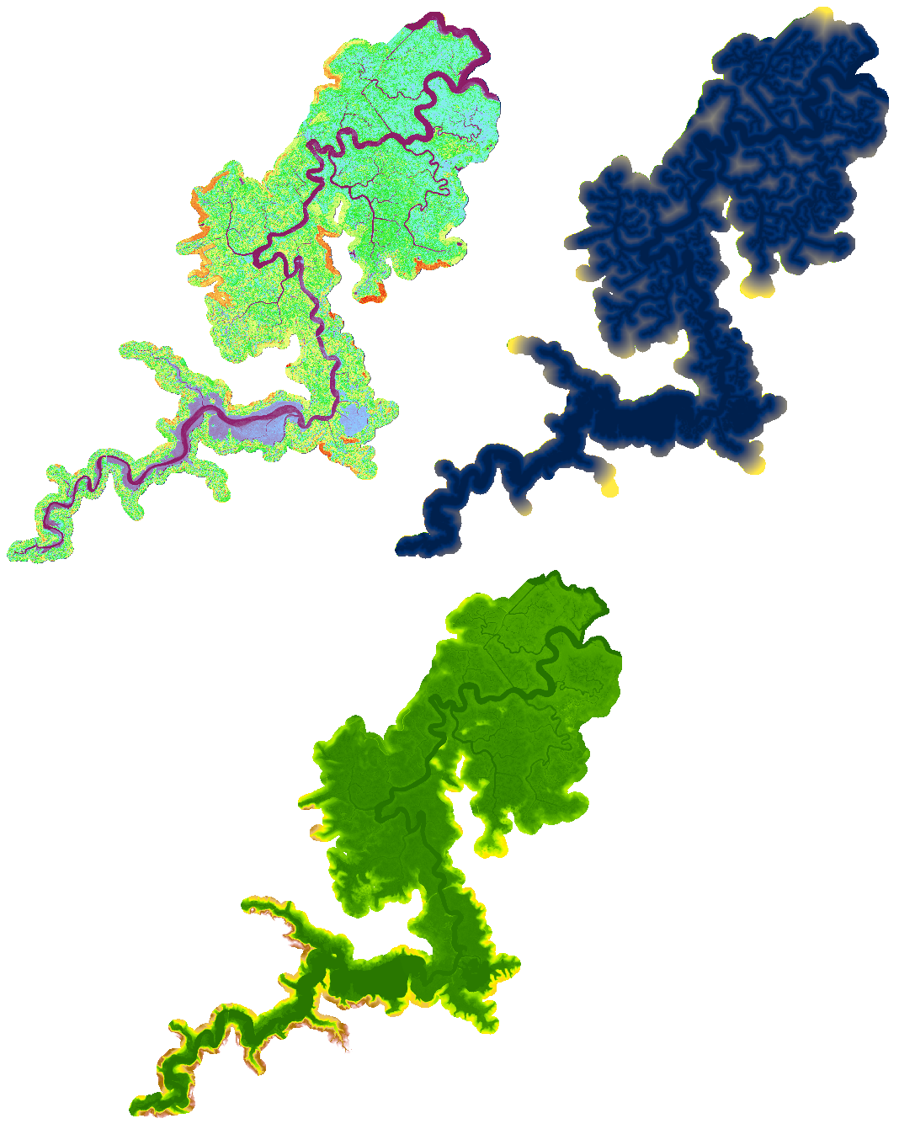
Spatial data
Many variables considered
Terrain: Elevation, slope, ruggedness, detrended DEM, Euclidean distance to channel
Vegetation: NAIP data – NDVI, GCI, and SIPI
Final Predictors:
Elevation
Euclidean distance to channel
NDVI

Slide 7
Modeling
All soil cores had GPS coordinates associated
Spatial data extracted at each core location
Models examined for fitting spatial variables to observations of organic matter density (OMd kg m⁻²) in upper 30 cm of marsh
General linear model
Random Forests
K-Nearest Neighbors
Neural Network
Final predictors were chosen based on contribution to preliminary model performance and limited autocorrelation

Slide 8
Final Model
Final model selected was multiple linear regression
MAE: 6.1 kg m⁻²
R²: 0.28
Random Forest performed slightly better but was heavily weighted towards the Euclidean distance predictor
Strange artifacts in extrapolated maps
Carbon density estimated based on observed % Carbon in organic matter

Slide 9
Extrapolating models

Slide 10
Key findings
We estimate that Blackbird and St. Jones marsh store 70 and 79 gigagrams (1000 metric tons) of organic carbon in the top 30 cm of sediment, respectively
Storage is probably much higher
Difficult to know variability with depth and in sediment thickness
High carbon storage near channels → vulnerability to erosion from boat wakes and tidal waves?

Slide 11
Acknowledgements
Special thanks to the DE Estuarine Research Reserves, DNREC, and City of Dover, who gave us permission to sample on managed lands.

