Slide 1
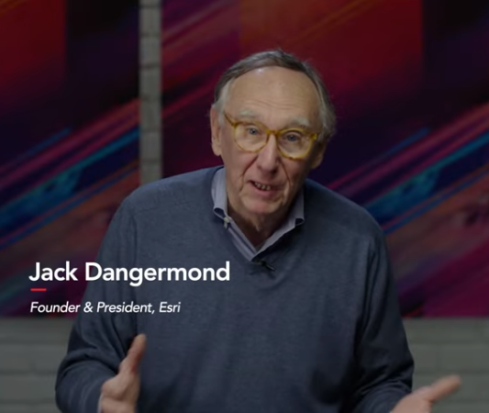
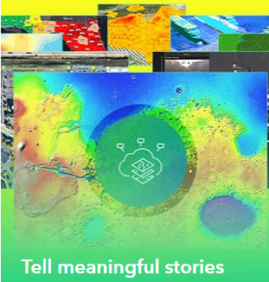
Inspire the world with GIS
Notes:
Miriam Pomillo, State of Delaware
Dr. Tracy Deliberty, UD Geography
Olena Smith, UD IT-RCI

Slide 2
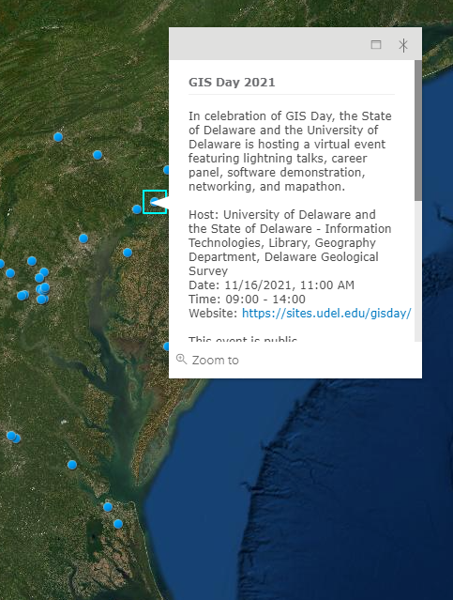
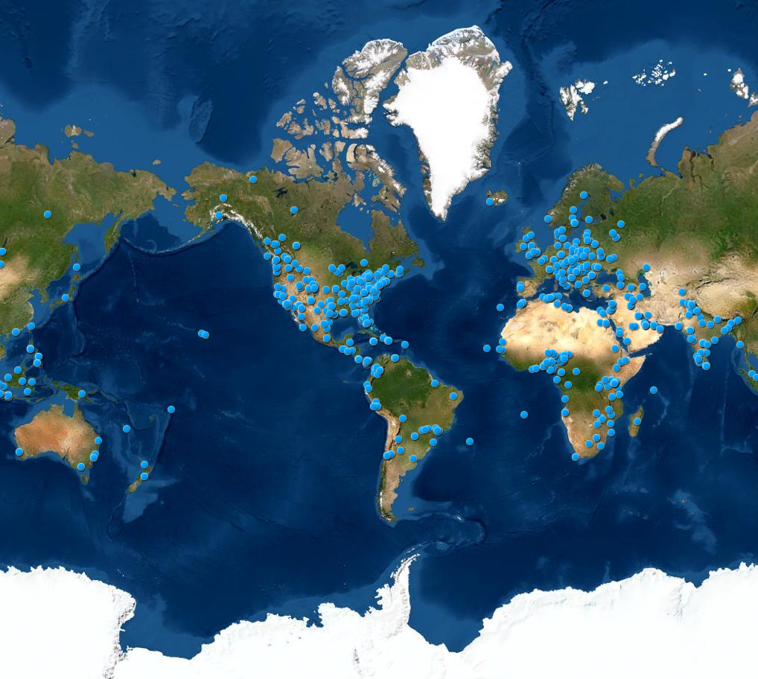
Inspire the world with GIS

Slide 3
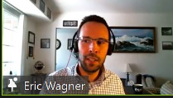
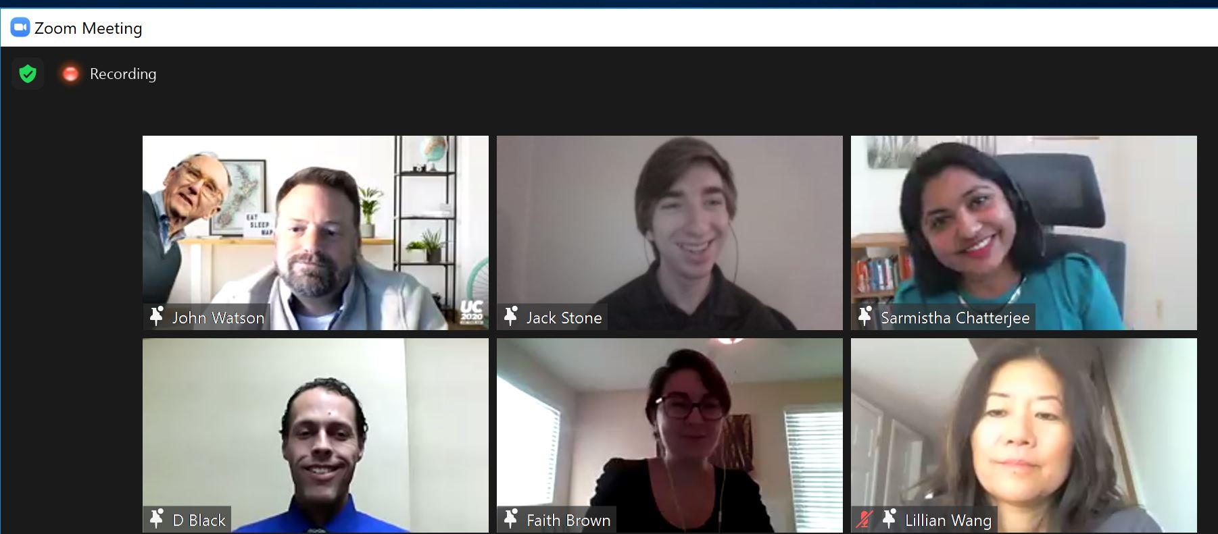
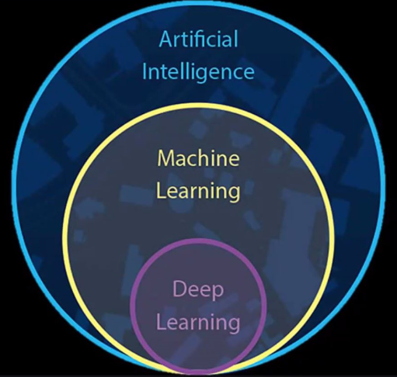
Inspire the world with GIS

Slide 4
Inspire the world with GIS
Thank You!!

