Slide 1
Elle Hammond, DMRC State Coordinator
Ingrid Hansen, DMRC Unit Leader
Celeste Peart, DE BEST Leader
2020 September

Slide 2
Agenda
1) Welcome
2) COVID-19 Update
3) DMRC/ DE BEST COVID-19 Response Review
4) Hurricane Season
Storm Isaias
Shelter considerations/planning with COVID
5) DE BEST
6) PFA and Self Care
7) Interpreter Corps
8 Fall Flu Clinics/In-service training
9) Volunteer Requirements
10) Volunteer Training opportunities
11) Social Media
Notes:
Count as of 8/28/20 NCC - 566, Kent - 237, Sussex - 245, (total DMRC 1048)
DE BEST - 237, Interpreter Corps -78
approx 425 new volunteers since COVID started

Slide 3
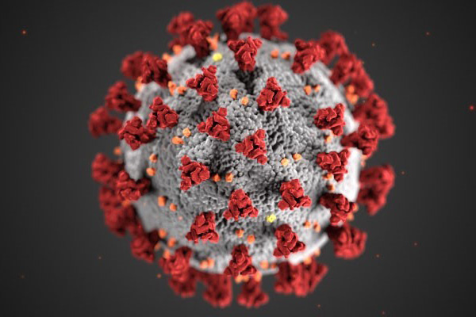
COVID-19
Update
Notes:
Elle will you be doing a quick update?
Current numbers/ lessons l

Slide 4
DMRC and DE BEST
Deployments:
COVID-19 Response
Food Bank Pantries (March - August)
Long Term Care Facility Nursing and CNA Support
Naloxone Drive Thru Point of Dispensing in Millboro
Testing Results Calling
Community COVID-19 Testing
Interpreter Corps Support
Notes:
KEEP THE SLIDES SIMPLE..
Food Bank Pantries (March - August)
DMRC First Aid Stations - 23 shifts, 117 hours
DE BEST Support at Food Banks - 65 shifts 260 hours
Total number of people served at supported pantries- 20,376
Long Term Care Facility Nursing and CNA Support
DMRC support - 23 shifts, 207 hours
Naloxone Drive Thru Point of Dispensing in Millboro
DMRC Support - 8 shifts, 40 hours
Testing Results Calling
DMRC Support - 7 shifts, 28 hours
Community COVID-19 Testing
Milford Perdue Plant
DMRC - 30 shifts, 36 hours
DE BEST- 6 Shifts, 35 hours
Wilmington High Rise Testing - 6 locations
DMRC - 95 shifts, 285 hours
DE BEST - 10 shifts, 30 hours
863 tested
First Responder COVID-19 Testing
DMRC - 8 shifts, 28 hours
EPI Interviews at Community Testing in Sussex
DMRC - 11 shifts, 54 hours
New Castle County Community Testing (July & Aug)
DMRC Support -96 shifts, 458 hours
Interpreter Corps Support
Community Testing Site Interpreters - 6 shifts, 34 hours
Interpreter Support at Non-congregate COVID Positive Shelters - 19 shifts, 19 hours

Slide 5
DMRC provided Emergency Shelter Support
Storm Isaias
DMRC and DE BEST
Deployments:
Notes:
Deployment - Storm Isaias
Sheltering Medical Station - Glasgow High School, Newark 3-9 pm
2 DMRC Shelter Nurses - 12 total hours
3 DMRC Shelter Techs - 13.5 total hours
Sheltering Behavioral & Emotional Support
DE BEST Leader and 3 DE BEST - 12 total hours
DISCUSS

Slide 6
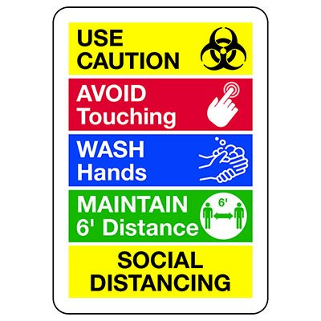
Hurricane
Season
Considerations
Shelter Considerations: Planning with COVID
Notes:
Muriel and Elle

Slide 7
Behavioral and
Emotional
Support
Team
Upcoming
Meeting:
Thursday, Sept 10
6:30 p.m.
www.DelawareBEST.org
Notes:
Quick shout out to the DE BEST volunteers that provided an immediate emergency response for the Hurricane Isaias Shelter in Newark: Tyler Dvorak, Wendy Bailey, and Ray Allen. Each was integral in providing PFA to those community members present at the shelter. Thank you!!! You provided invaluable service and remarkable representation for the DE BEST team!!
RECENT TEAM TRAINING OFFERED SELF-GUIDED and was ONLINE:
Crisis Counseling Program
Crisis Counseling - FULL CCP Training
Crisis Counseling Just-In-Time training
HOPELINE - 1-833-9-HOPEDE ….. *you or someone you know = please share. https://sites.udel.edu/delawaremrc/resources/
Find out more at DE BEST Virtual Meeting: September 10, 6:30 p.m.
COVID-19 has brought changes throughout our society. THE INCREASE IN STRESS/TRAUMA/SUBSTANCE/STATISTIC …. Just think on this for a second, if you will. On a scale of 1 to 10 (10 being the highest), how high is your stress since COVID-19 became a part of our lives? There are many ways that this pandemic has impacted our lives. Now, take a second please, and using CHAT (with FACILITATOR and ALL???),
What are the biggest stressors that COVID-19 has brought into YOUR life?

Slide 8
DE BEST
and
PFA
Psychological First Aid (PFA)
Notes:
We know that EMOTIONAL DISTRESS IS NOT ALWAYS VISIBLE, however life experiences have taught us that they can be just as painful and life-altering. Disaster experiences can bring on exacerbate existing mental health disorders as well as bring negative mental health symptoms to those that have never had them. WHAT ARE SOME SIGNS YOU OR OTHERS MAY SHOW WHEN STRESSED?
Some common stress reactions include: Confusion, Fear, Feelings of hopelessness and helplessness, Sleep problems, physical pain, anxiety, Anger, Grief, Shock, Aggressiveness, Withdrawal, Guilt, Shaken religious faith, Loss of confidence in self or others.
How can we reduce psychological distress and promote recovery immediately after a disaster ??? In the immediate aftermath of a disaster or emergency, Psychological First Aid, or PFA, is used to help reduce the likelihood of this and reduce the possibility of long term impacts. PFA is designed for use by the non-mental health professional while serving in an emergency response role ….. USED as An integral part of disaster response or really any time that people have experienced trauma (help them return to pre-disaster status – not to diagnose or resolve pre-disaster problems)
DE BEST volunteers are required to complete full PFA training. HOWEVER it is recommended that every volunteer have this skill. What comes to mind when I say Psychological First Aid?

Slide 9
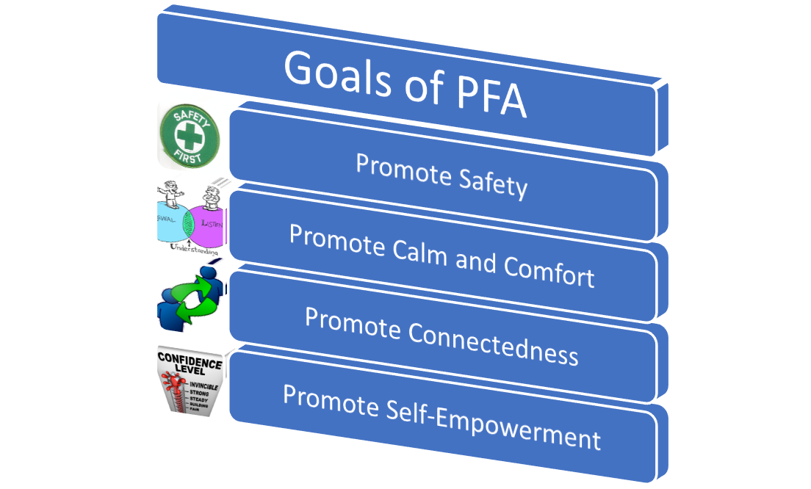
PFA
How to provide PFA: https://www.youtube.com/watch?v=kly45u9ml_A
Notes:
How can we promote these elements in a disaster or post-event setting?
SAFETY: check surroundings are safe, protection from rubber-neckers, basic survival needs, providing accurate information ---- REPEAT yourself as often as needed
CALM/COMFORT: active listening, don’t push for details, surroundings check, RESPECT i.e. culture, individual
CONNECTEDNESS: ASK about needs, help reunite, connect with resources, encourage community supports/support services, make referrals as needed
NOTE: recognize difference between normal response and the need for immediate care/eval - threats or unsafe/dangerous behavior
SELF-EMPOWERMENT: provide/clarify info, encourage they pursue attaining their needs (tell them where to find rather than getting it for them), support their return to normal activities (i.e. exercise, coping mechs, etc.)
7 THEMES
listen: don’t pressure them to talk
comfort them & help them feel calm
Assess needs & concerns
Protect people from further harm
Provide practical care & support
Help with basic needs (food, water, information)
connect them to information, services, social supports
https://www.youtube.com/watch?v=kly45u9ml_A
HOW DO YOU APPROACH PFA??? Say hello, ask a few questions (name, needs/water,blanket), LISTEN (not time to be curious and not time for self-disclosure, rather than sharing about self allow them to share)
DO:: ALWAYS LEAD THEM TOWARD RECONNECTING WITH THEIR OWN SELF-COPING TECHNIQUES - MAYBE FOR THEM IT IS JOURNALING, READING, EXERCISE, WALKING - WHATEVER THEY IDENTIFY AS HAVING WORKED FOR THEM IN PAST.
DON’T::: tell them how to feel/think/react, don’t give empty reassurances --- (you’ll feel better soon, I understand, It could be worse, don’t cry…)

Slide 10
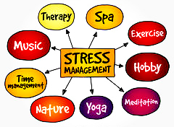
PFA and Self-Care
Notes:
MENTAL HEALTH SYMPTOMS for volunteers include the same symptoms that we naturally expect from those impacted by disasters.Due to disaster response work and conditions: depression, stress symptoms, posttraumatic stress symptoms, suicidal ideation, and a host of other functional and relational conditions have been reported. Responders are at a higher risk for undesired mental health symptoms than the population they serve. Included in the list of rescue workers at greatest risk for the development of ongoing trauma-related symptoms have been those who were volunteers.
CDC STATES: Responding to disasters is both rewarding and challenging work. Sources of stress for emergency responders may include witnessing human suffering, risk of personal harm, intense workloads, life-and-death decisions, and separation from family. Stress prevention and management is critical for responders to stay well and to continue to help in the situation.
Self-care is a concept that self-pursued activities lead to an enhanced quality of life and a sense of fulfillment. It encompasses activities that cater to emotional, physical, spiritual, intellect, social (i.e. familial or relational) needs of your person. self-care practices in the daily lives of disaster responders serves as a safeguard against vicarious traumatization, preventing burnout and compassion fatigue and helping to maintain psychological and physical health.
Thus, the use of self-care practices BEFORE, DURING AND AFTER events is expected to support and cultivate resiliency in disaster responders.
We spoke earlier about some of your coping mechanisms - what daily / or otherwise regularly / practiced self-care activities do you participate in that promote your wellness?
This is by far a quick review of PFA, and there are lots of information, resources and details available online – check our website for links & updates will be coming soon. Keep in mind, as we learned at the beginning of this discussion, that we are directly impacted as well as those we encounter in our response. This brings me to our reminder to prioritize self-care. Can you, using the chat function provide some examples of self-care?? Personal self-care evaluation: On a scale of 1 to 10 (10 being the highest), how much has COVID-19 impacted the amount of time you spend on self-care?????? Using our CHAT feature again, what are some examples of your favorite self-care activities?
BE KIND TO YOURSELF, Self-Care: Escape, Rest, Play
Escape (physically and/or mentally), Rest (no goal or time-line), Play (laugh, creative, physically active)
Nurture your personal worldview … sense of meaning/purpose/hope/life’s perspective
Remind yourself of your worth (the importance of the work you do)
Stay connected with others
Mindful of the “little things”
Mark transitions (experiencing the joy and the losses in life = traditions, rituals, ceremonies)
Take time to reflect
Identify and challenge your cynicism / negative beliefs
Purposefully partake in growth (learn, write, creative, artistic)

Slide 11
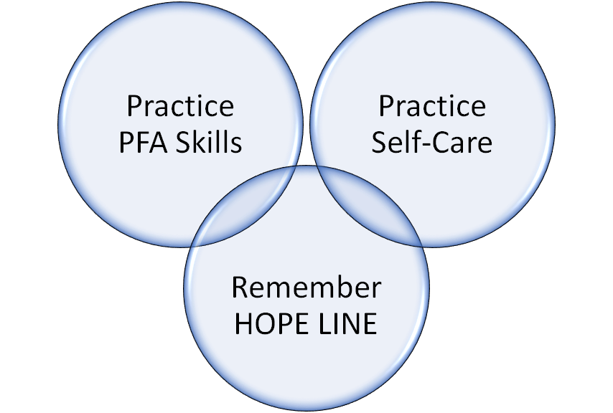
Behavioral and
Emotional
Support
Team
Upcoming
Meeting:
Thursday, Sept 10
6:30 p.m.
www.DelawareBEST.org
Notes:
RESPONDER SELF-CARE
· Create personal and family disaster plans. Planning for potential emergencies at home will help provide peace of mind during deployment.
· Develop a Personal Resiliency Plan or Self-Care Plan. Identifying personal stressors, red flags, and favorite coping strategies in advance will help responders take better care of themselves.
· Practice your Self-Care Plan during day-to-day life. This will make it more likely for self-care to be utilized during response.
· Participate in pre-incident training. The more knowledge acquired before a disaster, the better prepared you will be at the time of deployment.
· Prior to a deployment, always Evaluate your readiness to respond to the disaster. Recognize if your own physical and emotional health status makes you unable to perform the required functions of a specific deployment request.
· Limit your time working alone by trying to work in teams.
· Get support from team members: Develop a Buddy System
REGARDING DISASTER MENTAL HEALTH,,,, PLEASE REMEMBER THESE THREE THINGS:
· PFA can be done by anyone. REMEMBER to: LOOK, LISTEN, and LINK --- PLEASE go to our website for links to trainings or search Google as there are many available online for free
· The best responders are resilient responders. KEEP self-care practices in day-to-day life.
· Stress responses are normal. Please keep the HOPELINE phone and text numbers in your contacts and USE and SHARE this information. Someone is there to talk 24/7
RECENT TEAM TRAINING OFFERED SELF-GUIDED and was ONLINE:
Crisis Counseling Program
Crisis Counseling - FULL CCP Training
Crisis Counseling Just-In-Time training
HOPELINE - 1-833-9-HOPEDE ….. *you or someone you know = please share. https://sites.udel.edu/delawaremrc/resources/
Find out more at DE BEST Virtual Meeting: September 10, 6:30 p.m.

Slide 12
DMRC: What Is Your Specialty?
Delaware Behavioral
and Emotional Support Team (DE BEST)
Stop the Bleed Trainers
Shelter Support Team
Interpreter Corps
Community Naloxone Trainers
Flu Vaccination Support Team
DMRC Advisory Board
Notes:
WELCOME TO THE INTERPRETER CORPS team members --- we are happy to have this team of volunteers that have already provided their valuable services in deployments !!

Slide 13
Welcome !!
DMRC
Interpreter
Corps
Do you know more than one language??
Join the team today !!
Upcoming Interpreting Training:
Sept 21 - Oct 2 (4 hour sessions each)
Online Hybrid
Must Register: www.Delawaremrc.org for Information
Notes:
To help with the mission to create strong, healthy and prepared communities, volunteers support PH & DSAMH in pursuits that combat chronic disease and substance abuse.
DE BEST … Community Outreach … & encouraged to participate in Naloxone Trainings & Distributions
Upcoming Interpreting Training Course ,,, The community Interpreter International
Sept 21 - Oct 2 (4 hour sessions)
Non language specific
Online Hybrid - Live and Self-paced
See www.Delawaremrc.org for more information
Share with friends and family

Slide 14
Flu Vaccination Support Team
Fall Flu Clinics
In-Service Training Required:
Influenza & COVID-19
More information coming soon
...be on the lookout!
Notes:
Northern and Southern Health Services
Firefighter
To help prepare for deployments, volunteers are encouraged to participate in exercises.
EXERCISES both DMRC & DE BEST
2019 Flu Clinics, POD Exercises: Participated in 2 PODs and 50 Flu Clinics: Northern Health Services – 1 POD and 5 Flu Clinics, Southern Health Services – 1 POD and 15 Flu Clinics, Firefighter Flu Clinics – 23, Dept of Correction – 8
DEMA Statewide Mass Care Full Scale exercise on August 2017 – filling roles in the Disaster Recovery Center (DRC) in Milford, and a Volunteer Reception Center site in Newark
Mass Care Exercise at Sussex Central June 2018
3-day Delaware Medical Countermeasures Distribution & Dispensing: RSS Operations Exercise September 2019 --- State Health Operations Center (SHOC) roles could be to assist with the Receive, Store, and Stage (RSS) for the Strategic National Stockpile (SNS), i.e. Point of Dispensing (POD’s)

Slide 15
VOLUNTEER REQUIREMENTS
Volunteer Registration
SERVDE Updates
Waiver
Picture
Background Check Submission
Trainings
Volunteer Responsibilities
Call Down Drill Response
Deployment Request Response
Deployment Preparation
SAVE THIS CONTACT!
Phone: (866) 609-8029 SMS: 24639
Notes:
Waiver
Picture
Background Checks - except those with Active DPR Licence
Trainings ….. Current Required Trainings for all volunteers:
DMRC Orientation
IS 100- Introduction to the Incident Command System
IS 700 - National Incident Management System
Call Down Drill Response
Please select a response when you receive
Note: SERVDE phone communications will come from 1-866-609-8029 and texts will be from #24639.
Deployment Request Response (and training requests)
Deployment Preparation
Be prepared- Family Preparedness Plan, Emergency Supply kit
Do not self deploy, those assigned will be notified
Time log and Activity log form

Slide 16
VOLUNTEER TRAINING OPPORTUNITIES
Specialty Team Trainings
Quarterly DMRC Trainings
Online Trainings with Partners
MRC, DE TRAIN, FEMA, DLC
Trainings/Drills/Exercises with DPH and
Partner Organizations
…. and more !
www.DelawareMRC.org
Notes:
INGRID NOTES:
Specialty Teams (DE BEST, Interpreter Corps)
Team Specific Training - You will be notified when trainings are conducted if you are a part of that team.
Quarterly DMRC Trainings
Trainings will be announced
Other Trainings
Drills and Exercises
Just-in-Time Training
Community Emergency Response Team (CERT)
Independent Trainings
DE Train, MRC Train, Delaware Learning Center,FEMA Emergency Management Institute (EMI), Training links can be found on www.Delawaremrc.org training and resource pages

Slide 17
CONNECT WITH US ON SOCIAL MEDIA
Facebook.com/DelawareMRC
Facebook.com/DelawareBEST
Twitter.com/DelawareMRCorps

Slide 18
DelawareMRC.org
DelawareBEST.org
Elle Hammond, DMRC State Coordinator
302-223-1739
Elle.Hammond@delaware.gov
Ingrid Hansen, DMRC Unit Leader
(302) 831-8368
ingridh@udel.edu
Celeste Peart, DE BEST Leader
(302) 831-6136
cpeart@udel.edu
Bethany Hall-Long, PhD, RN, FAAN, Principal Investigator
Professor of Nursing & DE Lt. Governor

Slide 19
YOU MAKE A DIFFERENCE
Thank you for all you do!!
Notes:
Core Competencies are developed by National MRC to allow for unity of training across units.
This is part of the notion that volunteers need to pre-train in order to respond well and effectively.

Slide 20
DelawareMRC.org
DelawareBEST.org
RESOURCES and LINKS
DMRC Training Page
https://sites.udel.edu/delawaremrc/training/

