Slide 1


Self-Care During a Pandemic
Clifton Berwise, Ph.D.
Vanessa Frierson Freeman, Ph.D
Center for Counseling and Student Development
Click Me!

Slide 2
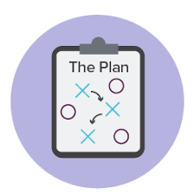
Overview
Coping with Stress
Create a Plan
Why is sleep important?
Sleep Hygiene
Resources

Slide 3

Feeling Overwhelmed?
It is normal to feel less productive and unmotivated during a crisis due to:
  Uncertainty about the future
  Grieving the loss of certain activities, loved ones, freedoms
  Drastic change in how we work and/or attend classes
  And many other reasons

Slide 4

Coping with Stress

Slide 5
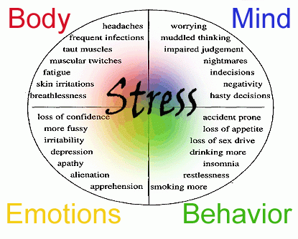

Slide 6

Problematic Coping Strategies
Not sleeping or eating
Procrastinating or avoiding
Pulling all nighters
Substance use/caffeine use
Stress eating
Withdrawing from friends
Ignoring your feelings

Slide 7
Take care of yourself
Get enough sleep
Prioritize and focus
Prioritize the important things
Get support
Family & Friends
Mentors & Spiritual Advisers
Eating well
Hygiene
Regular exercising
Learn to say no
Taking one thing at a time
Be in the present
Professionals
Make time for fun
Do hobbies
Be nice to yourself
Accepting you are human
Celebrating accomplishments
Spend time with loved ones
Do things that ground you and make you smile
Letting go of things you can’t control

Slide 8
LET’S MAKE A PLAN!

Slide 9
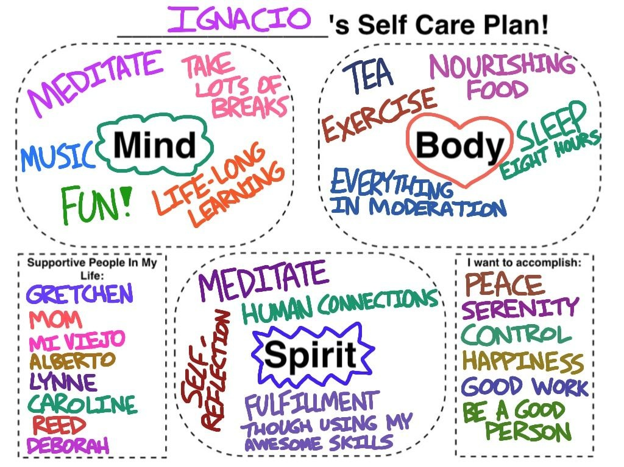

Slide 10

Apps for Meditation
Calm
Mindshift
Stop, Breathe, Think
Headspace
Counseling Center Self-Help Resources https://sites.udel.edu/counseling/resources/

Slide 11
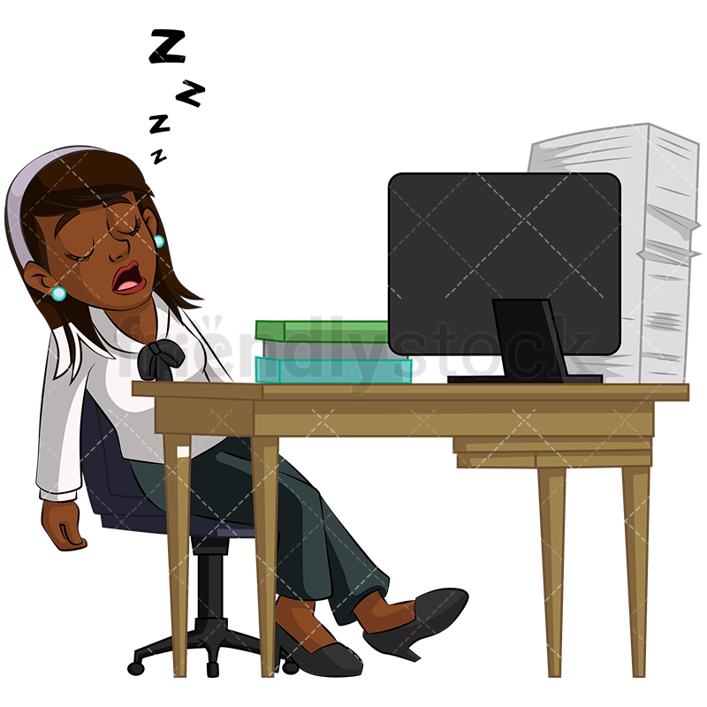
Let’s Talk About Sleep!

Slide 12
Why is Sleep SO Important Now?
Strengthens and Maintains Immune System
Heightens Brain Function
Enhances Mood
Improves Mental Health

Slide 13
What’s Messing up Sleep?
New schedule
Losing track of time/ Lack of time constraints
Stuck in the house/ Low light
Lack of control of immediate environment
Study, Netflix binging, Sleep, etc.. All in bed

Slide 14
What’s Messing up Sleep?
Anxiety/ Worry (e.g., What if I or someone I care about get(s) sick?/ I can’t work, so bills are really adding up)
Family/ Work Stress (e.g., my internet stopped working 10 minutes before the deadline for the test; my little brother won’t leave me alone and I have to finish this paper!)
Screen Time
Social Distancing?

Slide 15


Slide 16
Sleep Hygiene
Environment: light, noise, temperature
  Screen time
Role of napping
Caffeine - sources & effects
Role of exercise
Consistent bed and wake times

Slide 17

Bed is for Sleep
If you are studying or using their electronic devices in bed – you are making it harder for your brain to know when it’s time to go to sleep…

Slide 18
What/when you Eat/Drink Matters!
Healthy Diet
Not too much caffeine (e.g., coffee, tea, soda)
Limit alcohol
Caffeine and Alcohol after 3-5pm disrupt sleep quantity and quality!!

Slide 19


Caffeine is not the friend of sleep
Caffeine hides fatigue temporarily by blocking the natural neurochemical adenosine in your brain.
The caffeine crash is when the built-up adenosine returns to your system as caffeine wears off.

Slide 20
Set a Schedule
Wake the same time 7 days a week
Get in the bed to sleep the same time 7 days a week
Aim to get 6-8 hours of sleep
Reduce moderate to intense exercise within 3 hours of bed time
Wind down at least 1 hour before bed (e.g., casual reading, stretching, listening to relaxing music, take a warm shower)

Slide 21

Powering Down
Power down and turn devices off an hour before bed
Yes, really! It actually works!
If not an hour, at least 30 minutes
This neurochemically clears the head and helps promote sleep

Slide 22
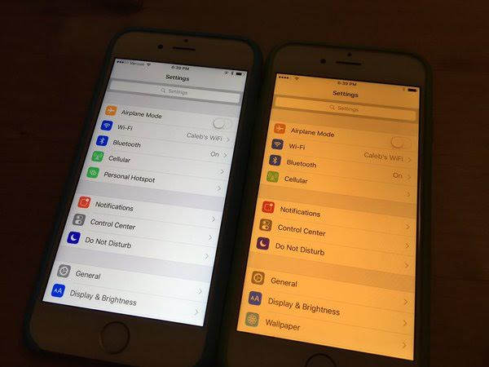
Respect Blue Light
Use a blue light eliminator on ALL electronic devices after dinner (auto-set)

Slide 23

Napping?
Napping is an amazing way to boost brain power – more effective than caffeine!
An early nap for 20-40 minutes works wonders, but should be avoided or reduced after 5pm.
Late naps diminish people’s ability to fall asleep at bedtime

Slide 24

More Sleep Improvement Tips!
Go outside throughout the day/ Open window blinds when possible
Stay Active
Deep breathing
Mindfulness related activities

Slide 25
Sleep Reminders
Set a sleep schedule
  Wake up the same time every day (including weekends)
Use your bed just to sleep
Watch what you eat/ drink and know what alcohol/caffeine can do late in the day
Wind down and power down those devices

Slide 26
The 24/7/365
UD Helpline.
Here for you whenever you need it.

Slide 27

Center for Counseling and Student Development
Website: https://sites.udel.edu/counseling/
Phone Number: 302-831-2141
Consultations via phone with a therapist

