Slide 1




Recruiting and Hiring for Faculty Excellence
UD ADVANCE: Mellissa Gordon, College of Education and Human Development
Heather Doty, College of Engineering
October 8, 2018
UD-NSF ADVANCE Institutional Transformation Cooperative Agreement
www.udel.edu/advance
NSF ADVANCE PAID 081993 and ADVANCE-IT HRD 1409472
Notes:
MG

Slide 2
Agenda
Background
Deepening the pool
Better searches by design
  Reducing the effect of blinds spots and hidden biases & improving the search process.
Avoiding the slippery slope
Interviews
After the search
Notes:
MG

Slide 3
Education & Human Development – 61% Female
Notes:
JJ

Slide 4


NSF ADVANCE: Institutional Transformation
…to increase the representation and advancement of women and other under-represented groups in faculty careers.
…to address various aspects of academic culture and institutional structure to improve the climate for all faculty.
NSF ADVANCE-IT HRD 1409472
Notes:
JJ
Who we are and our collaborative work…
ADVANCE is a data driven program to effect change.
Clear and convincing data reports are useful for driving change
2014 UD got $3.3 mill over 5 years. This official last yr NSF but 1 yr extension and the plan is the Admin will be continuing funding.
A lot of what Advance does is culture that benefits all faculty. This is not diversity training it is best practices based on research on how to recruit best and brightest faculty period!

Slide 5
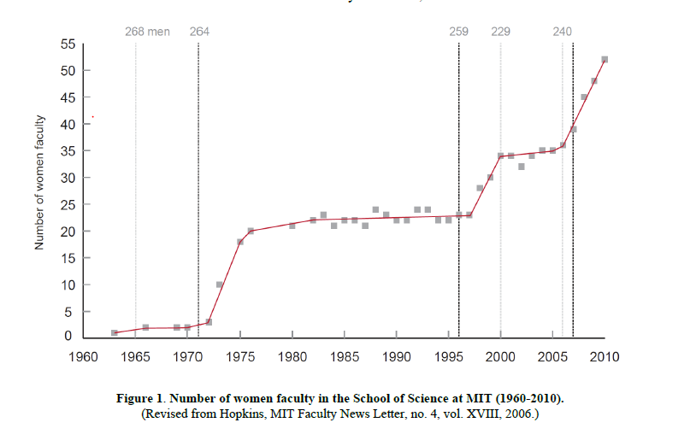
Case Study: Status of Women Science Faculty at MIT
Dean Birgeneau
Notes:
JJ
1970s title 9 govt mandate that more women in workforce. Stopped trying after 1979
In 1990s a female in faculty at MIT despondent that her colleagues, wrote a letter and sent it to dean. Went to all women in school except 1 went to dean (19 signed)
Dean started looking at lab space, course release, became convinced that proactive needed and they did the things we are advocated. Then he left things stalled but after that the realized.
Take away 1. you can make a change if you try. 2. Leadership is critical . It has to be intentional

Slide 6
Lessons Learned from MIT
Leadership is critical.
The dean’s involvement.
YOU as leaders of the search!
Excellence and diversity can go hand in hand.
The women were as qualified as the men; no sacrifice of quality for diversity.
Qualified women & people of color tend to apply at lower rates.
Calling and personally inviting them to apply can make a difference.
Notes:
JJ
Who are leaders here – it’s you!
Targeted calling.
Don’t say we are looking for women to apply. It should be what skills they have to bring that would make them an attractive candidate and fit within.

Slide 7

Initial Recruitment is Critical
When looking for the best candidate, it would not make sense to draw from only half the population.
Notes:
MG

Slide 8
Initial Recruitment is Critical
Smart recruitment means drawing from the whole population.
  Nothing else you do in the
search can make up for
drawing from less than that.
Each committee member should call 3-4 potential candidates to convince them to apply.
Notes:
MG

Slide 9
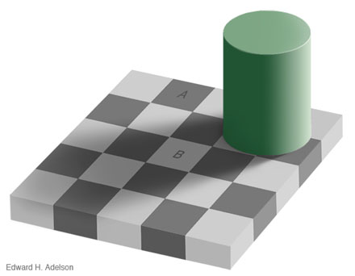
Are These Squares the Same Color?
http://persci.mit.edu/gallery/checkershadow
Notes:
JJ
Are Squares A and B the same color?
You can’t trust your brain even to choose these colors – if your brain has such simplistic shortcuts – be careful

Slide 10
Carla Kaplan:
Talented Quilter
AND
Yale Professor
Blind Spot: Hidden Biases of Good People
Banaji & Greenwald
Notes:
MG
Carla Kaplan Yale professor and quilter –
Boyfriend says take care of her hand because she’s a quilter
Doctor not impressed and yeah, yeah yeah
Med student comes by and says Hi Prof.
Dr changes his approach and works to get the best hand surgeon to work because he now sees her as part of his ingroup his context changes about how she should be treated.

Slide 11
Carla Kaplan, Talented Quilter AND Yale Professor
Blind Spot: Hidden Biases of Good People
Banaji & Greenwald
Only one identity gave her access to a renowned specialist.
Physician’s blind spot: Privileging one identity over another.
Conclusion: Good people’s unconscious assumptions affect both in-group and out-group via hidden discrimination.
  In-group members receive invisible benefits
  Out-group members are disadvantaged
Notes:
MG
Even though this happens. They're design strategies to overcome.

Slide 12
Blind Spots & Hidden Biases
Like the checkerboard example, many biases operate outside of awareness.
“[W]hen we are confronted with empirical data at odds with the way we ‘know’ the world to work… we choose to ignore data or try to fit [it] into our preconceived belief structure.”
David Schwartz. 2017. The Last Man Who Knew Everything: The Life and
Times of Enrico Fermi, Father of the Nuclear Age. Hachette Press
We can introduce design strategies into the search to help circumvent blind spots and hidden biases.
Notes:
MG

Slide 13
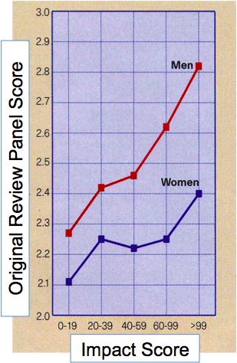
Swedish Medical Research Council Fellowship
Authors …
… observed that 46% of applicants (N=114) but only 20% of the awardees were female.
…acquired access to applications and reviewer scores.
…developed “impact score” based on aspects of applicants’ publications.
… compared applicants’ impact scores to original reviewer scores.
Wenneras and Wold, “Nepotism and Sexism in Peer-Review” Nature, vol. 387, May 1997.
Notes:
JJ
This is one the best empirical evidence that documents implicit bias in an evaluation process. – a REAL APPLICATION
A research has shown that women have to publish much more often than men to compete successfully for scientific jobs in Sweden. This study investigated the evaluation system of Swedish Medical Research Council Postdoc Fellowships.
This study is the first scientific study of sex discrimination in the awarding of a large number of research positions authored by researchers from the University of Goteborg.
To do the study, they had to go to court to use the Swedish freedom of press act to obtain numerical scores that were developed as scientists, in a confidential peer review system, evaluated grant proposals, job applications and publications of other scientists.
Authors found that to earn the same review panel score as a man, a woman had to publish three more papers in one of the most prestigious general science journals (like Nature itself) or 20 more papers in the next level, which would be a top journal in a specific field.
And this problem is occurring in a country that the United Nations has recently said is ''the leading country in the world with respect to equal opportunities for men and women,'' write the authors of the study, ''so it is not too far-fetched to assume that gender-based discrimination may occur elsewhere.'‘

Slide 14
Results:
Women had to be significantly more productive than men in order to receive the same reviewer score.
And for men or women…
Affiliation with a member of the review panel gave a comparable advantage.
Follow-Up Research
The Swedish Research Council did a series of follow-up studies and made adjustments to the evaluation process. The result was a narrowed gap in success rates.
Wenneras and Wold, Nature, vol. 387, May 1997.
Ahlqvist, V, et al. Swedish Research Council Report 2012/13 & 2014/15
Jacobsson, EC Workshop, Brussels, 2017
Notes:
JJ
A research has shown that women have to publish much more often than men to compete successfully for scientific jobs in Sweden. This study investigated the evaluation system of Swedish Medical Research Council Postdoc Fellowships.
This study is the first scientific study of sex discrimination in the awarding of a large number of research positions authored by researchers from the University of Goteborg.
To do the study, they had to go to court to use the Swedish freedom of press act to obtain numerical scores that were developed as scientists, in a confidential peer review system, evaluated grant proposals, job applications and publications of other scientists.
Authors found that to earn the same review panel score as a man, a woman had to publish three more papers in one of the most prestigious general science journals (like Nature itself) or 20 more papers in the next level, which would be a top journal in a specific field.
And this problem is occurring in a country that the United Nations has recently said is ''the leading country in the world with respect to equal opportunities for men and women,'' write the authors of the study, ''so it is not too far-fetched to assume that gender-based discrimination may occur elsewhere.'‘

Slide 15

Better Searches by Design
You can’t ‘de-bias’ people, but you can reduce the influence of bias in processes and environments
Notes:
MG
If you want to know more. Its an easy read but provides ways you can overcome

Slide 16
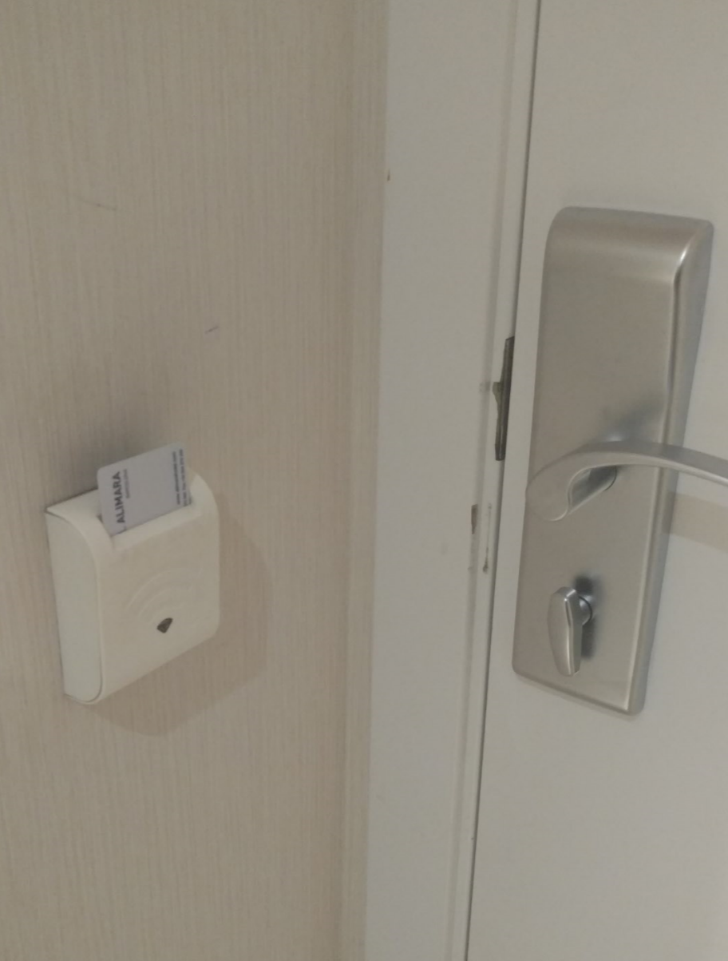
Design
Notes:
MG
We will make you do something even though they would say they care about the environment. We will make you be more thoughtful about conservation.

Slide 17
Design Your Search To Maximize:
Having an excellent and diverse pool of candidates.
Avoid Cloning: Looking for people just like ourselves can limit breadth of perspective
Having and utilizing all information.
Avoid Snap Judgment: Based on limited information
Awareness that the best candidate may not be “like you.”
Avoid Good Fit/Bad Fit: Sometimes a shortcut for how comfortable or culturally at ease one feels
Awareness of each individual’s potential contributions and
competence. Avoid Stereotyping: Characterized by assumptions about competence
Notes:
MG
Shortcuts we often make when judging other people.

Slide 18
Design Strategy 1: Committee Meetings
Assure the committee represents a diversity of faculty and opinions.
Plan meeting times so that all committee members can attend.
Create an AGENDA for each meeting.
Assure everyone gets a say.
- If needed have time limits for items.
Keep a record of decisions through careful minutes.
Refer to the minutes at the start of the next meeting.
Notes:
JJ

Slide 19
Design Strategy 2: Evaluation Tools
  Evaluation is a tiered process.
  - Narrowing the pool; creating short-lists, etc.
  For each part, the search committee should agree on candidate qualifications and evaluation criteria.
  Based on these qualifications and criteria, search committees should create evaluation tools.
  You may need different evaluations tools for different parts of the process.
Notes:
JJ
Red should be done as early as possible in the process. This should guide the choice of candidates.
Conversation should go back to the qualifications and evaluation criteria rather than your affective reactions.

Slide 20
Example Evaluation Tool
Name | Has PhD | Evidence of Research Productivity | Evidence of Teaching Effectiveness | Evidence of Ability to Make Contributions to Departments & UD
Dr. A | Y/N | ✓+ | ✓+ | ✓+
Dr. B | Y/N | ✓- | ✓- | ✓
Dr. C | Y/N | ✓+ | ✓+ | ✓+
Dr. D | Y/N | ✓ | ✓+ | ✓+
If in doubt, keep the person in the pool.
Use more fine-tuned criteria for other stages of the process.
Notes:
JJ
Same criteria for all applicants. You can create your own rubric if you like.
What is a check+ vs. Check-

Slide 21
Design Strategy 3: Optimize Conditions for Evaluation
  Minimize distractions such as exhaustion, hunger, competing activities.
  Distractions increase the probability of defaulting to
  intuitive, often unjustified, conclusions.
  Randomize the order of candidate applications for each reviewer.
  Compare candidates while scoring instead of evaluating them individually.
Notes:
MG

Slide 22
Group Discussion: 10 Minutes
  Script: “A Committee Meeting”
Notes:
MG
Make copies of activities in the dropbox folder “script final 2018 file” page 1 and 2 only. Page 3 is guidelines for what they should get from the activity

Slide 23
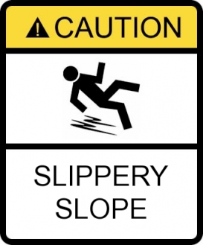
Avoiding the Slippery Slope
    Q: Some people in my committee speak up early
    and assertively, causing others to abandon their
    opinions and fall in line with that individual.
    How can we avoid that?
Notes:
MG

Slide 24
Avoiding the Slippery Slope
    Q: Some people in my committee speak up early
    and assertively, causing others to abandon their
    opinions and fall in line with that individual.
    How can we avoid that?
    A: Each evaluator should write and submit in advance a brief summary and rationale of their evaluation that references previously agreed upon evaluation criteria.
Notes:
MG

Slide 25
Avoiding the Slippery Slope
    Q: I’ve noticed that in some searches the evaluation
    criteria seem to shift. How can that be avoided?
Notes:
MG

Slide 26
Avoiding the Slippery Slope
    Q: I’ve noticed that in some searches the evaluation criteria seem to shift. How can that be avoided?
    A: Verify that you and the committee are evaluating candidates against the criteria you set in advance. Refer back to your criteria.
Notes:
MG

Slide 27
Skype Interviews
Use Skype to go from a “long short list” to a list of candidates for campus interviews.
Some Best Practices for Skype Interviews
Take steps to avoid technical problems.
Do your best to treat each candidate equally.
Have one or two members of the search committee conduct or at least lead all interviews.
Record interviews for others to see
See handout for more suggestions.
Notes:
JJ

Slide 28
Design Strategy 4:
Structure the Interviews – Skype & Campus
Biases can creep in during interviews.
Biases plays less of a role if interviews are structured.
Use your agreed-upon selection criteria to help you structure interview questions.
Time of day matters. Jet or time zones lag may matter.
Notes:
JJ

Slide 29
Interviews
Interviews are not one-way interactions.
Candidates are evaluating your department and UD during their visit.
Make the most of this opportunity! Even if you know early on that a candidate won’t receive an offer, make sure that he or she has a good experience on campus anyway. Word will spread about UD, good or bad.
Notes:
JJ

Slide 30
2011
Notes:
MG

Slide 31
Closing the Deal
You are not finished when you turn over the committee/department recommendation to the chair.
Keep updated on the progress of the offer.
Are things happening in a timely manner?
Support your candidate’s negotiations for success.
Dual career? Start-up? Etc.
If the search does not result in a hire -- keep records and follow up on interesting candidates.
Notes:
MG

Slide 32

Thank you for the gift of your time!
Notes:
MG

Slide 33
Conclusion
We look forward to hearing about your successful search!
Let us know how we can help.
Please hand out ADVANCE materials to candidates.

